Slide 1
Unit 1
Introduction of Economics

Slide 2
Introduction
Economics is the study of how individuals, families, businesses, and societies use limited resources to fulfill their unlimited wants.

Slide 3
Wants Versus Needs
In 1901, people discovered oil in Texas – but they were actually looking for water! Disappointed, they offered to trade the oil for water at a ratio of 1:1 (one barrel of oil for each barrel of water).
Which is a more primary need, oil or water? Why?

Slide 4
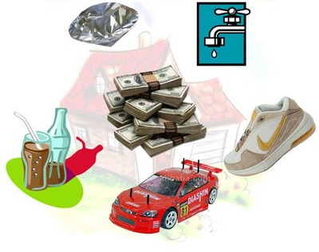
Wants Versus Needs
Wants are anything other than what is needed for basic survival.
Examples?
Needs are things required for basic survival.
Examples?

Slide 5
Choices
Spending decisions involve choices.
Each available choice competes with other available choices.
Businesses, like individuals, must make daily decisions about what to produce, when to produce it, and when to stop producing.
Societies face choices about how to utilize their resources in the production of goods and services.

Slide 7
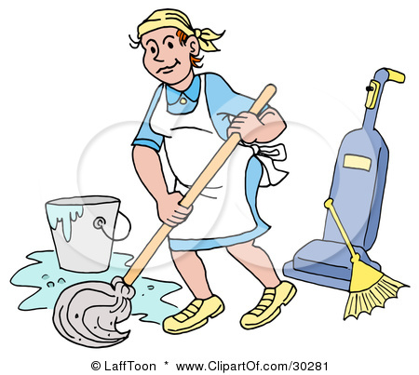
Goods and Services
A good is something you buy and consume. Goods are things that you can keep, eat, or use.
If you go to the store and buy an apple, you get to keep the apple and take it home with you, to it is a good.
A service is something that someone does for you. When you buy a service, you hire people to perform work. You are not buying something you can touch or hold.
If your car is broken, you might hire someone to fix it. You are paying for a service.

Slide 8
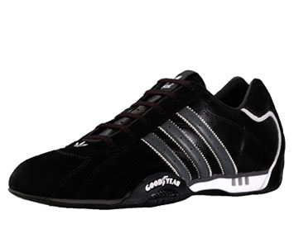
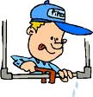
Goods and Services: Let’s Practice
Goods | Services

Slide 9
Read each scenario and tell whether you are purchasing goods or a service.
You get your hair cut.
You buy a book from a garage sale.
You buy your mother a flower from a flower shop.
You hire someone to cut your lawn.
You visit the doctor for a checkup.
You purchase a game to give as a birthday gift.
You pay your sister $5.00 to clean your messy room.
You buy an ice cream cone from an ice cream truck.
You take an airplane when you go on a trip.
Your brother sells you his old baseball mitt for $2.00.
Service
Good
Good
Service
Service
Good
Service
Good
Service
Good

Slide 10
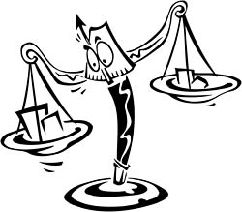
The Problem of Scarcity
All resources are limited.
People compete for limited resources.
Scarcity exists because people cannot satisfy their every want.
Unlike scarcity, shortage are temporary.

Slide 11
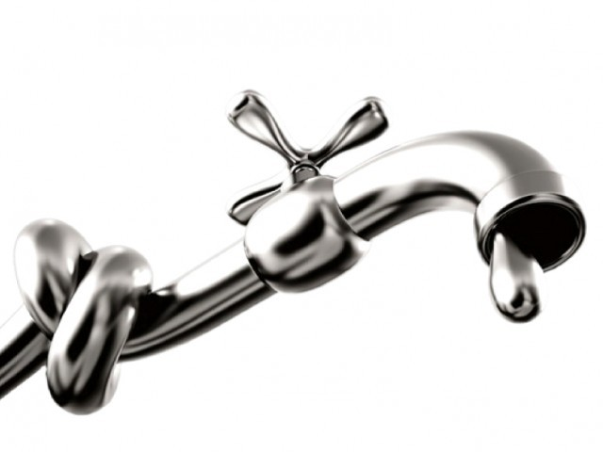
Water competition is growing, how are companies learning to cope?
http://www.cnbc.com/2015/07/24/water-scarcity-is-becoming-a-business-problem.html

Slide 12
What is scarce is this comic?
The fathers time.

Slide 14
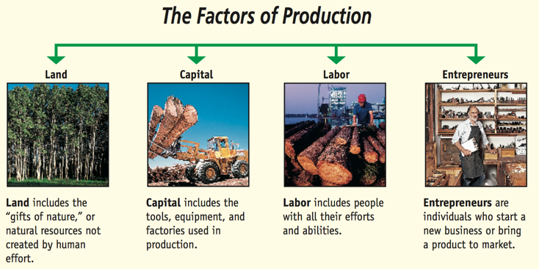

Slide 15
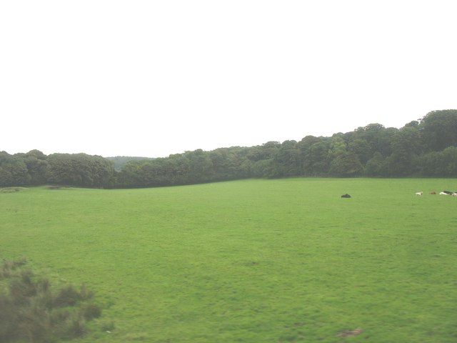
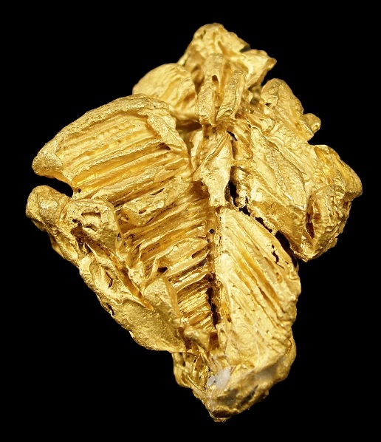
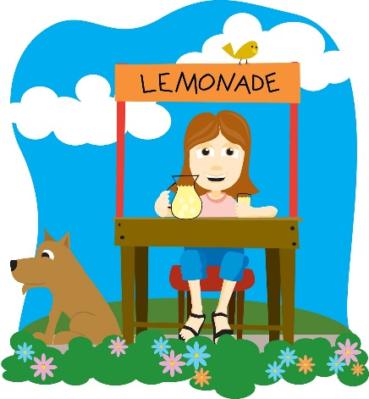
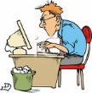
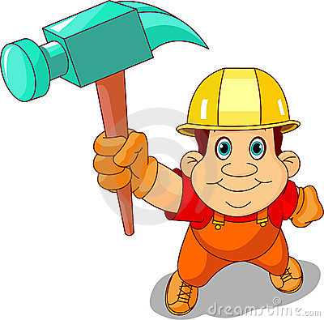
Let’s Practice
Land | Labor | Capital | Entrepreneurship

Slide 16
Activity-Make a Factors of Production Poster
LAND
LABOR
FACTORS OF PRODUCTION
CAPITAL
ENTREPRENEUSHIP

Slide 17
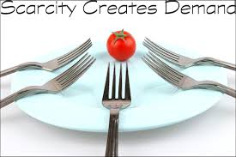
Review
Scarcity forces people to make choices about how they will use their resources.
The effects of these choices may be long-lasting.
During the 1600s, the demand for Holland’s tulips became so great that prices rose to unbelievable levels. In fact, around 1610, a single tulip bulb could be given as the dowry for a bride.
What do you think the groom might have had to give up in order to offer a tulip bulb in 1610?
What do you think the trade-off would be today?

Slide 18
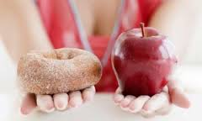
Trade-Offs
When making economic decisions, limited resources force individuals, businesses, and nations to make trade-offs.
Trade-offs result in giving up something of value to get what is most wanted.
When people make economic choices, they exchange one good or service for another. In making a purchase, the good they are exchanging is money.
Exchanging one thing to get the use of another is called a trade-off.

Slide 19
Trade-Offs
You make trade-offs every time you use a resources in one way instead of another.
The result of a trade-off is what you give up in order to get or do something else.
Sometimes the choice can involve the resource of time, for example, choosing to volunteer at an animal shelter instead of going with friends to the local mall.
At other times, the choice may involve money-buy the newest Playstation Game or save for a cell phone?

Slide 20
Opportunity Cost
Every time an economic decision is made, there is the risk of not selecting the best choice.
The opportunity cost of a decision is what is given up when the alternative choice is not selected.
For example, the opportunity cost of deciding to spend one hour studying for a math test is the lost opportunity to spend time with friends.
The risk is whether the extra time studying will result in a higher test score.

Slide 21
Opportunity Cost
For example, time is a scare resource. There are a limited number of hours in a day and you must choose how to use them.
If you use one-hour of study a school assignment, the trade-offs are all the other things you could have done during that hour.
The opportunity cost is what you would have done for that hour had you chosen not to study.
In other words, it is the opportunity that you have up in order to study.

Slide 22
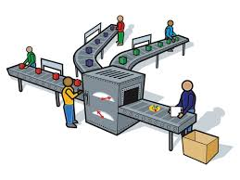
Opportunity Cost
Knowing about the trade-offs and opportunity costs can help you make decisions at all levels. You will be able to make wiser use of your resources if you are aware of the trade-offs and opportunity costs of your decisions.
Businesses must also consider these factors when they make choices about investing money or producing one good rather than another.

Slide 23
This cartoon illustrates what economic concept?
Opportunity cost and trade-off. It shows that every time we make a decision, we have to give up something.

Slide 26
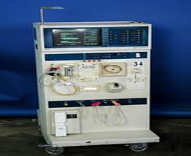
What is Economics Really About Activity

Slide 27
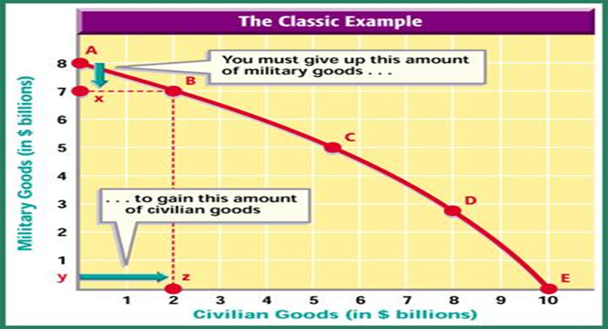
Production Possibilities Curve
The production possibilities curve shows the maximum combination of goods and services that can be produced from a given amount of resources.
Using a production possibilities curve, a producer can decide how to use resources.
Classic Example: military spending vs domestic programs (guns or butter)

Slide 28
Monsters Inc (Production Possibilities Curve)

Slide 29
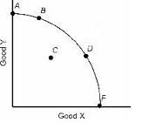
Shifting in the Production Possibility Curve
There are two ways to shift the PPC.
a change in the quantity or quality resources
a change in technology

Slide 30
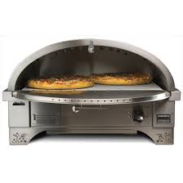
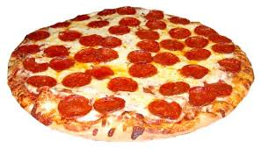
Identify what will happen to the PPC for consumer goods and capital goods.
Reminder:
Consumer Goods- are made for direct consumption like pizza.
Capital Goods-are made for indirect consumption like the pizza oven.

Slide 31
Identify what will happen to the PPC for consumer goods and capital goods.
What would happen if we had faster computers and better technology?
The entire PPC will shift because we can produce more consumer goods and more capital goods.
Consumer Goods
Capital Goods

Slide 32
Identify what will happen to the PPC for consumer goods and capital goods.
2. What if a country’s power plants were destroyed and the amount of the electricity they produce decreased?
A destruction of a power plant would mean we would have less electricity this would cause the PPC to shift inward because we would have to produce less consumer goods and less capital goods.
Consumer Goods
Capital Goods

Slide 33
Identify what will happen to the PPC for consumer goods and capital goods.
3. What if there was an increase in unemployment which causes recession in the economy?
If we have a recession and caused unemployed workers that would not be a shift because the workers are still alive.
Now if the workers died, we would lose our resource of workers which would cause a shift inward.
Consumer Goods
Capital Goods

Slide 34
Identify what will happen to the PPC for consumer goods and capital goods.
4. What if there was an increase in education?
Improvement in education would result in a shift outward. Remember this is not more workers it's better workers, the quality of workers increase. This is the idea of human capital if our workers are better trained and more intelligent that would cause us to be able to produce more goods.
Consumer Goods
Capital Goods

Slide 35
Three Basic Questions
What goods and services should be produced?
If more of one particular item is produced, then less of something else will produced.
How should they be produced?
Decisions must be made as to what the best combination of available inputs will be to get the job done for the lowest possible cost.
For whom should it be produced?
The type of economic system under which people live determines how the goods and services will be distributed among its members.

Slide 36
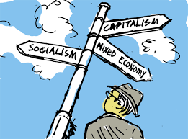
Economic System
The way a nation uses its resources to satisfy its people’s needs and wants is called an economic system.

Slide 37
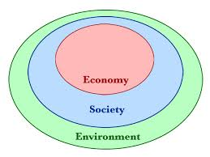
Types of Economic Systems
There are four basic types of economic systems: traditional, command, market, and mixed.

Slide 38
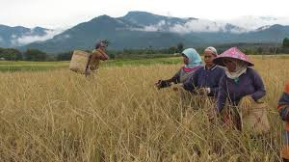
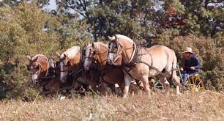
Traditional Economy
The traditional economy system makes decisions based on customs and beliefs that have been handed down from generation to generation.
Advantages:
You know what is expected of you.
Family and community ties are strong.
Disadvantages:
Change is discouraged and perhaps punished.
Methods of production are often inefficient.
Choices among consumer goods are rare.
Individuals rarely experience an increased level of material well-being.

Slide 39
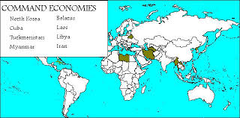
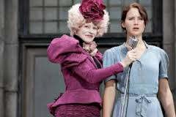
Command Economy
In a command economy (or controlled) system, government leaders control the factors of production and make all decisions about their use.
Disadvantages:
Lack of incentives to work hard or show inventiveness.
Lack of consumer choices.

Slide 40
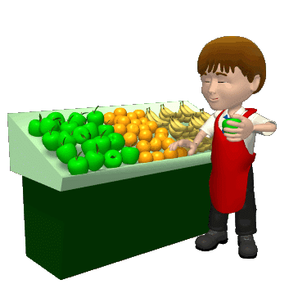
Market Economy
In a market economy (or capitalist) system, individuals own the factors of production and make economic choices based on market price while looking out for their own and their families’ best interests.
Advantages:
People have freedoms.
Competition provides consumers with a wide array of goods and services to choose.
There is an efficient system of determining costs.
Disadvantages:
Lack of concern about those too young, too old, or too sick to work.

Slide 41
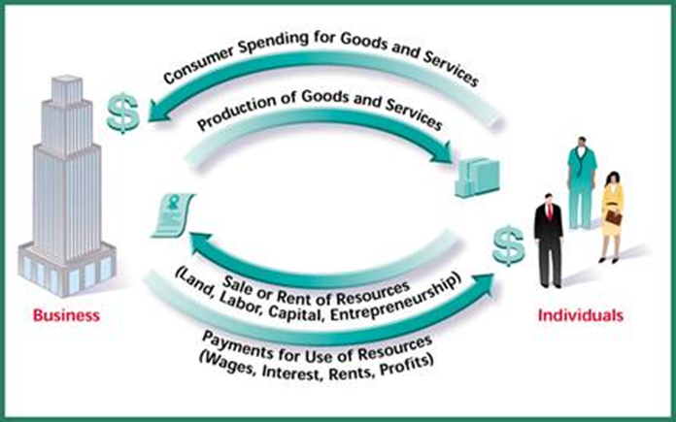
Circular Flow
The flow of resources, goods and services, and income in a market system is a circular flow of income and output.

Slide 43
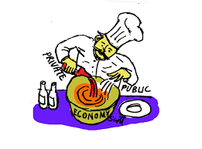
Mixed Economy
A mixed economy system combines characteristics more than one type of economy.
Most countries have a mixed economy in which private ownership of property and individual decision making are combined with government intervention and regulations.
A mixed economy is a combination of market and command economies.

Slide 44
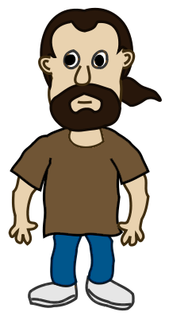
Name that Economic System
My name is Heraldo Esterez. I have lived in Cuba all my life. I wanted to become a teacher. However, I work for a large sugar producer that is owned by the government. The government decides when I work, where I work, and how much money I receive. What economic system am I describing?
Command Economy

Slide 45
Name that Economic System
My name is Curt Jones and I have always had a passion for delicious ice cream. I discovered a way to freeze ice cream into small dots. I patented the process for making the ice cream and built a plant to make enough ice cream to sell it internationally. Which economic system am I describing?
Market Economy

Slide 46
Name that Economic System
I am a basket maker in India. The people in my village make beautiful baskets. My grandmother and my mother made baskets. What type of economic system am I describing?
Traditional Economy

Slide 47
Name that Economic System
My name is Morgan Taylor. I went shopping for a new pair of jeans. I refused to buy the jeans because they were too expensive. Which economic system am I describing?
Market Economy

Slide 48
Name that Economic System
My name is Madison Brown. I worked for an ice cream company for many years. I am now 65 years old and have health problems that prevent me from working. I receive a Social Security check each month to help pay my expenses. What economic system am I describing?
Mixed Economy

Slide 49
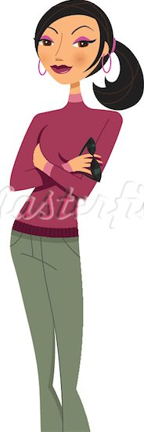
Name that Economic System
My name is Whitney Smith. I own a toy factory. My employees use many sharp instruments to make the toys. A federal agency called O.S.H.A. (Occupational Health and Safety Administration) visits my factory often to make sure my employees have the safe equipment to use. Which economic system am I describing?
Mixed Economy
Market and Command Economies

Slide 50
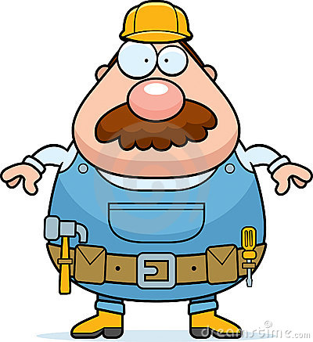
Name that Economic System
My name is Derek Jones. I am an engineer. My father and grandfather are engineers also. Which economic system am I describing?
Traditional Economy

Slide 51
Name that Economic System
My name is Mr. Jones and I have always had a passion for delicious ice cream. I discovered a way to make ice cream that formed tiny dots. I patented the process for making the ice cream and built a plant to make enough ice cream to sell internationally. I decided to build Kiosks, carts to store and sell ice cream, to dealers nationally and internationally. The Florida Health Department told me that each Kiosk that stays in Florida must have three sinks. The Health Department in California requires that all the Kiosks have four sinks in them. Which economic system am I describing?
Mixed Economy
Market and Command Economies

Slide 52
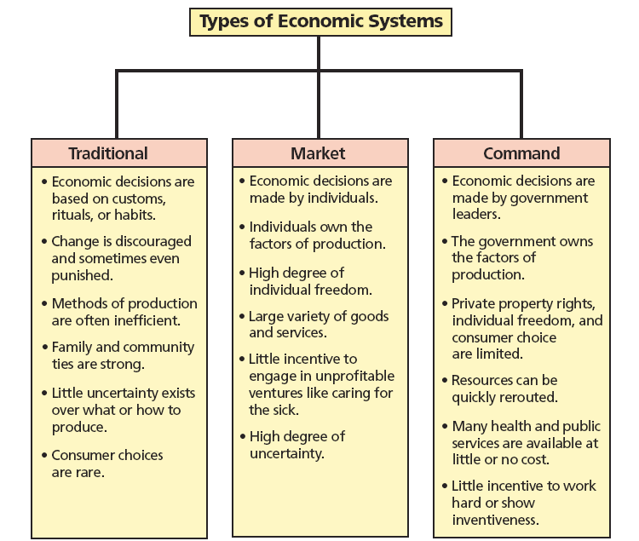
Economic Systems Activity
C
_____ the government controls the economy. It assigns jobs, sets production goals, and decides wages.”
____business is based on competition. Success comes from doing something better and cheaper than your competitors.”
_____producers decide what and how much to based on what people want to buy.”
____ we have no need for money. By custom, some of us hunt, some fish, others farm, and we are all taken care of.”
_____central planners decide when we should expand old factories or build new ones.”
_____the government makes economic decisions.”
_____the government has a very small role.”
M
“In my country……
M
T
C
C
M

Slide 53
Specialization and Division of Labor and Capital
Part 1: Making Production More Efficient
Group 2:
2 students – modeling playdoh into balls for buns
2 students – flatten balls into buns
1 student – modeling playdoh into balls for meat
1 student – flatten balls into meat
3 students – use rulers to make sure meat patties are correct size
1 student – assemble bottom bun and meat
1 student – put on three dabs of ketchup
1 student – put on three dabs of mustard
1 student – put on two pickles
1 student – put 16 sesame seed holes in bun and assemble burgers
1 student – help where needed
1 student – quality control person
Each hamburger must have:
1 cm thick buns and 1 inch wide
.5 cm thick patty and 1.5 cm wide
3 dabs of ketchup
3 dabs of mustard
2 pickles
16 sesame seeds
Describe each factor of production used?
Land-
Labor-
Capital-
Why did the assembly line group make more hamburgers? Was it because they worked harder?
Part 1: Making Production More Efficient
Group 1:
Each student must make their own hamburgers. You may NOT divide the playdoh by passing some of each color to each student.
Classroom/workspace
Human resource of workers
Hamburgers/playdoh
No, the assembly line group specialized by dividing the labor. The non-assembly line group wasted time waiting to use the capital and playdoh. The assembly line students only had to learn one task.

Slide 54
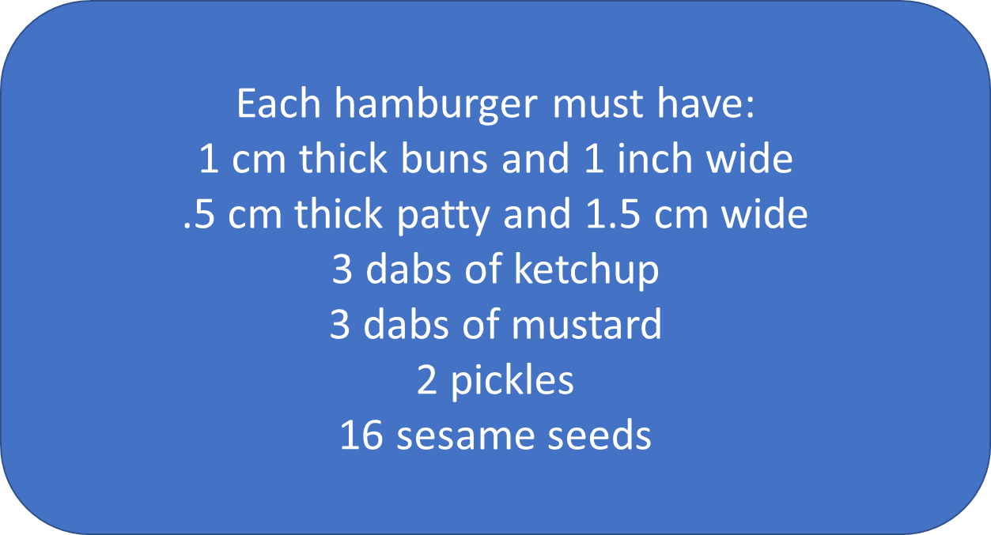
Specialization and Division of Labor and Capital
Part 2: Making Work More Productive
Group 2:
2 students – modeling playdoh into balls for buns
2 students – flatten balls into buns
1 student – modeling playdoh into balls for meat
1 student – flatten balls into meat
3 students – use rulers to make sure meat patties are correct size
1 student – assemble bottom bun and meat
1 student – put on three dabs of ketchup
1 student – put on three dabs of mustard
1 student – put on two pickles
1 student – put 16 sesame seed holes in bun and assemble burgers
1 student – help where needed
1 student – quality control person
Why does better capital make a difference?
Do you think that workers who use modern, more efficient capital would be paid less or more than workers who do not use capital, or who use older, less efficient capital?
What are ways that other producers of goods and services use capital to improve productivity?
Part 2: Making Work More Productive
Group 1:
You may now organize and use the “new” capital.

Slide 55
Limited Role of Government
Capitalism is another name for the market economy system.
Pure capitalism has been called Laissez-faire system; a French term meaning “let (people) do (as they choose).”
Laissez-faire is an economic system in which the government minimizes its interference with the economy. Also known as “hands off” government.
Capitalism in the United States is best defined as an economic system in which private individuals own the factors of production but use them within certain legislated limits.

Slide 56
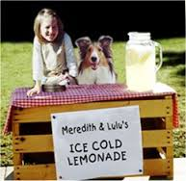
Other Characteristics
The American economy is known as a free enterprise system. Individuals are free to own the factors of production and decide how to use them within legal limits; same as capitalism.
Americans also have freedom of choice where buyers, not sellers, make the decisions about what should be produced.
At times, the government has intervened in various areas of the economy to protect buyers and regulate price.
The goal of a business is to make a profit.

Slide 57
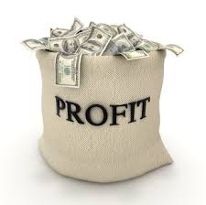
Other Characteristics
The desire to make a profit is referred to as profit incentive or profit motive.
The risk of failing, when profits are not realized, is also part of the free-enterprise system.
In a free-enterprise system, the lure of profits encourages competition.
For competition to exist, industry barriers to enter into, and exit from must be weak.

Slide 58
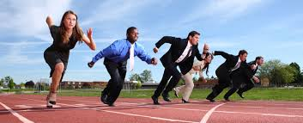
Other Characteristics
Competition leads to an efficient use of resources since businesses are forced to keep costs of production as low as possible.
One of the most important characteristics of capitalism is the existence of private property.

Slide 60
Goals of Free Enterprise
Economic goals of Americans:
Freedom – to allow each member of society to make choices.
Efficiency – wise use of limited resources.
Equity – economic system should be fair and just.
Security – want protection against risks beyond our control.
Stability – attempt to reduce extreme ups and downs in the standard of living.
Growth – increased production of goods and services over time.

Slide 61
Rights and Responsibilities
The American free-enterprise system bestows numerous economic rights and protections on us, but we must take on certain responsibilities (such as supporting ourselves and our family).
We must also become knowledgeable about government policies and elect responsible government officials.

Slide 62
The American economy is defined by six basic characteristics.

Slide 63
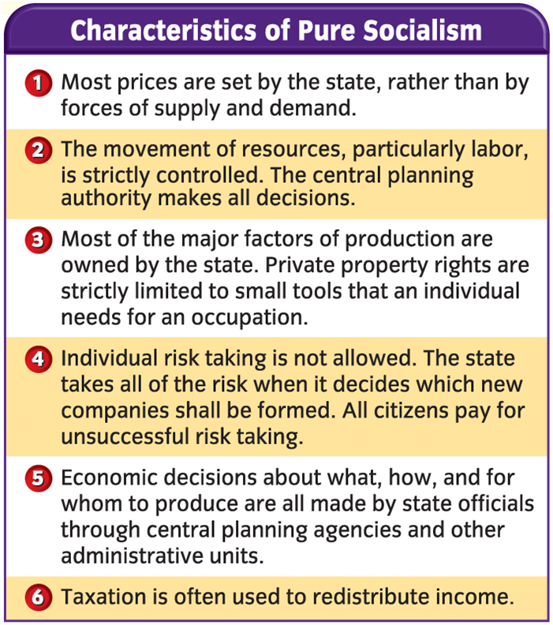
Pure Socialism
Pure command socialism is an economic system in which there is little private property and the government owns the factors of production and attempts to manage output and the distribution of goods.
He outlined the eventual plan of capitalism and predicted the evolution of socialism into communism, an idealized society in which no government is necessary.

Slide 64
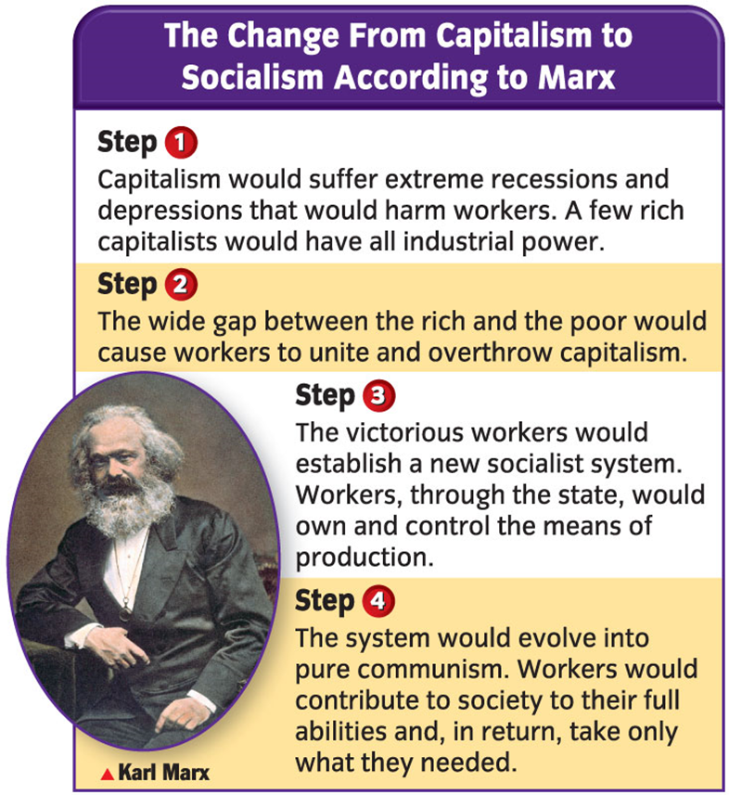
Pure Socialism (cont.)
Today, communism means any authoritarian socialist system that supports revolution as a means to overthrow capitalism and bring about socialist goals.
Karl Marx viewed history as a continual struggle between capitalists (owners of land, machines, and factories) and the workers.
He believed that the capitalists exploited the workers.
He outlined the eventual collapse of capitalism and predicted the evolution of socialism into communism, an idealized society in which no government is necessary.

Slide 66
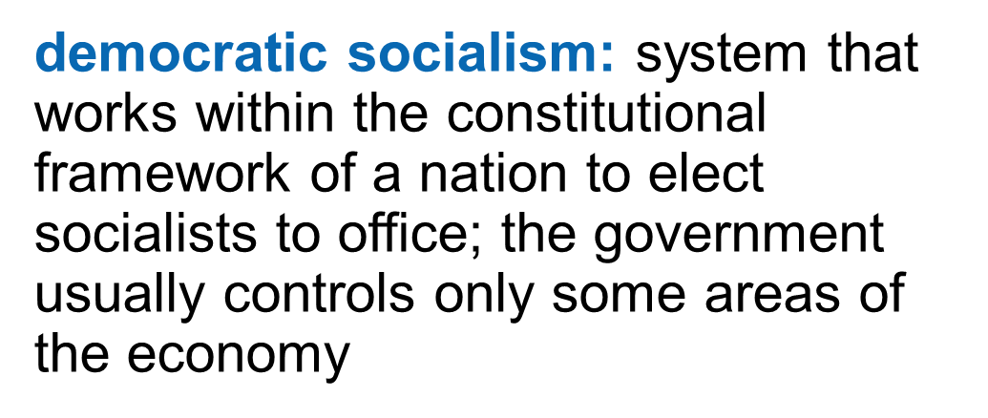
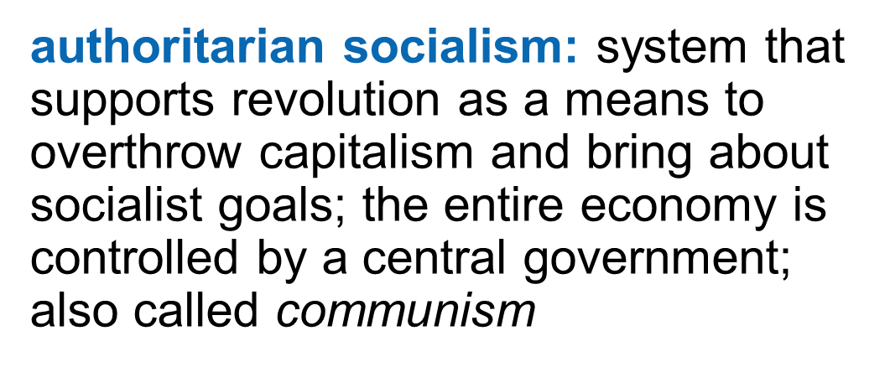
Pure Socialism (cont.)
In the twentieth century, socialism split into two major trends:

Slide 67
Capitalism vs Communism - Freedom versus Oppression - Propaganda Cartoon - Cold War 1940s

Slide 68
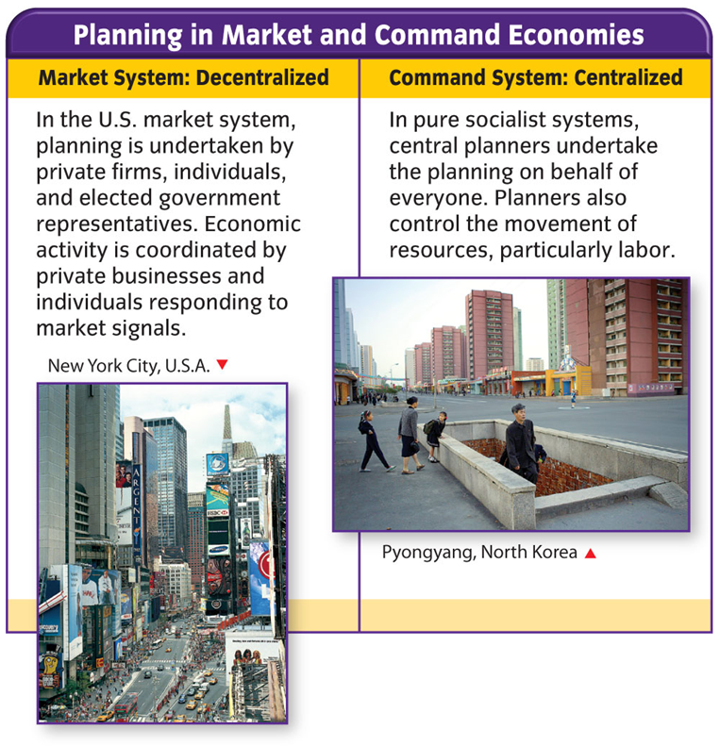
The Benefits of Capitalism
Supporters of capitalism:
Those who place a high value on personal freedom, initiative, and individuality.
Demonstrate that capitalism allows for more efficiency in the marketplace and for greater rates of economic growth.

Slide 69
The Benefits of Capitalism (cont.)
The United States has an economy planned by private firms, individuals, and elected government officials, while socialism has an economy planned by central planners.
Problems of capitalism:
Income is unequally distributed throughout the economy.
There are not enough schools and museums for the general public.

Slide 70
All economic systems answer three basic questions:

Slide 71
There are four basic types of economic systems:

Slide 72
Characteristics of a American Economy Activity
Use your textbook pages 40-44 to complete the activity.

