Slide 1
Notes:
This slideshow includes several links to free video clips. Produced by the Federal Reserve Bank of Philadelphia, they are all part of a series entitled “The Federal Reserve and You.” Feel free to watch all, some, or none of the clips throughout the lecture. You may also decide simply to watch each chapter of the series in its entirety, ignoring the included video clip recommendations. Videos labeled “Video Clip” are more specific and shorter than those labeled “Video Recap,” which are more general and longer. Note that watching the videos will take a great deal of extra time and requires an Internet connection (and a free JW Player plug-in). If desired, you can order the DVD for free off the website. If using the DVD, the name and number of each recommended video clip have been included in the “Notes” section of each applicable slide. The website for ordering the DVD and for browsing through the video clips is this: http://www.philadelphiafed.org/education/federal-reserve-and-you/segments.cfm

Slide 2
Table of Contents
Access Prior Knowledge
(Warm Up)
Set Goals
(Learning Targets)
Provide New Information
(Lecture)
Analyze New Information
(Class Activity)
Generalize
(Conclusion)
Homework
(Extension Activity)
The Federal
Reserve Note
Learning
Targets
Structure of
The Fed
The FOMC
Decides
Learning
Targets
My Fed District
Origins of
The Fed
Quiz
The Great
Depression
The Payments
System
Supervision and
Regulation
The Fed and
Monetary Policy
Notes:
This lesson follows a format recommended by Jane E. Pollock in “Improving Student Learning: One Teacher at a Time” (2007), which is itself an outgrowth of a book by Robert J. Marzano, Debra J. Pickering, and Jane E. Pollock entitled, “Classroom Instruction that Works: Research-Based Strategies for Increasing Student Achievement” (2001). This format is broken into six parts, each listed as a subheading in bold on this slide. Use this slideshow to guide your class sequentially through each of these six stages.

Slide 3
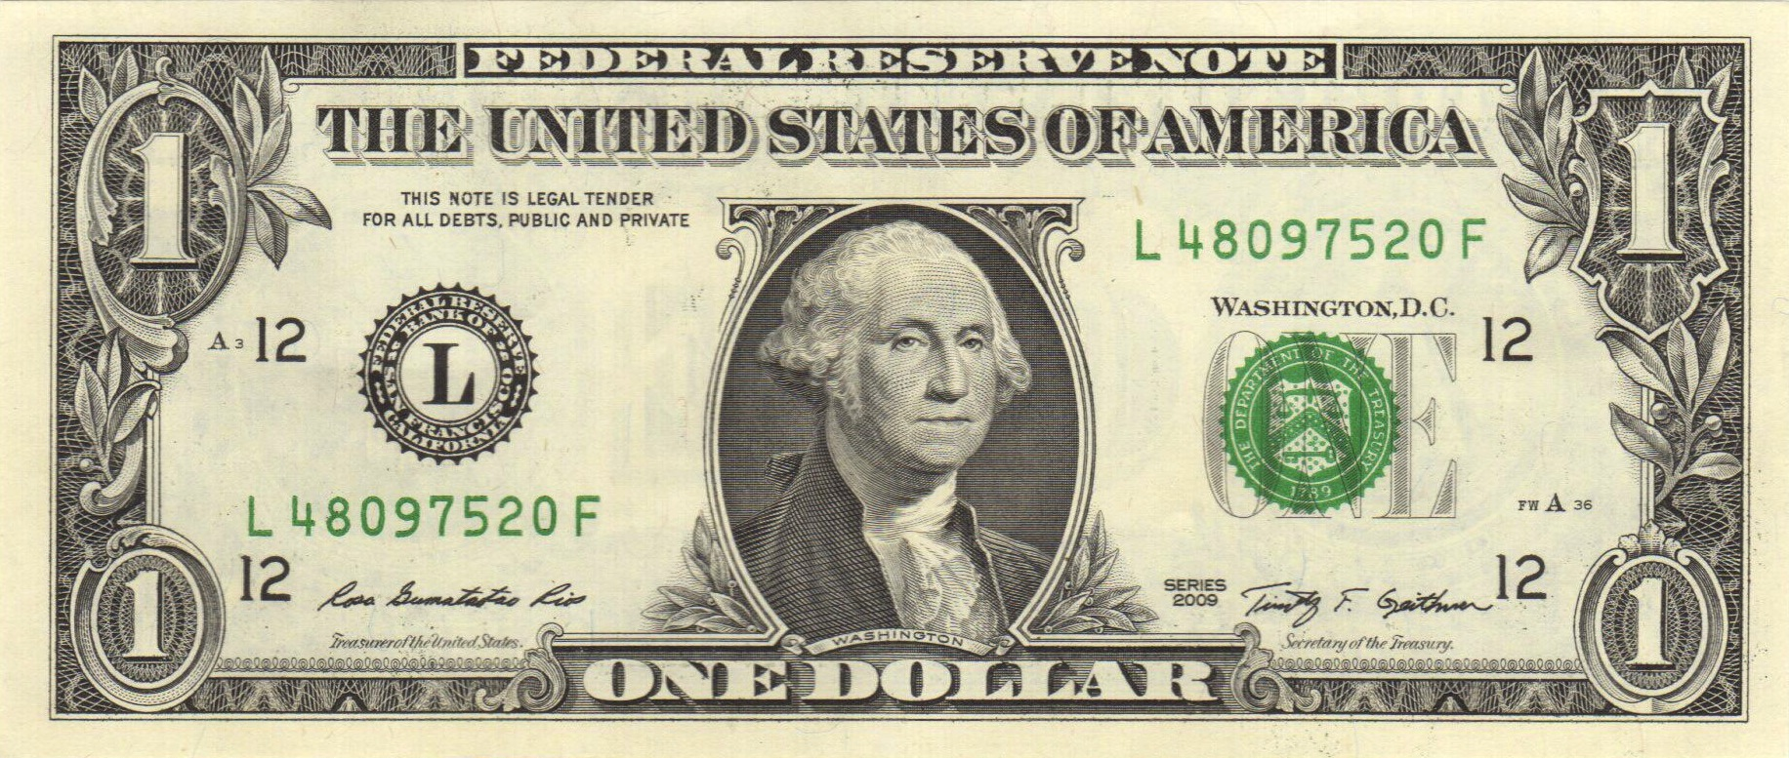
The Federal Reserve Note
DIRECTIONS
Use the Word Bank to correctly label this $1 bill. If you have a $1 bill with you in class, take it out to see how it is similar and different to the one below.
WORD BANK
Type of Note
Treasury Department Seal
Federal Reserve District Seal
District Letter
District Number
Treasurer of the United States
Secretary of the Treasury
Serial Number
Plate Serial Number
Note Position Number
Location of Printing
Notes:
This Warm Up Activity can be completed individually, in small groups, or as a whole class. If students have a $1 bill, instruct them to take it out at this time. If you feel trusting, you may allow students to look at your own $1 bills. If you are projecting this slideshow onto a writeable surface, you can have students (or yourself) write guesses/answers into the white rectangles. The answers appear on the next slide.

Slide 4
The Federal Reserve Note
DIRECTIONS
Use the Word Bank to correctly label this $1 bill. If you have a $1 bill with you in class, take it out to see how it is similar and different to the one below.
WORD BANK
Type of Note
Treasury Department Seal
Federal Reserve District Seal
District Letter
District Number
Treasurer of the United States
Secretary of the Treasury
Serial Number
Plate Serial Number
Note Position Number
Location of Printing
Note Position Number
Federal Reserve District Seal
Serial Number
Treasury Department Seal
District Letter
Type of Note
District Letters
And Numbers
Skip
Explanation
District Number
Treasurer of the United States
Secretary of the Treasury
Location of Printing
Plate Serial Number

Slide 5
The Federal Reserve Note
DIRECTIONS
Use the Word Bank to correctly label this $1 bill. If you have a $1 bill with you in class, take it out to see how it is similar and different to the one below.
WORD BANK
Type of Note
Treasury Department Seal
Federal Reserve District Seal
District Letter
District Number
Treasurer of the United States
Secretary of the Treasury
Serial Number
Plate Serial Number
Note Position Number
Location of Printing
Letter | Number | Location of Federal Reserve District Bank
A | 1 | Boston
B | 2 | New York
C | 3 | Philadelphia
D | 4 | Cleveland
E | 5 | Richmond
F | 6 | Atlanta
G | 7 | Chicago
H | 8 | St. Louis
I | 9 | Minneapolis
J | 10 | Kansas City
K | 11 | Dallas
L | 12 | San Francisco
Notes:
Each $1 bill has a district letter and district number that identifies the Federal Reserve District that issued the note. For example, if the $1 bill has the letter L and the number 12, the Federal Reserve Bank of San Francisco issued it.

Slide 6
The Federal Reserve Note
THE FEDERAL RESERVE AND THE TREASURY DEPARTMENT
Use the list of items to determine which are associated with the Federal Reserve and which are associated with the Treasury Department.
WORD BANK
Type of Note
Treasury Department Seal
Federal Reserve District Seal
District Letter
District Number
Treasurer of the United States
Secretary of the Treasury
Serial Number
Plate Serial Number
Note Position Number
Location of Printing
Federal Reserve | Treasury Department
Notes:
The answers appear on the next slide.

Slide 7
The Federal Reserve Note
THE FEDERAL RESERVE AND THE TREASURY DEPARTMENT
Use the list of items to determine which are associated with the Federal Reserve and which are associated with the Treasury Department.
WORD BANK
Type of Note
Treasury Department Seal
Federal Reserve District Seal
District Letter
District Number
Treasurer of the United States
Secretary of the Treasury
Serial Number
Plate Serial Number
Note Position Number
Location of Printing
Federal Reserve | Treasury Department
Type of Note
Treasury Department Seal
Federal Reserve District Seal
Treasurer of the United States
District Letter
Secretary of the Treasury
District Number
Plate Serial Number
Serial Number
Note Position Number
Location of Printing

Slide 8
The Federal Reserve Note
THE FEDERAL RESERVE AND THE TREASURY DEPARTMENT
Use the list of items to determine which are associated with the Federal Reserve and which are associated with the Treasury Department.
WORD BANK
Type of Note
Treasury Department Seal
Federal Reserve District Seal
District Letter
District Number
Treasurer of the United States
Secretary of the Treasury
Serial Number
Plate Serial Number
Note Position Number
Location of Printing
Federal Reserve | Treasury Department
Type of Note
Treasury Department Seal
Federal Reserve District Seal
Treasurer of the United States
District Letter
Secretary of the Treasury
District Number
Plate Serial Number
Serial Number
Note Position Number
Location of Printing
CONCLUSION
What is the main difference between the Federal Reserve and the Treasury Department when it comes to currency?
Notes:
The answer appears on the next slide.

Slide 9
The Federal Reserve Note
THE FEDERAL RESERVE AND THE TREASURY DEPARTMENT
Use the list of items to determine which are associated with the Federal Reserve and which are associated with the Treasury Department.
WORD BANK
Type of Note
Treasury Department Seal
Federal Reserve District Seal
District Letter
District Number
Treasurer of the United States
Secretary of the Treasury
Serial Number
Plate Serial Number
Note Position Number
Location of Printing
Federal Reserve | Treasury Department
Type of Note
Treasury Department Seal
Federal Reserve District Seal
Treasurer of the United States
District Letter
Secretary of the Treasury
District Number
Plate Serial Number
Serial Number
Note Position Number
Location of Printing
CONCLUSION
What is the main difference between the Federal Reserve and the Treasury Department when it comes to currency?
The Treasury Department prints the currency.
The Federal Reserve issues the currency into circulation.
Notes:
If you want to take this concept one step further, you can explain to the students that it is not wise to allow the government to put money into circulation. This is true because governments will tend to print too much money, causing inflation. By leaving the distribution of money in the hands of a relatively independent institution, we can ensure that money is not printed for political purposes.

Slide 10
Learning Targets
Knowledge
Understand the history and organizational structure of the Federal Reserve System.
Reasoning
Explain how each of the Federal Reserve’s three major functions improve the economic well-being of people in the United States.
ESSENTIAL QUESTIONS
What is the relationship between banks and the Federal Reserve?
Why is the Federal Reserve considered such an important part of the United States economy?
Notes:
[Pass out “Notes (The Federal Reserve)” at this time.] Learning targets allow students to know what they are supposed to learn before delving into new material. Using learning targets (similar to objectives, goals, outcomes, etc.) comes from Classroom Assessment for Student Learning” by Richard J. Stiggins, Judith A. Arter, Jan Chappuis, and Stephen Chappuis (2006). Learning targets are broken into five categories: knowledge, reasoning, skill, product, and disposition. To write them, I first examine the national standards from the Council for Economic Education, and then I translate those ideas into student-friendly language, ensuring each category gets addressed. The learning targets listed on this slide are part of a larger set of learning targets that go with the full unit, “The Financial Sector.”

Slide 11
Structure of the Fed
The Federal Reserve is the central bank in the U.S. To limit its power, its creators purposely gave it both centralized and decentralized features.

Slide 12
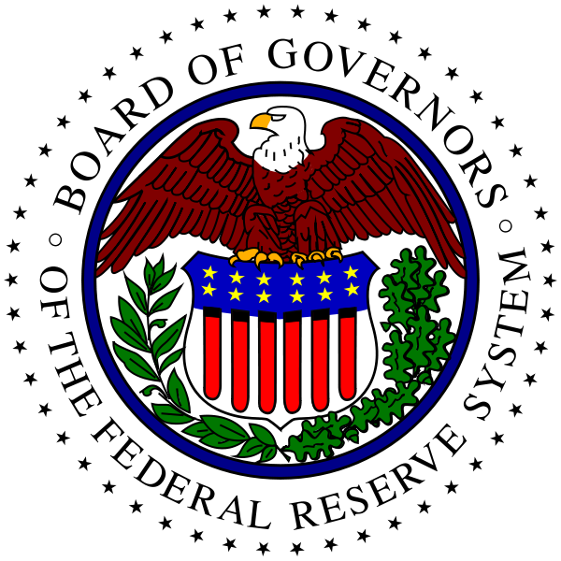
Structure of the Fed
The Federal Reserve is the central bank in the U.S. To limit its power, its creators purposely gave it both centralized and decentralized features.
1) Board of Governors
A) The Fed’s central governing body, consisting of 7 members.
Members of the Board of Governors are appointed by the President and confirmed by the Senate. This ensures they are part of the democratic process.

Slide 13
Structure of the Fed
The Federal Reserve is the central bank in the U.S. To limit its power, its creators purposely gave it both centralized and decentralized features.
1) Board of Governors
A) The Fed’s central governing body, consisting of 7 members.
B) To insulate them from politics, members serve one 14-year term.
The Chair of the Board of Governors is chosen from among its 7 members and acts as Chair for 4 years at a time. Currently, the Chair is Janet Yellen.

Slide 14
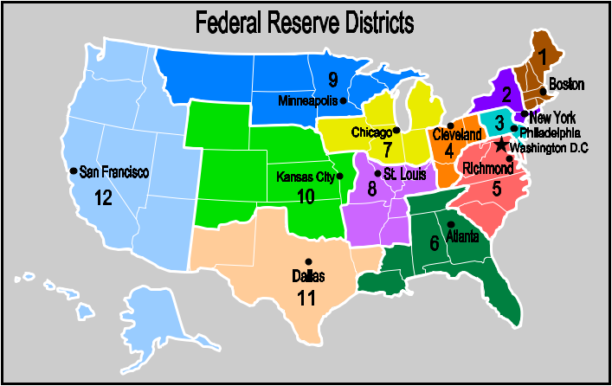
Structure of the Fed
The Federal Reserve is the central bank in the U.S. To limit its power, its creators purposely gave it both centralized and decentralized features.
1) Board of Governors
A) The Fed’s central governing body, consisting of 7 members.
B) To insulate them from politics, members serve one 14-year term.
2) Federal Reserve District Banks
The Fed has 12 regions, each with its own District Bank.
District Banks provide services to the region’s banks and assist the Board of Governors in managing the day-to-day business of the central bank.
Notes:
Allow students time to determine which Federal Reserve District they live in.

Slide 15
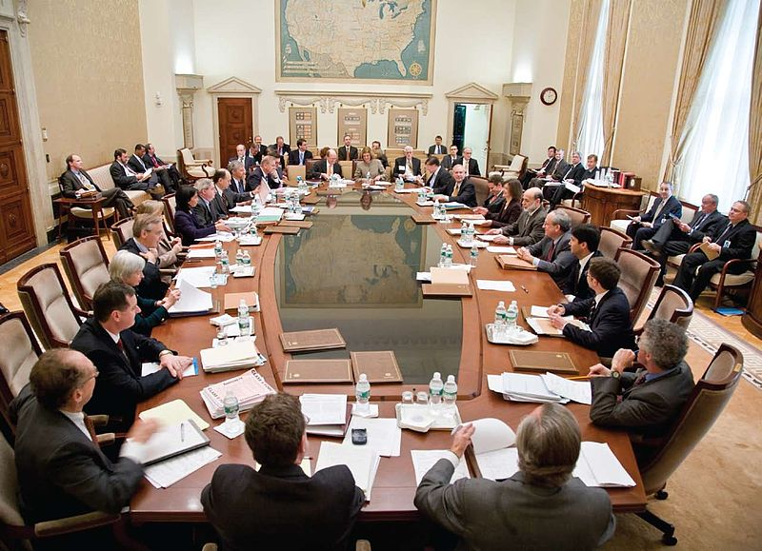
Structure of the Fed
The Federal Reserve is the central bank in the U.S. To limit its power, its creators purposely gave it both centralized and decentralized features.
1) Board of Governors
A) The Fed’s central governing body, consisting of 7 members.
B) To insulate them from politics, members serve one 14-year term.
2) Federal Reserve District Banks
The Fed has 12 regions, each with its own District Bank.
3) Federal Open Market Committee
Makes decisions regarding which type of monetary policy to pursue.
The FOMC has 12 voting members: the Board of Governors, the New York District Bank President, and 4 other rotating District Bank Presidents.
Video
Recap
Notes:
[VIDEO: Chapter 1 The Federal Reserve and You; Segment 2 Structure of the Federal Reserve] There are other committees, entities, and advisory councils included in the structure of the Federal Reserve System. They have been omitted for simplicity.

Slide 16
Origins of the Fed
The Federal Reserve System was not created until 1913. Before that time the financial system suffered from a lack of regulation and unstable currency.

Slide 17
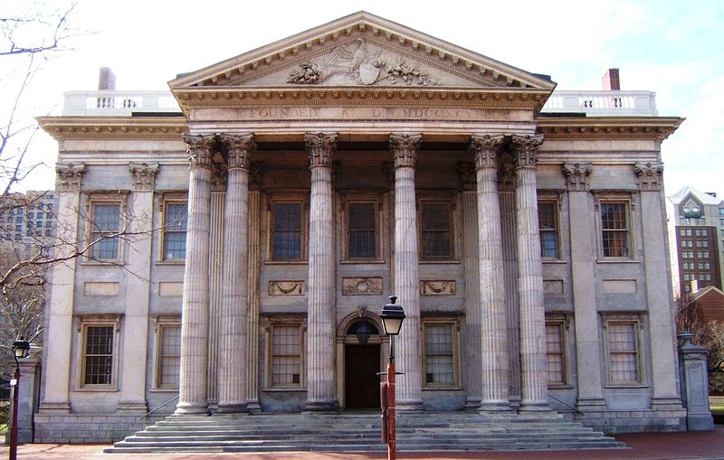
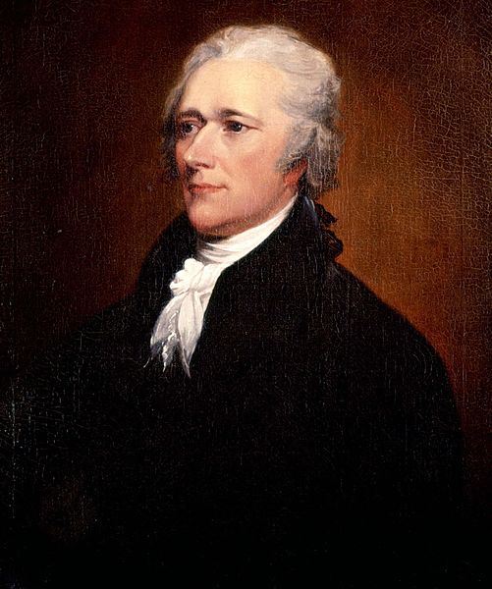
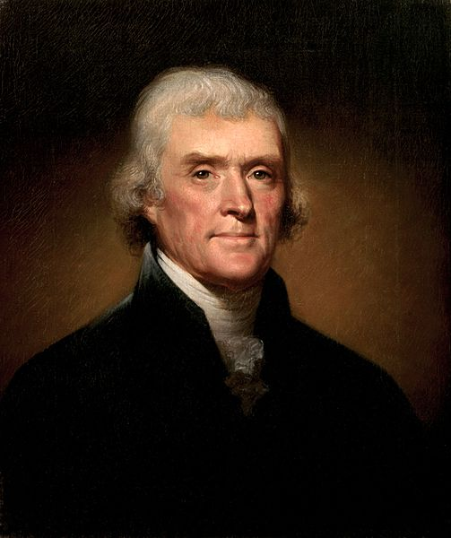
Origins of the Fed
The Federal Reserve System was not created until 1913. Before that time the financial system suffered from a lack of regulation and unstable currency.
1) 1st Bank of the United States
It financed government debt, but did not regulate banks or money.
Alexander Hamilton helped create this controversial bank in 1791. Due to its shortcomings, people (such as Thomas Jefferson) allowed it to expire in 1811.
Video
Clip
Notes:
[VIDEO: Chapter 2 History of Central Banking in the United States; Segment 1 The First Bank of the United States]

Slide 18
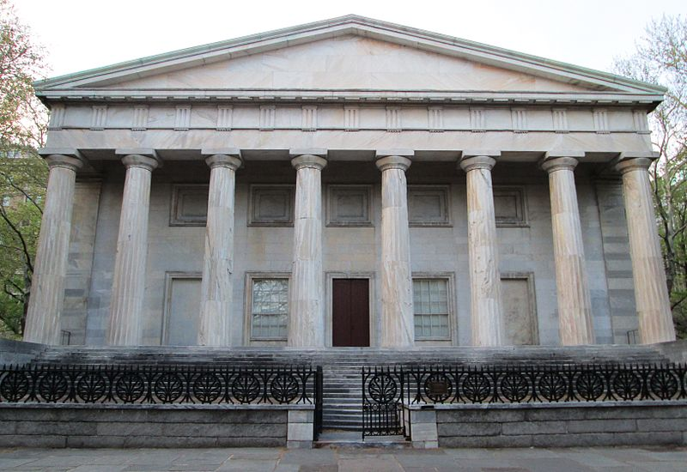
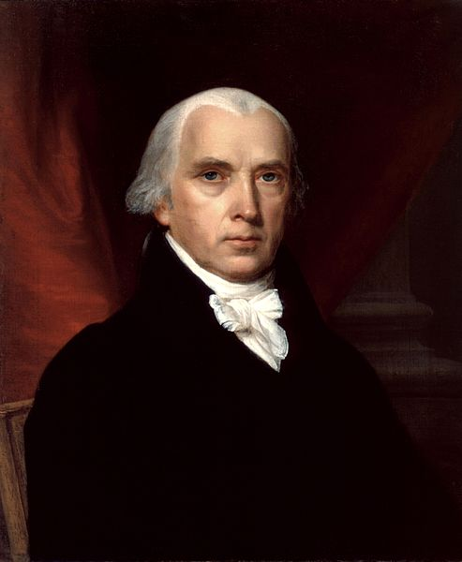
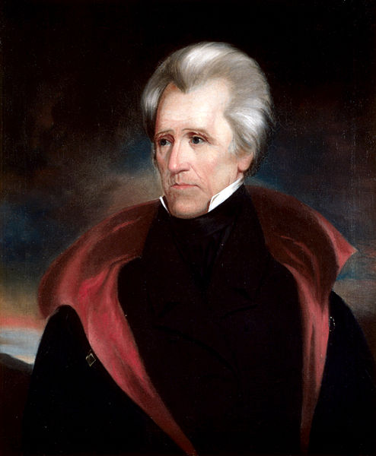
Origins of the Fed
The Federal Reserve System was not created until 1913. Before that time the financial system suffered from a lack of regulation and unstable currency.
1) 1st Bank of the United States
It financed government debt, but did not regulate banks or money.
2) 2nd Bank of the United States
Set up to finance the War of 1812, it functioned like the 1st bank.
James Madison created this bank in 1816. When Andrew Jackson became president, he transferred its money to state banks, allowing it to expire in 1836.
Video
Clip
Notes:
[VIDEO: Chapter 2 History of Central Banking in the United States; Segment 2 The Second Bank of the United States]

Slide 19
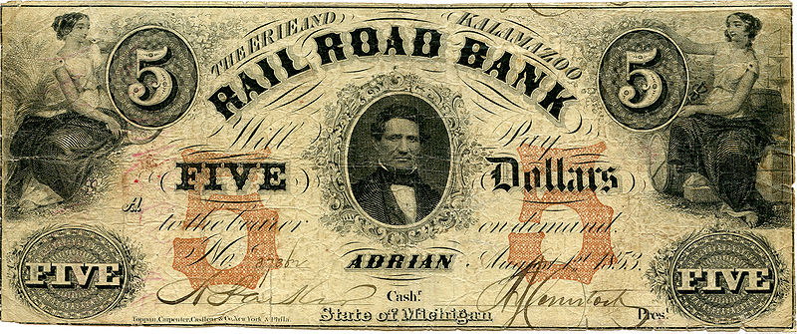
Origins of the Fed
The Federal Reserve System was not created until 1913. Before that time the financial system suffered from a lack of regulation and unstable currency.
1) 1st Bank of the United States
It financed government debt, but did not regulate banks or money.
2) 2nd Bank of the United States
Set up to finance the War of 1812, it functioned like the 1st bank.
3) “Free Banking” Era
No central bank existed at this time, just state-regulated banks.
The Free Banking Era (1837 - 1863) still suffered from little regulation and no uniform currency. The unstable currencies caused half of all banks to fail.

Slide 20
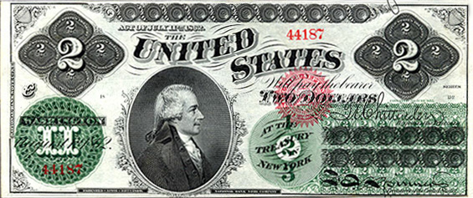
Origins of the Fed
The Federal Reserve System was not created until 1913. Before that time the financial system suffered from a lack of regulation and unstable currency.
1) 1st Bank of the United States
It financed government debt, but did not regulate banks or money.
2) 2nd Bank of the United States
Set up to finance the War of 1812, it functioned like the 1st bank.
3) “Free Banking” Era
No central bank existed at this time, just state-regulated banks.
4) National Banking Era
Nationally-chartered banks issued currency backed by the Treasury.
The National Banking Act of 1863 created a uniform currency and financed the Civil War, but it could not prevent the financial panics of the next 50 years.
Video
Clip
Notes:
[VIDEO: Chapter 2 History of Central Banking in the United States; Segment 3 The State and National Banking Periods]

Slide 21
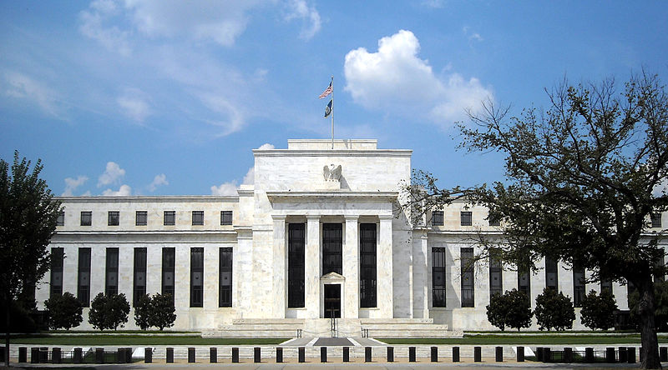
Origins of the Fed
The Federal Reserve System was not created until 1913. Before that time the financial system suffered from a lack of regulation and unstable currency.
1) 1st Bank of the United States
It financed government debt, but did not regulate banks or money.
2) 2nd Bank of the United States
Set up to finance the War of 1812, it functioned like the 1st bank.
3) “Free Banking” Era
No central bank existed at this time, just state-regulated banks.
4) National Banking Era
Nationally-chartered banks issued currency backed by the Treasury.
5) The Federal Reserve System
During the Panic of 1907 J.P. Morgan loaned millions to banks, helping end the panic. Lawmakers realized a central bank was needed to deal with future crises.
A central bank that is both governmental and independent.
Video
Clip
Notes:
[VIDEO: Chapter 2 History of Central Banking in the United States; Segment 4 Creation of the Federal Reserve]

Slide 22
The Great Depression
The Fed initially did not respond well to the Great Depression (1929 - 1939), but some of its most important policies and tools were developed at this time.

Slide 23
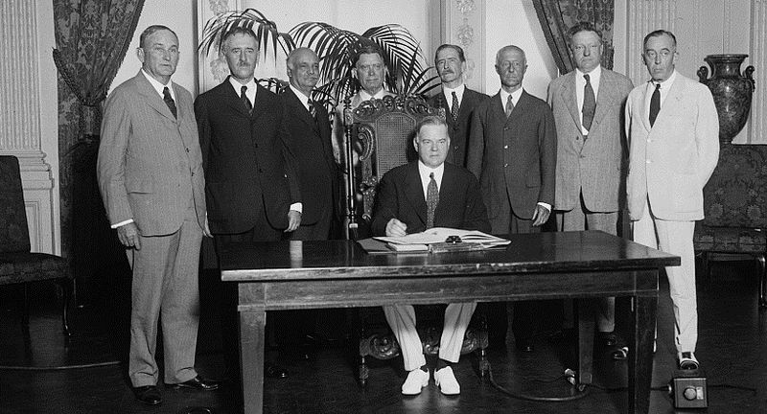
The Great Depression
The Fed initially did not respond well to the Great Depression (1929 - 1939), but some of its most important policies and tools were developed at this time.
1) Out With the Old Ideas…
A) Laissez-faire: leave the system alone and it will fix itself.
Initially, President Hoover and the Fed declined to help fight the depression. They eventually did enact helpful policies, but the damage had been done.

Slide 24
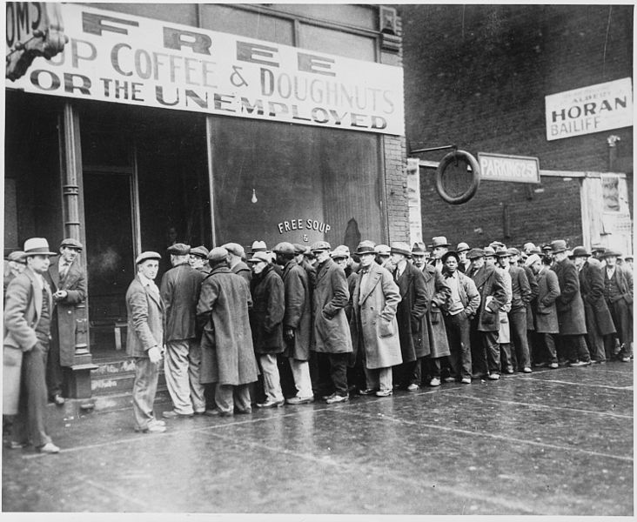
The Great Depression
The Fed initially did not respond well to the Great Depression (1929 - 1939), but some of its most important policies and tools were developed at this time.
1) Out With the Old Ideas…
A) Laissez-faire: leave the system alone and it will fix itself.
B) View on Prices: inflation is the only problem, not deflation.
Surprisingly, the Fed pursued policies that caused deflation until 1933. They did not understand its disastrous effects on the economy.

Slide 25
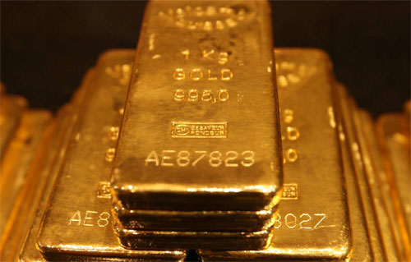
The Great Depression
The Fed initially did not respond well to the Great Depression (1929 - 1939), but some of its most important policies and tools were developed at this time.
1) Out With the Old Ideas…
A) Laissez-faire: leave the system alone and it will fix itself.
B) View on Prices: inflation is the only problem, not deflation.
C) Gold Standard: money supply is tied to the amount of gold.
Any economy tied to a gold standard has a limited supply of money. By eliminating the gold standard in 1933, the Fed could greatly affect the money supply.

Slide 26
The Great Depression
The Fed initially did not respond well to the Great Depression (1929 - 1939), but some of its most important policies and tools were developed at this time.
1) Out With the Old Ideas…
A) Laissez-faire: leave the system alone and it will fix itself.
B) View on Prices: inflation is the only problem, not deflation.
C) Gold Standard: money supply is tied to the amount of gold.
2) …In With the New
A) National Banking Act: created deposit insurance with the FDIC.
This measure (1933) has been credited with stopping the bank runs that had gripped the country since 1929. Depositors were initially insured up to $2,500.

Slide 27
The Great Depression
The Fed initially did not respond well to the Great Depression (1929 - 1939), but some of its most important policies and tools were developed at this time.
1) Out With the Old Ideas…
A) Laissez-faire: leave the system alone and it will fix itself.
B) View on Prices: inflation is the only problem, not deflation.
C) Gold Standard: money supply is tied to the amount of gold.
2) …In With the New
A) National Banking Act: created deposit insurance with the FDIC.
B) National Banking Act: created FOMC to conduct monetary policy
The FOMC is the main way the Fed now conducts its monetary policy. The FOMC uses open-market operations to increase or decrease the money supply.

Slide 28
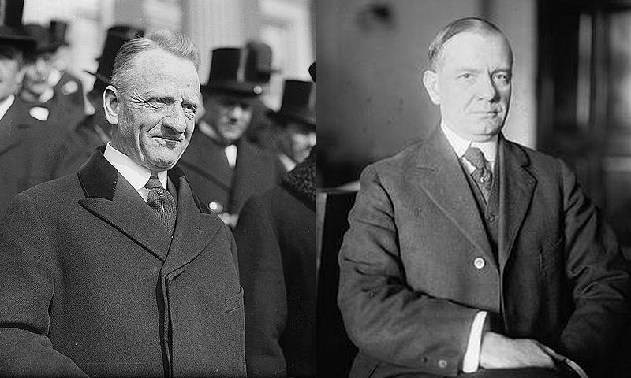
The Great Depression
The Fed initially did not respond well to the Great Depression (1929 - 1939), but some of its most important policies and tools were developed at this time.
1) Out With the Old Ideas…
A) Laissez-faire: leave the system alone and it will fix itself.
B) View on Prices: inflation is the only problem, not deflation.
C) Gold Standard: money supply is tied to the amount of gold.
2) …In With the New
A) National Banking Act: created deposit insurance with the FDIC.
B) National Banking Act: created FOMC to conduct monetary policy
The Glass-Steagall Act was actually part of the National Banking Act of 1933. Most of the Glass-Steagall provisions were repealed by 1999.
C) Glass-Steagall Act: separated commercial & investment banks.
Video
Recap
Notes:
[VIDEO: Chapter 2 History of Central Banking in the United States; Segment 5 The Great Depression] There were other provisions in the Glass-Steagall part of the National Banking Act. In the picture, the man on the left is Carter Glass, and the man on the right is Henry Steagall.

Slide 29
The Payments System
The Fed has three major functions. First, the Fed ensures that currency, check, and electronic transfers of money are safe, secure, and efficient.

Slide 30
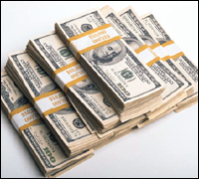
The Payments System
The Fed has three major functions. First, the Fed ensures that currency, check, and electronic transfers of money are safe, secure, and efficient.
1) Currency Distribution
The government prints currency and the Fed distributes it.
The Fed, not the government, decides how much currency is printed each year. It is held in District Banks until a depository institution makes an order.
Video
Clip
Notes:
[VIDEO: Chapter 5 The Payments System; Segment 4 Forms of Payment -- Cash]

Slide 31
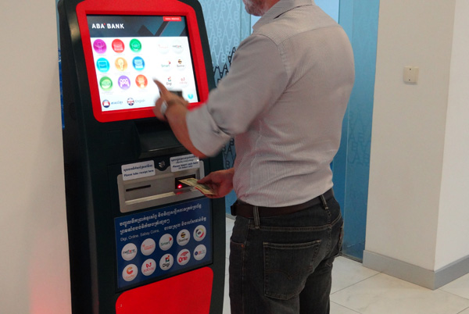
The Payments System
The Fed has three major functions. First, the Fed ensures that currency, check, and electronic transfers of money are safe, secure, and efficient.
1) Currency Distribution
The government prints currency and the Fed distributes it.
2) Automated Clearinghouse
ACH clears electronic credit and debit transfers (including checks) made by depositors.
Examples of credit transfers include direct deposit checks, tax refunds, and social security benefits. Debits include mortgage payments and utility bills.

Slide 32
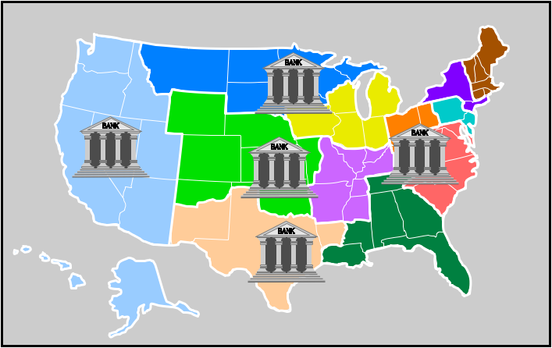
The Payments System
The Fed has three major functions. First, the Fed ensures that currency, check, and electronic transfers of money are safe, secure, and efficient.
1) Currency Distribution
The government prints currency and the Fed distributes it.
2) Automated Clearinghouse
ACH clears electronic credit and debit transfers (including checks) made by depositors.
3) Fedwire
Allows financial institutions to settle payments electronically and immediately to one another.
Only financial institutions that hold an account with the Fed can use Fedwire. ACH may transfer billions of dollars each day, but Fedwire transfers trillions.
Video
Clip
Notes:
[VIDEO: Chapter 5 The Payments System; Segment 3 Forms of Payment -- Electronic]

Slide 33
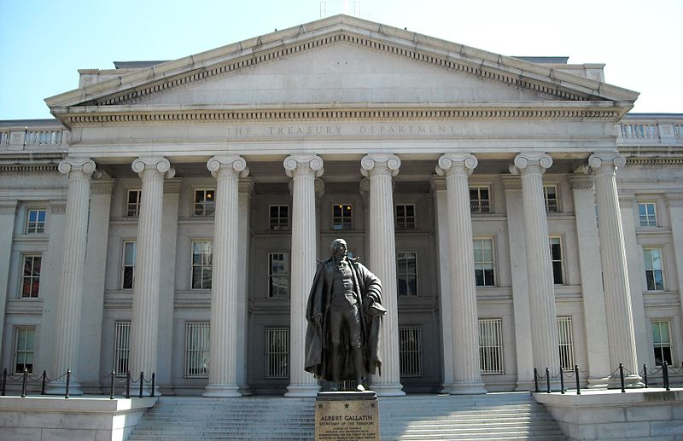
The Payments System
The Fed has three major functions. First, the Fed ensures that currency, check, and electronic transfers of money are safe, secure, and efficient.
1) Currency Distribution
The government prints currency and the Fed distributes it.
2) Automated Clearinghouse
ACH clears electronic credit and debit transfers (including checks) made by depositors.
3) Fedwire
Allows financial institutions to settle payments electronically and immediately to one another.
4) Government’s Fiscal Agent
Acts as the federal government’s bank by providing financial services to the Treasury.
The Fed maintains a bank account for the Treasury, collects tax deposits, and processes government checks, government securities, and money orders.
Video
Recap
Notes:
[VIDEO: Chapter 5 The Payments System; Segment 1 Introduction]

Slide 34
Supervision and Regulation
The second major function of the Fed is to supervise and regulate financial institutions. This ensures they are run safely and consumers are treated fairly.

Slide 35
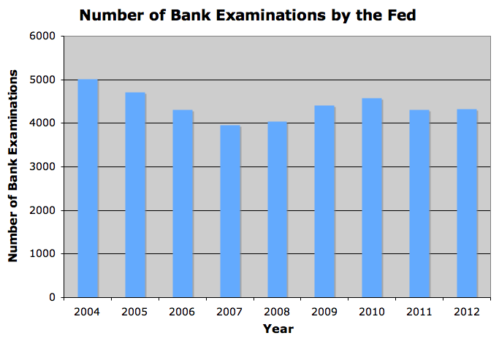
Supervision and Regulation
The second major function of the Fed is to supervise and regulate financial institutions. This ensures they are run safely and consumers are treated fairly.
1) The Bank Examination
A) Assess the quality of a bank’s capital, assets, management, earnings, liquidity, and risk.
When making these assessments, bank examiners may investigate a financial institution by performing either an on-site or an off-site evaluation.

Slide 36
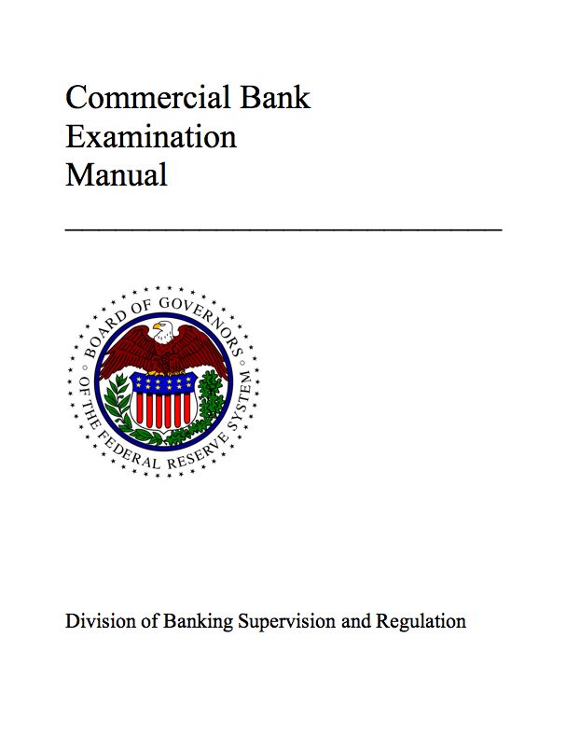
Supervision and Regulation
The second major function of the Fed is to supervise and regulate financial institutions. This ensures they are run safely and consumers are treated fairly.
1) The Bank Examination
A) Assess the quality of a bank’s capital, assets, management, earnings, liquidity, and risk.
B) Review the quality of the bank’s loans using the 5-C’s.
A bank examiner looks at a loan applicant’s Capacity to repay, Collateral, Condition or circumstances, Capital (assets minus liabilities), and Character.
Video
Clip
Notes:
[VIDEO: Chapter 6 Supervision and Regulation; Segment 4 Bank Examinations]

Slide 37
Supervision and Regulation
The second major function of the Fed is to supervise and regulate financial institutions. This ensures they are run safely and consumers are treated fairly.
1) The Bank Examination
Disclosures | Description
Annual Percentage Rate (APR) | Similar to the annual interest rate, but is slightly higher
Finance Charges | Amount of interest paid over the life of the loan
Amount Financed | Dollar amount of the loan
Total Payments | Total paid by end of the loan
Payment Schedule | Amount, number, and due date of payments
Prepayment | Tells if a penalty is charged for prepayment of the loan
A) Assess the quality of a bank’s capital, assets, management, earnings, liquidity, and risk.
B) Review the quality of the bank’s loans using the 5-C’s.
2) The Fed Enforces the Law
A) Truth in Lending Act: borrower must be provided with loan details
In 1968, Congress passed TILA to promote informed consumer decision-making during the loan process. This table lists key information lenders must provide.

Slide 38
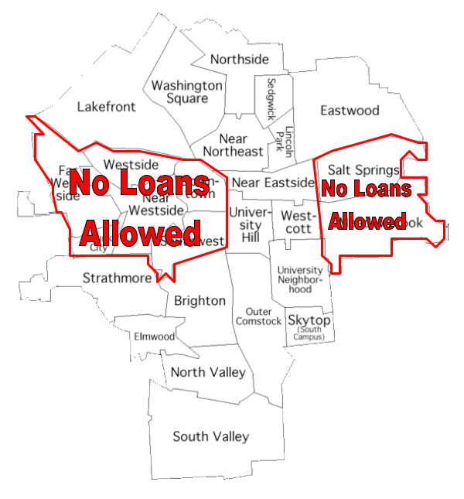
Supervision and Regulation
The second major function of the Fed is to supervise and regulate financial institutions. This ensures they are run safely and consumers are treated fairly.
1) The Bank Examination
A) Assess the quality of a bank’s capital, assets, management, earnings, liquidity, and risk.
B) Review the quality of the bank’s loans using the 5-C’s.
2) The Fed Enforces the Law
A) Truth in Lending Act: borrower must be provided with loan details
B) Community Reinvestment Act: banks cannot exclude loans to people with low income.
In 1977 this law was passed to prevent banks from denying loans to people in low-income communities, a practice known as redlining.

Slide 39
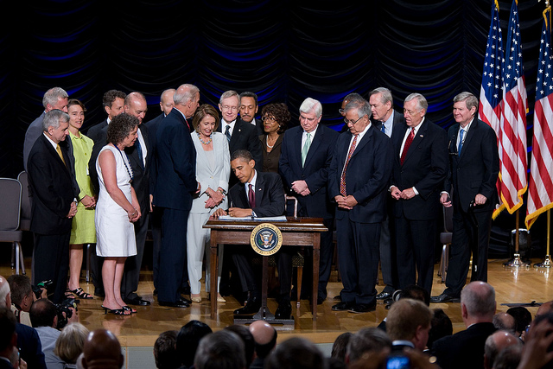
Supervision and Regulation
The second major function of the Fed is to supervise and regulate financial institutions. This ensures they are run safely and consumers are treated fairly.
1) The Bank Examination
A) Assess the quality of a bank’s capital, assets, management, earnings, liquidity, and risk.
B) Review the quality of the bank’s loans using the 5-C’s.
2) The Fed Enforces the Law
A) Truth in Lending Act: borrower must be provided with loan details
B) Community Reinvestment Act: banks cannot exclude loans to people with low income.
This law (2010) was written in response to the financial crisis of 2007-2009. It ends bailouts and increases regulation for firms deemed too big to fail.
C) Dodd-Frank Act: supervision increases for large financial firms.
Video
Recap
Notes:
[VIDEO: Chapter 6 Supervision and Regulation; Segment 1 Introduction] In the picture, President Barack Obama signs the Dodd-Frank Wall Street Reform and Consumer Protection Act into law at the Ronald Reagan building in Washington, D.C. on July 21, 2010.

Slide 40
The Fed and Monetary Policy
The third major function of the Fed is to conduct monetary policy. This means the Fed alters the money supply to promote economic growth and stability.
Video
Intro
Notes:
[VIDEO: Chapter 4 Monetary Policy; Segment 1 Introduction]

Slide 41
The Fed and Monetary Policy
The third major function of the Fed is to conduct monetary policy. This means the Fed alters the money supply to promote economic growth and stability.
1) The FOMC Meeting
A) Meets to discuss nationwide economic data every 6 weeks.
Each District Bank President highlights the economic situation in his/her region. This, along with other data, brings a diversity of views to policy decisions.
Video
Clip
Notes:
[VIDEO: Chapter 4 Monetary Policy; Segment 5 The Role of the FOMC]

Slide 42
The Fed and Monetary Policy
The third major function of the Fed is to conduct monetary policy. This means the Fed alters the money supply to promote economic growth and stability.
1) The FOMC Meeting
A) Meets to discuss nationwide economic data every 6 weeks.
B) Seeks both price stability and maximum employment.
To obtain these objectives, the FOMC uses open-market operations to affect the federal funds rate, which is the rate banks charge each other for loans.
Video
Clip
Notes:
[VIDEO: Chapter 4 Monetary Policy; Segment 4 Monetary Policy Goals]

Slide 43
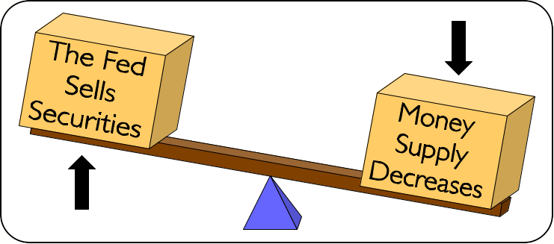
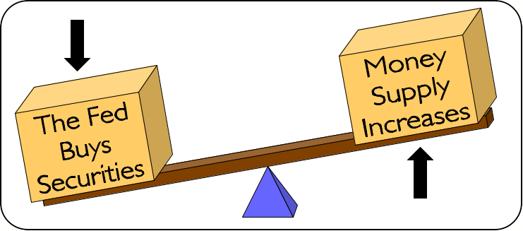
The Fed and Monetary Policy
The third major function of the Fed is to conduct monetary policy. This means the Fed alters the money supply to promote economic growth and stability.
1) The FOMC Meeting
A) Meets to discuss nationwide economic data every 6 weeks.
B) Seeks both price stability and maximum employment.
2) Four Tools of Monetary Policy
A) Open-Market Operations: sell or buy government securities
If the Fed sells securities, investors pay the Fed, reducing the money supply. If the Fed buys them, investors receive money, raising the money supply.
Video
Clip
Notes:
[VIDEO: Chapter 4 Monetary Policy; Segment 6 Open Market Operations] This is the main tool used when conducting monetary policy. The other three are generally not used actively in managing the nation’s economy, though changes in each do affect the money supply.

Slide 44
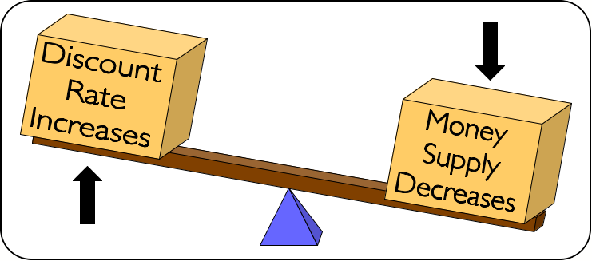
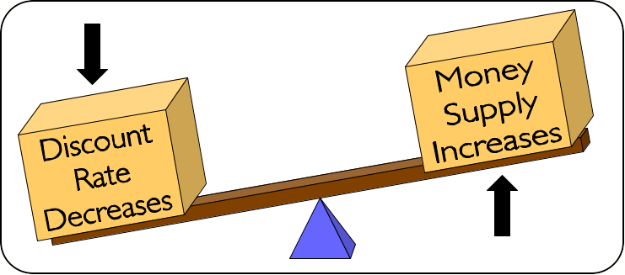
The Fed and Monetary Policy
The third major function of the Fed is to conduct monetary policy. This means the Fed alters the money supply to promote economic growth and stability.
1) The FOMC Meeting
A) Meets to discuss nationwide economic data every 6 weeks.
B) Seeks both price stability and maximum employment.
2) Four Tools of Monetary Policy
A) Open-Market Operations: sell or buy government securities
B) Discount Rate: interest rate on money borrowed from the Fed
When the discount rate increases, banks borrow less from the Fed. When it decreases, the money supply rises since money is not as expensive.
Video
Clip
Notes:
[VIDEO: Chapter 4 Monetary Policy; Segment 7 The Discount Rate] The discount rate is generally set slightly higher than the federal funds rate to discourage banks from borrowing from the Fed. Thus, the discount rate does rise and fall when the federal funds rate rises and falls, but that does not actually change the money supply. The money supply is only affected when the spread between the discount rate and the federal funds rate is changed. An increase in the spread decreases the money supply, and a decrease in the spread increases the money supply. This subtlety is not noted on the slideshow because it is usually not taught this way. It is taught the way I have presented it on the slideshow. Regardless, the discount rate is not actively used by the Fed to manage the money supply.

Slide 45
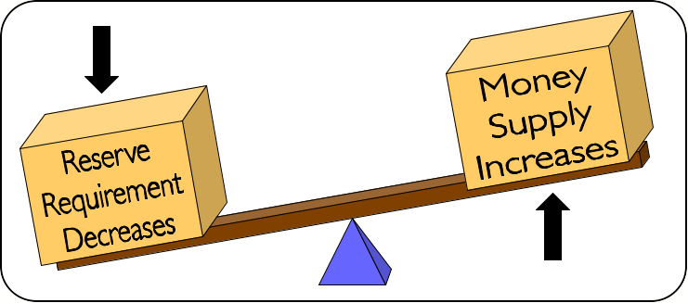
The Fed and Monetary Policy
The third major function of the Fed is to conduct monetary policy. This means the Fed alters the money supply to promote economic growth and stability.
1) The FOMC Meeting
A) Meets to discuss nationwide economic data every 6 weeks.
B) Seeks both price stability and maximum employment.
2) Four Tools of Monetary Policy
A) Open-Market Operations: sell or buy government securities
B) Discount Rate: interest rate on money borrowed from the Fed
C) Reserve Requirement: ratio of bank deposits kept as reserves
When reserve requirements increase, a bank cannot lend out as much money. When they decrease, the money supply rises since banks can lend more.
Video
Clip
Notes:
[VIDEO: Chapter 4 Monetary Policy; Segment 9 Reserve Requirements] The reserve requirement for most financial institutions is 10%. It has not changed since 1992.

Slide 46
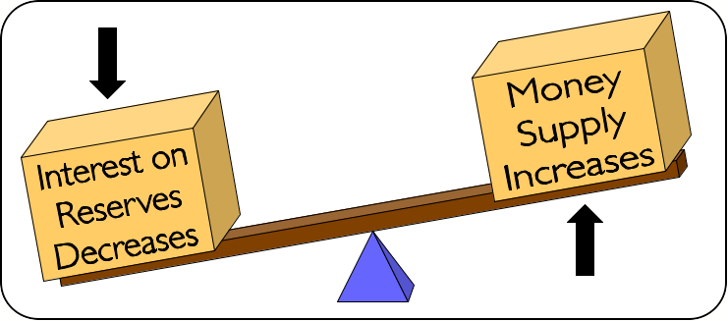
The Fed and Monetary Policy
The third major function of the Fed is to conduct monetary policy. This means the Fed alters the money supply to promote economic growth and stability.
1) The FOMC Meeting
A) Meets to discuss nationwide economic data every 6 weeks.
B) Seeks both price stability and maximum employment.
2) Four Tools of Monetary Policy
A) Open-Market Operations: sell or buy government securities
B) Discount Rate: interest rate on money borrowed from the Fed
C) Reserve Requirement: ratio of bank deposits kept as reserves
When interest on reserves increases, banks hold more money with the Fed. When it decreases, the money supply rises since lending is a better option.
D) Interest on Reserves: interest earned from deposits with the Fed
Video
Clip
Notes:
[VIDEO: Chapter 4 Monetary Policy; Segment 8 Interest on Reserves] This tool is often omitted when discussing monetary policy. Congress passed a law allowing the Fed to begin paying interest on deposits with the Fed in 2008, so it is a recent development. Although interest on reserves is not actively used to manage the money supply, both it and the discount rate were used during the financial crisis of 2007-2009.

Slide 47
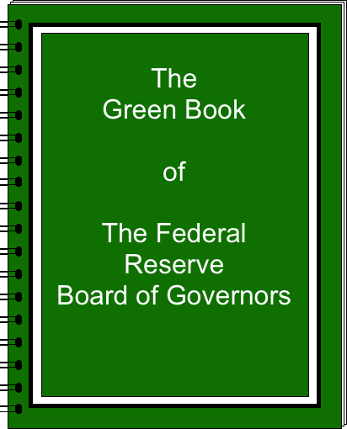
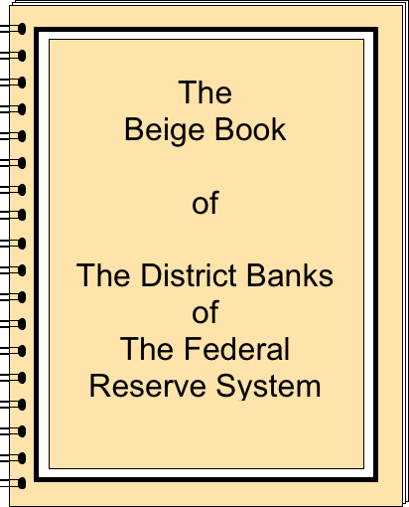
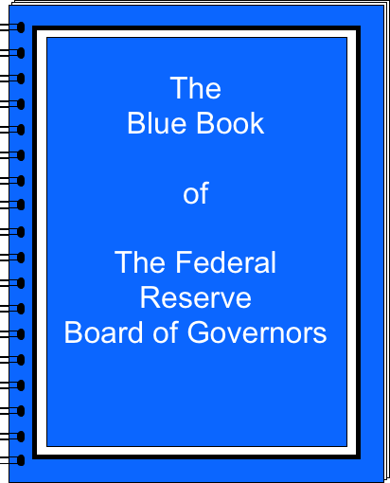
The FOMC Decides
Class Activity
BACKGROUND
The Federal Open Market Committee (FOMC) is one of the most economically powerful groups in the world. They meet every six weeks to discuss the condition of the U.S. economy. The Board of Governors prepares a report about the current and projected state of the economy (Green Book), and each District Bank creates a report about its regional economy (Beige Book). Lasting two days, these meetings conclude with a vote that determines the best proposed change to the target federal funds rate (Blue Book).
Go to
Quiz
Notes:
This is the Class Activity included in the download, entitled “The FOMC Decides.” Divide the class into heterogeneous groups of four. This means there should be approximately one beginning student, two mainstream students, and one advanced student in each group. Assign the Green Book data sheet to the advanced student and one of each of the Beige Book data sheets to the remaining three students. The worksheets entitled “The FOMC Decides” are differentiated by ability. Give the beginning student the (a) version, the two mainstream students the (b) version, and the advanced student the (c) version.

Slide 48
The FOMC Decides
Class Activity
DIRECTIONS - RESEARCH
Green Book
Projected economic conditions in the U.S.
1) In groups of four, we will replicate the FOMC meeting from January 29 – 30, 2008. Each student will read an excerpt from one of the reports prepared for the meeting. (Only three of twelve districts have been included.)
Beige Book – New York
Current economic conditions in the 1st district
Beige Book – Atlanta
Current economic conditions in the 6th district
Beige Book – San Francisco
Current economic conditions in the 12th district
Go to
Quiz

Slide 49
The FOMC Decides
Class Activity
DIRECTIONS - RESEARCH
1) Real Gross Domestic Product (GDP)
1) In groups of four, we will replicate the FOMC meeting from January 29 – 30, 2008. Each student will read an excerpt from one of the reports prepared for the meeting. (Only three of twelve districts have been included.)
2) Unemployment and Wages
2) Working individually, use the data in your Green Book or Beige Book to take notes on the back of this sheet (ten minutes). Write down what you learned about each category.
3) Inflation and Prices
Go to
Quiz

Slide 50
The FOMC Decides
Class Activity
DIRECTIONS - RESEARCH
1) Real Gross Domestic Product (GDP)
1) In groups of four, we will replicate the FOMC meeting from January 29 – 30, 2008. Each student will read an excerpt from one of the reports prepared for the meeting. (Only three of twelve districts have been included.)
2) Unemployment and Wages
2) Working individually, use the data in your Green Book or Beige Book to take notes on the back of this sheet (ten minutes). Write down what you learned about each category.
3) Inflation and Prices
3) Allow each person one minute to describe his/her findings to the group. Begin with the student with the Green Book, followed by each student with a Beige Book.
Go to
Quiz

Slide 51
The FOMC Decides
Class Activity
DIRECTIONS - RESEARCH
1) In groups of four, we will replicate the FOMC meeting from January 29 – 30, 2008. Each student will read an excerpt from one of the reports prepared for the meeting. (Only three of twelve districts have been included.)
2) Working individually, use the data in your Green Book or Beige Book to take notes on the back of this sheet (ten minutes). Write down what you learned about each category.
3) Allow each person one minute to describe his/her findings to the group. Begin with the student with the Green Book, followed by each student with a Beige Book.
4) Once everyone has summarized his/her findings, discuss the state of the economy as a group for two minutes.
Go to
Quiz

Slide 52
The FOMC Decides
Class Activity
DIRECTIONS - CONCLUSION
Alternative A
Lower the target by 50 basis points to 3.00%
1) Discuss the potential changes to the federal funds rate, published in the Blue Book. Consider the options below as a group for two minutes. A decrease in the federal funds rate helps stimulate a weak economy, while an increase helps cool off an overly strong economy. (Note that a basis point is worth 0.01%.)
Alternative B
Lower the target by 25 basis points to 3.25%
Alternative C
Keep the target at 3.50%
Alternative D
Raise the target by 25 basis points to 3.75%
Alternative E
Raise the target by 50 basis points to 4.00%
Go to
Quiz

Slide 53
The FOMC Decides
Class Activity
DIRECTIONS - CONCLUSION
Alternative A
Lower the target by 50 basis points to 3.00%
1) Discuss the potential changes to the federal funds rate, published in the Blue Book. Consider the options below as a group for two minutes. A decrease in the federal funds rate helps stimulate a weak economy, while an increase helps cool off an overly strong economy. (Note that a basis point is worth 0.01%.)
Alternative B
Lower the target by 25 basis points to 3.25%
Alternative C
Keep the target at 3.50%
Alternative D
Raise the target by 25 basis points to 3.75%
Alternative E
Raise the target by 50 basis points to 4.00%
2) As a group, decide on the best policy alternative for the economy that existed on January 30, 2008. Record your group’s decision on the back of this sheet. Be sure to explain why your group considered this policy alternative to be the best one.
What Actually
Happened?
Skip
Answer
Go to
Quiz

Slide 54
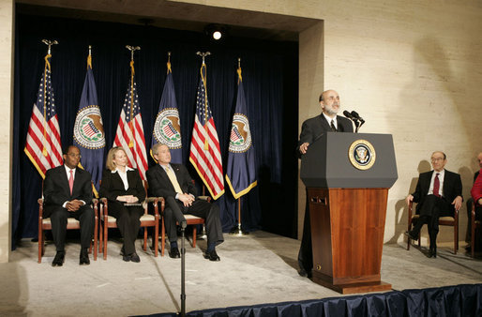
The FOMC Decides
Class Activity
PRESS RELEASE
Release Date: January 30, 2008
The Federal Open Market Committee decided today to lower its target for the federal funds rate 50 basis points to 3 percent.
Financial markets remain under considerable stress, and credit has tightened further for some businesses and households. Moreover, recent information indicates a deepening of the housing contraction as well as some softening in labor markets.
Alternative A
Lower the target by 50 basis points to 3.00%
Go to
Quiz

Slide 55
Learning Targets
Knowledge
Understand the history and organizational structure of the Federal Reserve System.
Reasoning
Explain how each of the Federal Reserve’s three major functions improve the economic well-being of people in the United States.
ESSENTIAL QUESTIONS
What is the relationship between banks and the Federal Reserve?
Why is the Federal Reserve considered such an important part of the United States economy?
Go to Quiz
Skip Quiz
Notes:
Help students make connections between the learning targets and the activities from today. If desired, see if students can answer the Essential Questions.

Slide 56
Quiz
DIRECTIONS
Version (a)
This quiz covers topics from today’s lesson and is divided into three sections. In the first section, match the correct letter from each definition with each vocabulary word. Then, select the best answer for each question or incomplete statement. Finally, correctly complete each table.
Version (b)
This quiz covers topics from today’s lesson and is divided into three sections. In the first section, match the correct letter from each definition with each vocabulary word. Then, select the best answer for each question or incomplete statement. Finally, correctly complete each table.
Version (c)
This quiz covers topics from today’s lesson and is divided into three sections. In the first section, write the definition of each vocabulary word in your own words. Then, write a short response for each question. Finally, correctly complete each table.
Matching /
Vocabulary
Multiple Choice /
Short Response
Calculations
Notes:
A short quiz has been included, which can be utilized in different ways. Each student can complete the quiz silently, the teacher can read the questions aloud and call on students for informal answers, or it can be given at the beginning of tomorrow’s class. There are three versions, allowing for differentiation. Difficulty increases from (a) to (b) to (c).

Slide 57
Quiz
MATCHING / VOCABULARY
1) _____ 1st Bank of the United States
2) _____ 2nd Bank of the United States
3) _____ “Free Banking” Era
4) _____ National Banking Era
Show Answers
Multiple Choice /
Short Response
Calculations

Slide 58
Quiz
MATCHING / VOCABULARY
1) _____ 1st Bank of the United States
b
b) Alexander Hamilton was the brains behind the establishment of this central bank.
2) _____ 2nd Bank of the United States
c) Due to the controversy surrounding this central bank, Andrew Jackson succeeded in allowing it to expire in 1836.
c
3) _____ “Free Banking” Era
a
a) There was no central bank in the United States during this time. Currency was issued and backed by individual banks.
4) _____ National Banking Era
d) During this time, a law was passed that financed the Civil War and allowed banks to issue a uniform currency.
d
Matching /
Vocabulary
Multiple Choice /
Short Response
Calculations

Slide 59
Quiz
MULTIPLE CHOICE / SHORT RESPONSE
5) The members of the Federal Reserve Board of Governors serve one 14-year term because
8) During the Great Depression, the Federal Reserve realized that it needed to
6) The district Bank President who always gets to vote on the Federal Open Market Committee (FOMC) is from
9) Everyday, financial institutions transfer trillions of dollars using the Federal Reserve service known as
10) One of the main ways in which the Federal Reserve supervises and regulates the banking system is to
7) Prior to the Federal Reserve System, the nation’s financial sector suffered from a lack of
Matching /
Vocabulary
Show Answers
Calculations

Slide 60
Quiz
MULTIPLE CHOICE / SHORT RESPONSE
5) The members of the Federal Reserve Board of Governors serve one 14-year term because
8) During the Great Depression, the Federal Reserve realized that it needed to
d) it insulates them from political pressures.
a) increase bank regulation and conduct monetary policy.
6) The district Bank President who always gets to vote on the Federal Open Market Committee (FOMC) is from
9) Everyday, financial institutions transfer trillions of dollars using the Federal Reserve service known as
c) Fedwire.
d) New York City.
10) One of the main ways in which the Federal Reserve supervises and regulates the banking system is to
7) Prior to the Federal Reserve System, the nation’s financial sector suffered from a lack of
c) perform on-site and off-site bank examinations.
b) supervision and regulation.
Matching /
Vocabulary
Multiple Choice /
Short Response
Calculations

Slide 61
Quiz
CALCULATIONS
11) Open-Market Operations
13) Reserve Requirement
If the Fed… | Then the money supply…
Sells Securities
Buys Securities
If the reserve requirement… | Then the money supply…
Increases
Decreases
12) Discount Rate
14) Interest on Reserves
If the discount rate… | Then the money supply…
Increases
Decreases
If the interest on reserves… | Then the money supply…
Increases
Decreases
Matching /
Vocabulary
Multiple Choice /
Short Response
Show Answers

Slide 62
Quiz
CALCULATIONS
11) Open-Market Operations
13) Reserve Requirement
If the Fed… | Then the money supply…
Sells Securities
Buys Securities
If the reserve requirement… | Then the money supply…
Increases
Decreases
Decreases
Decreases
Increases
Increases
12) Discount Rate
14) Interest on Reserves
If the discount rate… | Then the money supply…
Increases
Decreases
If the interest on reserves… | Then the money supply…
Increases
Decreases
Decreases
Decreases
Increases
Increases
Matching /
Vocabulary
Multiple Choice /
Short Response
Calculations

Slide 63
My Fed District
Homework
DIRECTIONS
Use the Federal Reserve’s website (www.federalreserve.gov) to answer the following questions. Tabs are located near the top of each page, allowing you to navigate to a particular category. Also, there is a search field located at the very top of each page.
“ABOUT THE FED” TAB
1) Which Federal Reserve District do you live in?
2) Who is the President of the Federal Reserve Bank in your District?
3) If your district has any branch banks, where are they located?
“MONETARY POLICY” TAB
4) Is your District Bank President currently a voting member on the FOMC?
5) When did the most recent FOMC meeting occur?
6) Locate your district’s Beige Book report for the most recent FOMC meeting. Briefly summarize its findings.
MAP SKILLS
7) Using different colored pens or pencils, outline the 12 Federal Reserve Districts on the map below.
8) Using numbers 1 – 12, label the number of each Federal Reserve District.
9) Label the location of the Board of Governors.
10) Label the location of each Federal Reserve District Bank’s home city.
11) How does the organization of the Fed allow it to more efficiently provide services to its customers?
Notes:
These are the directions for the Homework that is included in the download, entitled “My Fed District.” Assign students one of the three versions. Difficulty increases from (a) to (b) to (c), allowing for differentiation, if desired. Students may either self-identify which difficulty to complete, or the teacher can decide.

Slide 64
Resources
Slideshow
http://www.federalreserveeducation.org/about-the-fed/structure-and-functions/ - Info about the structure of the Fed
http://www.federalreserveeducation.org/about-the-fed/structure-and-functions/banking-supervision/ - Info about supervision and regulation
http://commons.wikimedia.org/wiki/File:US-FederalReserveBoard-Seal.svg - Board of Governors Seal
http://commons.wikimedia.org/wiki/File:Janet_Yellen_official_portrait.jpg - Picture of Janet Yellen
http://commons.wikimedia.org/wiki/File:Federal_Open_Market_Committee_Meeting.jpg - Picture of FOMC Meeting
http://commons.wikimedia.org/wiki/File:FirstBankofUS00_crop.jpg - First Bank of the United States
http://commons.wikimedia.org/wiki/File:Alexander_Hamilton,_by_Trumbull.jpg - Alexander Hamilton
http://commons.wikimedia.org/wiki/File:Thomas_Jefferson_by_Rembrandt_Peale,_1800.jpg - Thomas Jefferson
http://commons.wikimedia.org/wiki/File:Second_Bank_of_the_United_States_rear.jpg - Second Bank of the United States
http://commons.wikimedia.org/wiki/File:James_Madison.jpg - James Madison
http://commons.wikimedia.org/wiki/File:Andrew_jackson_head.jpg - Andrew Jackson
http://commons.wikimedia.org/wiki/File:Erie_and_Kalamazoo_Banknote_1853.jpg - Free Banking Era Bank Note
http://commons.wikimedia.org/wiki/File:US_$2_1862_Legal_Tender.jpg - National Banking Era Bank Note
http://commons.wikimedia.org/wiki/File:Marriner_S._Eccles_Federal_Reserve_Board_Building.jpg - The Federal Reserve System
http://commons.wikimedia.org/wiki/File:Herbert_Hoover_at_desk_with_group_standing_behind_him.jpg - Herbert Hoover
http://commons.wikimedia.org/wiki/File:Unemployed_men_queued_outside_a_depression_soup_kitchen_opened_in_Chicago_by_Al_Capone,_02-1931_-_NARA_-_541927.jpg - Great Depression
http://commons.wikimedia.org/wiki/File:Gold_Bars.jpg - Gold Standard
http://commons.wikimedia.org/wiki/File:US-FDIC-Seal.svg - FDIC
http://commons.wikimedia.org/wiki/File:GlassSteagall.jpg - Glass Steagall
http://commons.wikimedia.org/wiki/File:StrappedCurrency.jpg - Currency Distribution
http://commons.wikimedia.org/wiki/File:Cash-in_machine_(CDM)_of_ABA_Bank.jpg - Cash Machine Picture for ACH
http://www.federalreserve.gov/publications/annual-report/default.htm - Data for Number of Bank Examinations
http://www.federalreserve.gov/boarddocs/supmanual/supervision_cbem.htm - Commercial Bank Examination Manual
http://www.nolo.com/legal-encyclopedia/home-buyers-what-you-can-learn-from-the-truth-in-lending-disclosure.html - Details for Truth in Lending Act
http://commons.wikimedia.org/wiki/File:Syracuse_map_neighborhoods.gif - Syracuse neighborhood map (modified)
https://www.flickr.com/photos/speakerpelosi/4816864266/ - Official White House Photo by Lawrence Jackson (no modifications) - Dodd-Frank Act
http://www.philadelphiafed.org/education/teachers/resources/day-in-life-of-fomc/ - Data on the FOMC
http://commons.wikimedia.org/wiki/File:Ben_Bernanke_sworn_in_to_the_Federal_Reserve_Post.jpg - Ben Bernanke at podium

Slide 65
Resources
Class Activity - The FOMC Decides
Green Book, Beige Book, Blue Book, and Statement from January 29 – 30, 2008 FOMC Meeting
http://www.federalreserve.gov/monetarypolicy/fomchistorical2008.htm
Inflation Rate and Consumer Price Indexes
Bureau of Labor Statistics (BLS)
http://www.bls.gov
Real Gross Domestic Product (GDP) by Region and by Sector
Bureau of Economic Analysis (BEA)
http://www.bea.gov
Return on Average Assets of Banks by Federal Reserve District
Federal Reserve Economic Database (FRED) - Run by the Federal Reserve Bank of St. Louis
http://research.stlouisfed.org/fred2/
Unemployment Rate by Federal Reserve District
Federal Reserve Economic Database (FRED) - Run by the Federal Reserve Bank of St. Louis
http://research.stlouisfed.org/fred2/
Homework - My Fed District
http://commons.wikimedia.org/wiki/File:Usa-state-boundaries-lower48%2B2.png - Blank map of the United States

