Slide 2
Table of Contents
1
Access Prior Knowledge
(Warm Up Activity)
2
Set Goals
(Learning Targets)
3
Provide New
Information
(Lecture)
4
Analyze New
Information
(Class Activity)
5
Generalize
(Conclusion)
6
Homework
(Extension Activity)
A Game of
Barter
Learning
Targets
Functions of
Money
Money Basics
Learning
Targets
Money
Homework
Types of Money
Quiz
Characteristics
of Money
M1
Money Supply
M2 and M3
Money Supply
The
Monetary Base
Notes:
This lesson follows a format recommended by Jane E. Pollock in “Improving Student Learning: One Teacher at a Time” (2007), which is itself an outgrowth of a book by Robert J. Marzano, Debra J. Pickering, and Jane E. Pollock entitled, “Classroom Instruction that Works: Research-Based Strategies for Increasing Student Achievement” (2001). This format is broken into six parts, each listed as a subheading in bold on this slide. Use this slideshow to guide your class sequentially through each of these six stages.

Slide 3
A Game of Barter
Warm Up Activity - Directions
Each student will be given two cards. One is a Want Card, which lists the item you are attempting to acquire. The other is a Have Card, which tells you the item you currently possess. Use your Have Card to trade with your classmates, but do not trade your Want Card. When your Have Card is the same as your Want Card, you may return to your seat. Keep track of each trade in the table below.
RECORD DATA
Which Want Card do you have?
In the first row, write down which Have Card you possess at the beginning of the simulation. After each trade write down your new Have Card. Continue trading until your Want Card matches your Have Card.
Trade | Have Card
Initial Have Card
1
2
3
4
5
6
7
8
9
Notes:
Refer to the document entitled “Lesson Plan (Money)” for instructions on making this Warm Up Activity a success.

Slide 4
A Game of Barter
Warm Up Activity - Directions
Each student will be given two cards. One is a Want Card, which lists the item you are attempting to acquire. The other is a Have Card, which tells you the item you currently possess. Use your Have Card to trade with your classmates, but do not trade your Want Card. When your Have Card is the same as your Want Card, you may return to your seat. Keep track of each trade in the table below.
RECORD DATA
Which Want Card do you have?
In the first row, write down which Have Card you possess at the beginning of the simulation. After each trade write down your new Have Card. Continue trading until your Want Card matches your Have Card.
Trade | Have Card
Initial Have Card
1
2
3
4
5
6
7
8
9
Pair of Shoes
Television
Car
Pizza
Bicycle
Cell Phone
Pair of Jeans
Guitar
Television

Slide 5
A Game of Barter
Warm Up Activity - Conclusion
1) How many trades did it take for you to match your Have Card with your Want Card?
2) Were some class members unable to match their Cards? If so, why do you think this was the case?
3) Barter is defined as the “direct exchange of a good or service for another good or service without the use of money.” What are the advantages of using barter instead of money?
4) What are the disadvantages of using barter instead of using money?
5) Money is generally considered better than barter. Using what you observed in this simulation, why do you think this is the case?
Skip Answers
Show Answers

Slide 6
A Game of Barter
Warm Up Activity - Conclusion
1) How many trades did it take for you to match your Have Card with your Want Card?
1) Sample Answer
In the example, it took 7 trades.
2) Were some class members unable to match their Cards? If so, why do you think this was the case?
2) Sample Answer
It is likely some people could not find a match because there may not have been a matching Have Card for every Want Card.
3) Barter is defined as the “direct exchange of a good or service for another good or service without the use of money.” What are the advantages of using barter instead of money?
3) Sample Answer
Barter is useful because the items being exchanged have real value. This is an advantage over most modern-day currencies, which have no intrinsic value.
4) What are the disadvantages of using barter instead of using money?
4) Sample Answer
Barter requires a “double coincidence of wants,” which means the two people must each want what the other has to offer. Bartered items may lose a significant amount of value before being traded. Because bartered goods often have vastly different values, equal trades are rare.
5) Money is generally considered better than barter. Using what you observed in this simulation, why do you think this is the case?
5) Sample Answer
Money eliminates the need for a “double coincidence of wants.” Money holds its value over time. And money can be reliably measured, making comparisons easier.

Slide 7
Learning Targets
Knowledge
Understand the functions, types, and characteristics of money.
Understand how the money supply is classified into different categories based on liquidity.
Reasoning
None
Skill
None
Essential Questions
How do economists define money?
Notes:
[If desired, pass out “Learning Targets (Money)” to each student.] Learning targets allow students to know what they are supposed to learn before delving into new material. Using learning targets (similar to objectives, goals, outcomes, etc.) comes from Classroom Assessment for Student Learning” by Richard J. Stiggins, Judith A. Arter, Jan Chappuis, and Stephen Chappuis (2006). Learning targets are broken into five categories: knowledge, reasoning, skill, product, and disposition. To write them, I first examine the national standards from the Council for Economic Education, and then I translate those ideas into student-friendly language, ensuring each category gets addressed. The learning targets listed on this slide are part of a larger set of learning targets that go with the full unit, “The Financial Sector.”

Slide 8
Functions of Money
Money is defined as any asset that is widely accepted as final payment for goods and services. All money must serve the following three functions.
Notes:
[Pass out “Notes (Money)” to each student.] There are three versions, allowing for differentiation: guided notes, outline notes, and mind map notes. Some sources include a fourth function of money (standard of deferred payments), but most modern textbooks include only three functions of money. The “Standard of Deferred Payments” function is encompassed in the other three.

Slide 9
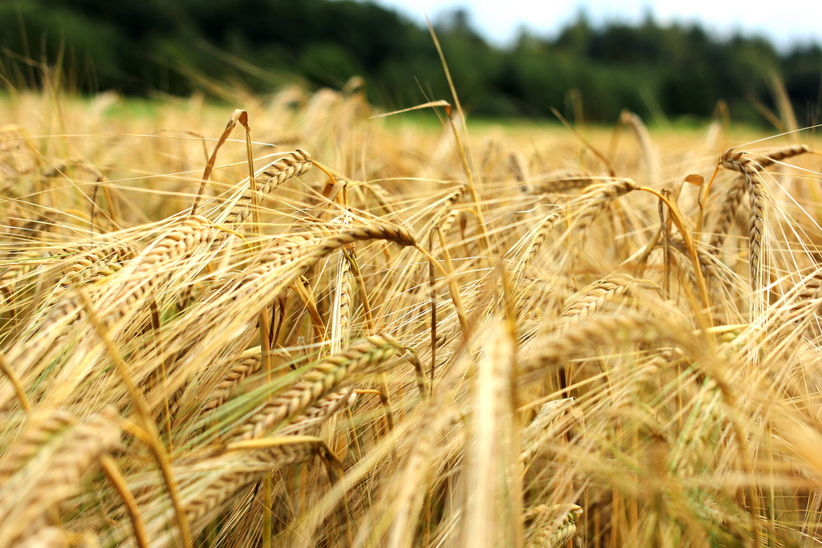
Functions of Money
Money is defined as any asset that is widely accepted as final payment for goods and services. All money must serve the following three functions.
1) Medium of Exchange
A) An asset that is used primarily for trade, not consumption.
In ancient Mesopotamia, barley functioned as one of the main mediums of exchange. Even though it could be consumed, its main role was to facilitate trade.

Slide 10
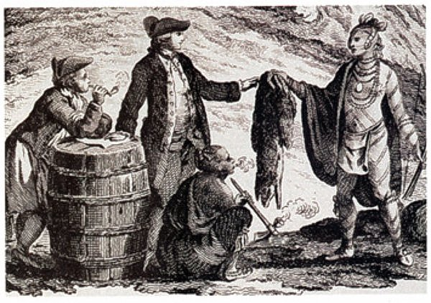
Functions of Money
Money is defined as any asset that is widely accepted as final payment for goods and services. All money must serve the following three functions.
1) Medium of Exchange
A) An asset that is used primarily for trade, not consumption.
B) Eliminates the need for a double coincidence of wants.
Barter can only occur if each person has what the other wants. By acting as an intermediary, money provides a common item that all people want.

Slide 11
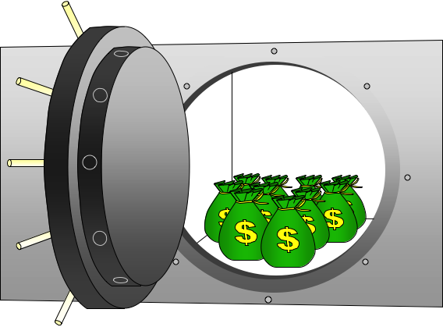
Functions of Money
Money is defined as any asset that is widely accepted as final payment for goods and services. All money must serve the following three functions.
1) Medium of Exchange
A) An asset that is used primarily for trade, not consumption.
B) Eliminates the need for a double coincidence of wants.
2) Store of Value
A) It must maintain its purchasing power when not in use.
In the U.S. we feel safe storing our money in a bank. We know the value of our money will hold up in storage, even if we do not need it for several years.

Slide 12
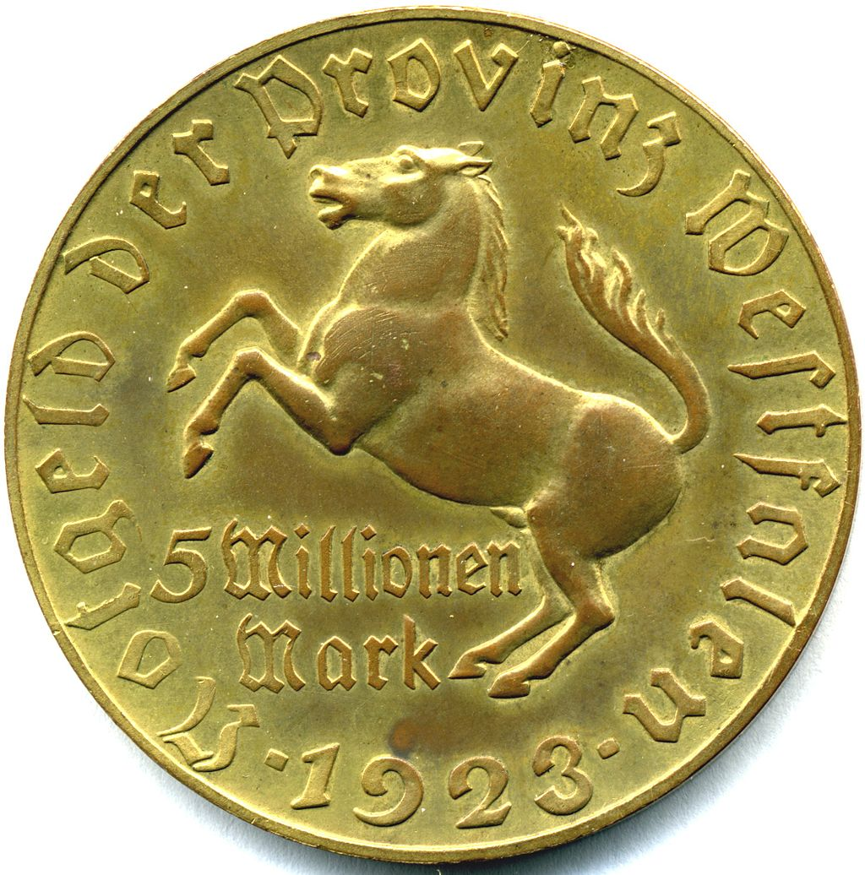
Functions of Money
Money is defined as any asset that is widely accepted as final payment for goods and services. All money must serve the following three functions.
1) Medium of Exchange
A) An asset that is used primarily for trade, not consumption.
B) Eliminates the need for a double coincidence of wants.
2) Store of Value
A) It must maintain its purchasing power when not in use.
B) When retrieved, it must still be usable in transactions.
Suppose you deposited this 5 million German mark in January 1923 when it was worth $700. If you did not withdraw it until October, you would have $0.00001.

Slide 13
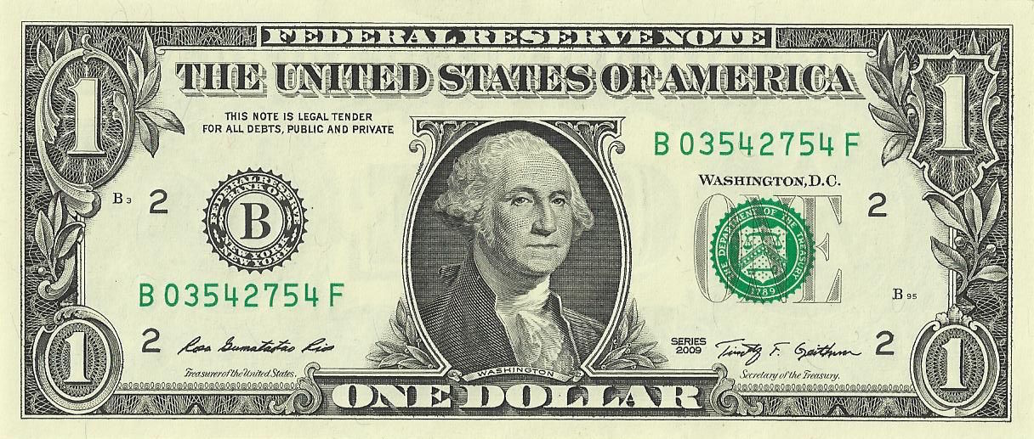
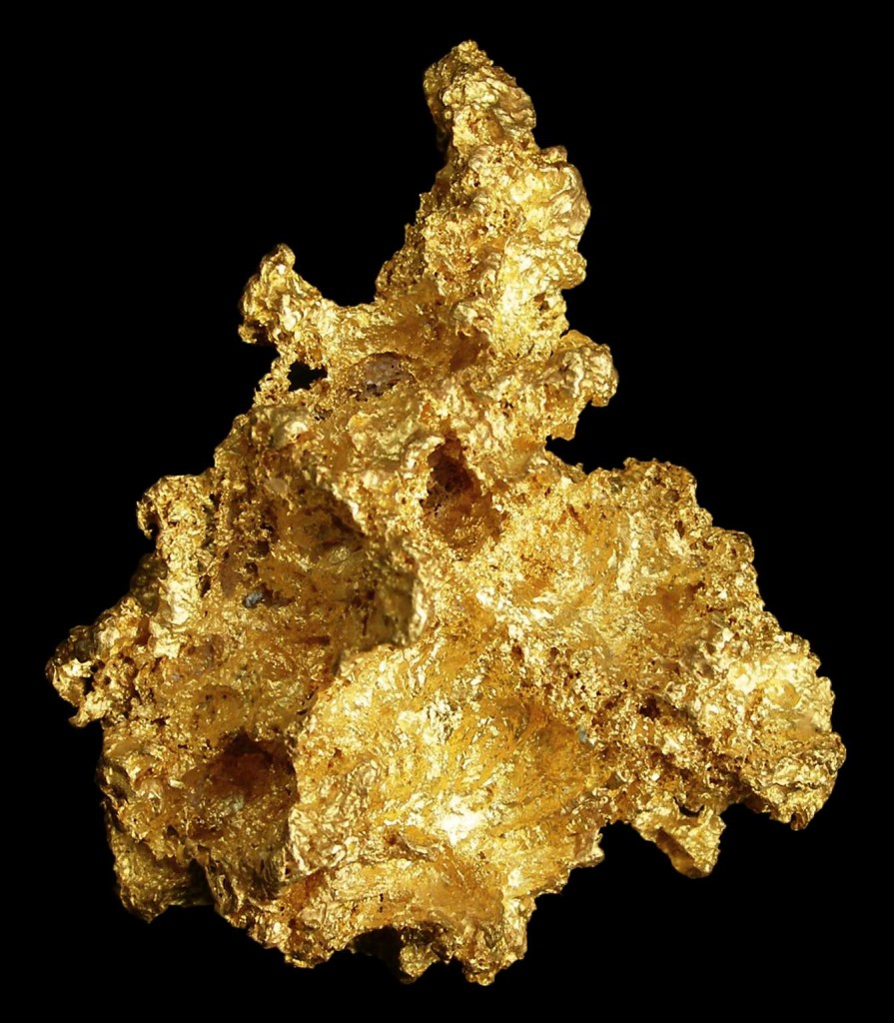
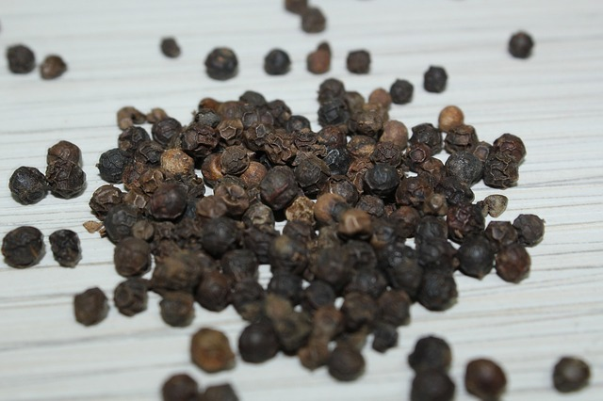
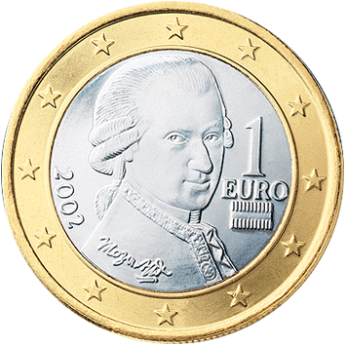
Functions of Money
Money is defined as any asset that is widely accepted as final payment for goods and services. All money must serve the following three functions.
1) Medium of Exchange
A) An asset that is used primarily for trade, not consumption.
B) Eliminates the need for a double coincidence of wants.
2) Store of Value
A) It must maintain its purchasing power when not in use.
X
X
X
B) When retrieved, it must still be usable in transactions.
3) Unit of Account
A) Provides a common measure of value in economic transactions.
The common measure of value in the U.S. is the dollar. Prices are expressed in dollars, not pounds of gold, number of peppercorns, or European Euros.

Slide 14
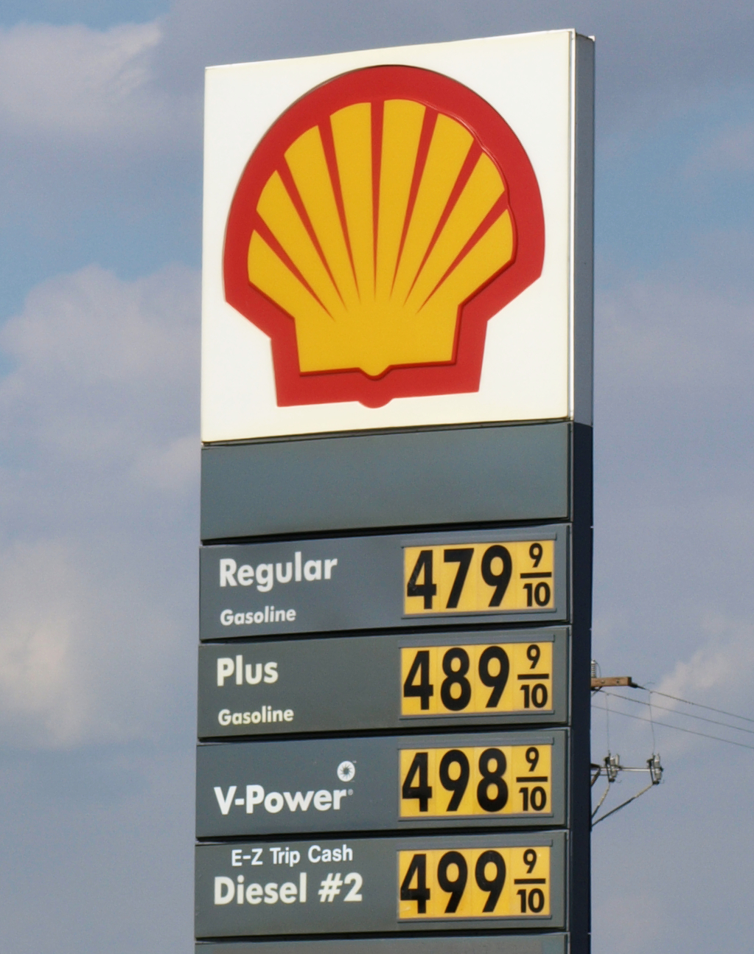
Functions of Money
Money is defined as any asset that is widely accepted as final payment for goods and services. All money must serve the following three functions.
1) Medium of Exchange
A) An asset that is used primarily for trade, not consumption.
B) Eliminates the need for a double coincidence of wants.
2) Store of Value
A) It must maintain its purchasing power when not in use.
B) When retrieved, it must still be usable in transactions.
3) Unit of Account
A) Provides a common measure of value in economic transactions.
By quoting prices in dollars, it is easy to know the opportunity cost of buying the item. If we purchase it on credit, we also know how much debt we have.
B) Allows people to quote prices and manage deferred payments (debt).

Slide 15
Types of Money
For thousands of years, commodities were used as money. This evolved into commodity-backed money, which later evolved into fiat money in the 1900s.
Notes:
Fiat money had been used before 1900, but it did not gain widespread use until the twentieth century.

Slide 16
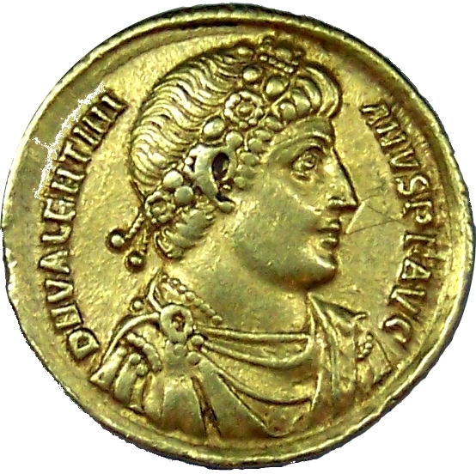
Types of Money
For thousands of years, commodities were used as money. This evolved into commodity-backed money, which later evolved into fiat money in the 1900s.
1) Commodity Money
A) A good used as money in exchanges that has intrinsic value.
Many commodities have been used as money in the past--barley, beaver pelts, salt, and tobacco to name a few--but the best example is probably gold.

Slide 17
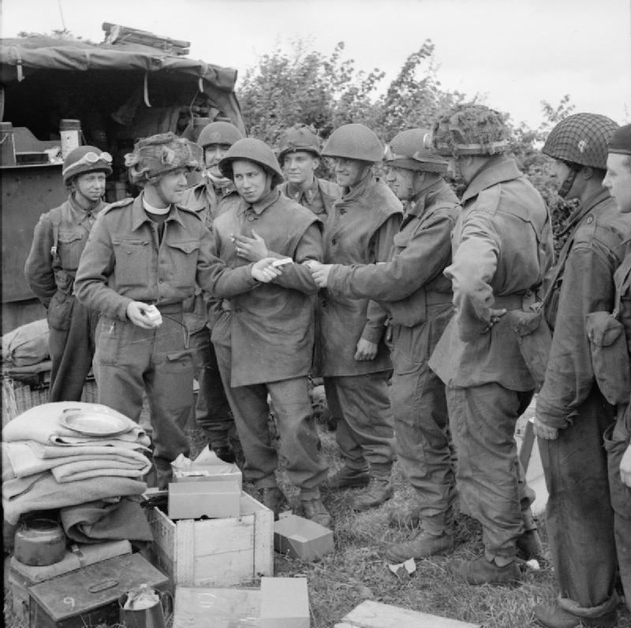
Types of Money
For thousands of years, commodities were used as money. This evolved into commodity-backed money, which later evolved into fiat money in the 1900s.
1) Commodity Money
A) A good used as money in exchanges that has intrinsic value.
B) Similar to barter, but the good is a recognized medium of exchange.
In WWII POW camps, prisoners used cigarettes in transactions. They were money, not a bartering item, because people universally regarded them as money.

Slide 18
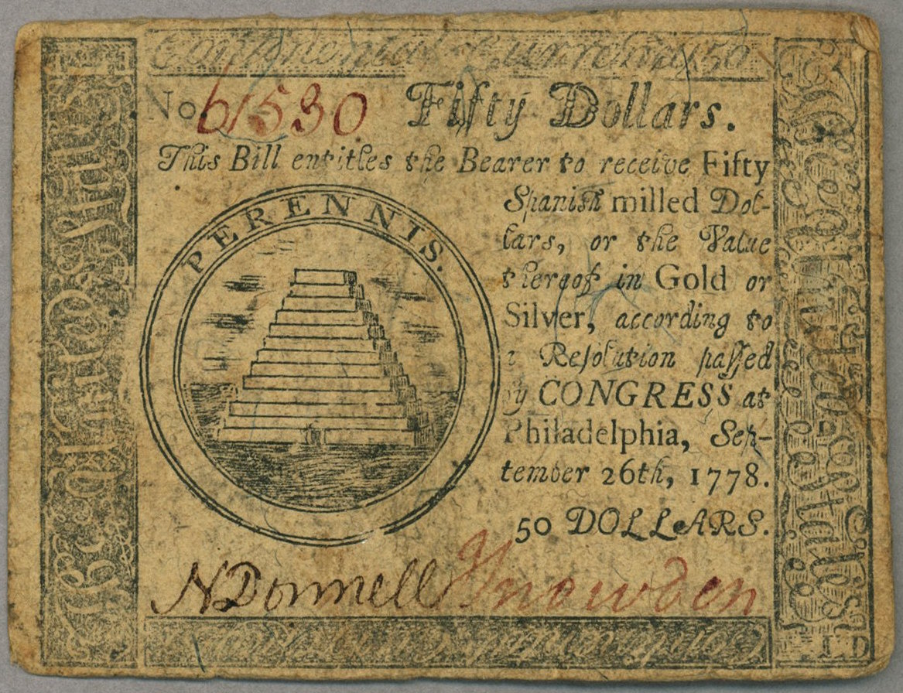
Types of Money
For thousands of years, commodities were used as money. This evolved into commodity-backed money, which later evolved into fiat money in the 1900s.
1) Commodity Money
A) A good used as money in exchanges that has intrinsic value.
B) Similar to barter, but the good is a recognized medium of exchange.
2) Representative Money
A) Signifies ownership of valuable goods, but has no intrinsic value.
Enlarge Image
Eventually, people realized a piece of paper, such as a bank note, signifying ownership of a commodity was easier to trade than the actual commodity.

Slide 19
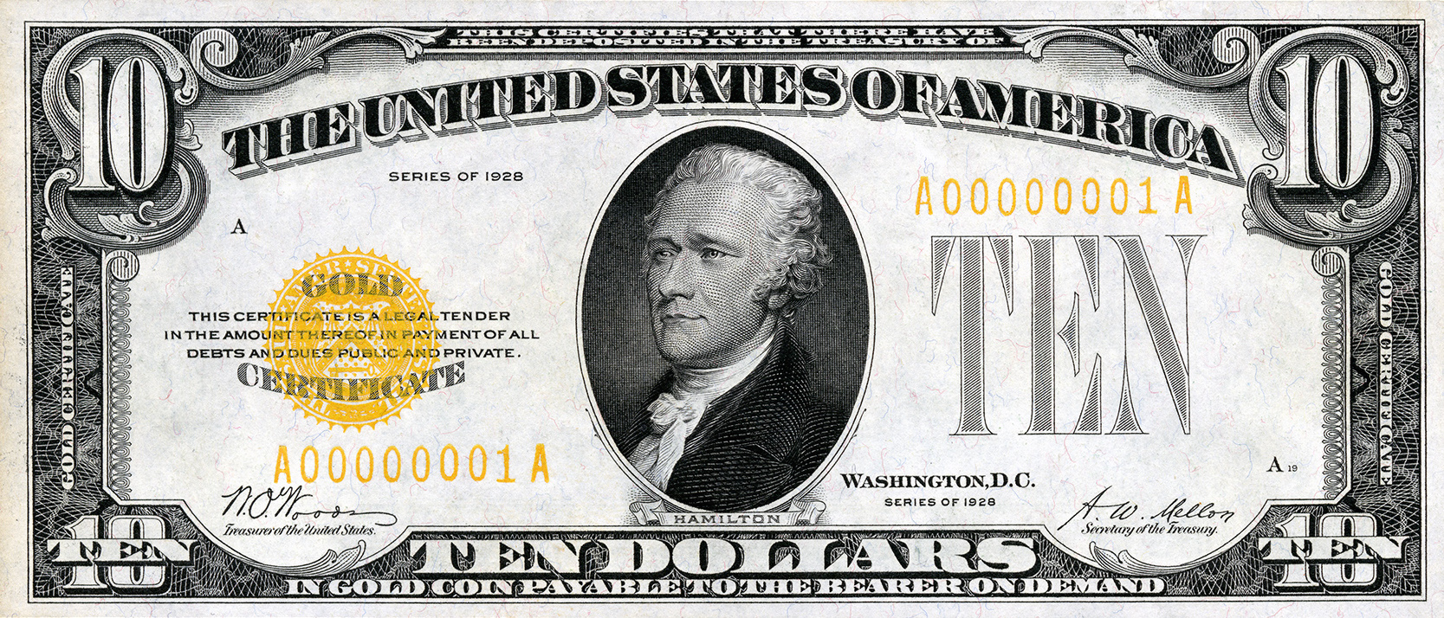
Types of Money
For thousands of years, commodities were used as money. This evolved into commodity-backed money, which later evolved into fiat money in the 1900s.
1) Commodity Money
A) A good used as money in exchanges that has intrinsic value.
B) Similar to barter, but the good is a recognized medium of exchange.
2) Representative Money
A) Signifies ownership of valuable goods, but has no intrinsic value.
B) Example: Paper money that is redeemable for gold (gold standard).
Enlarge Image
From 1873 to 1971, the U.S. had various forms of a gold (and silver) standard. These gold certificates, though rare, can still be redeemed for gold.

Slide 20
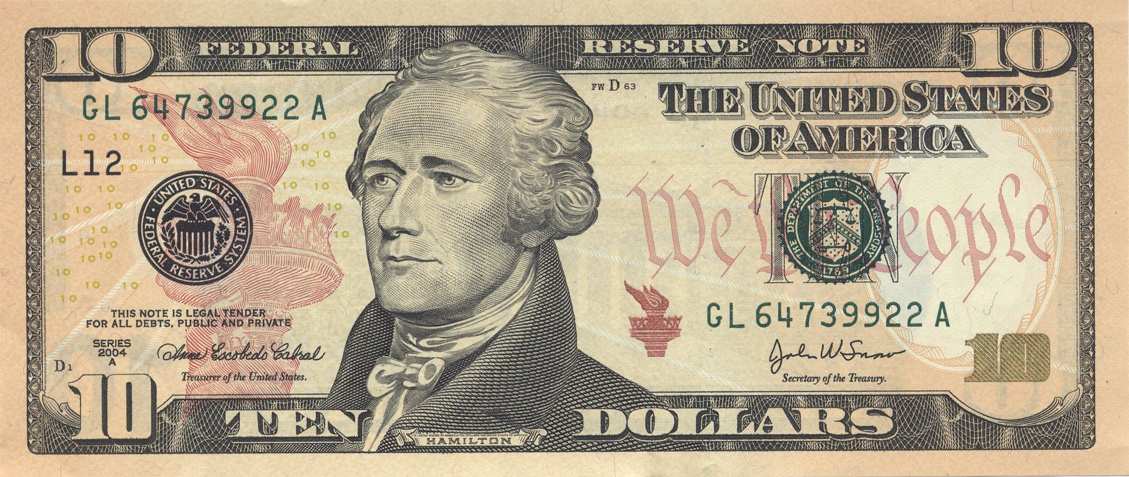
Types of Money
For thousands of years, commodities were used as money. This evolved into commodity-backed money, which later evolved into fiat money in the 1900s.
1) Commodity Money
A) A good used as money in exchanges that has intrinsic value.
B) Similar to barter, but the good is a recognized medium of exchange.
2) Representative Money
A) Signifies ownership of valuable goods, but has no intrinsic value.
B) Example: Paper money that is redeemable for gold (gold standard).
3) Fiat Money
Enlarge Image
A) Has no intrinsic value and cannot be exchanged for valuable goods.
Today, the U.S. dollar is not backed by a commodity. Unlike the first two types of money, this allows the government to control how much money exists.

Slide 21
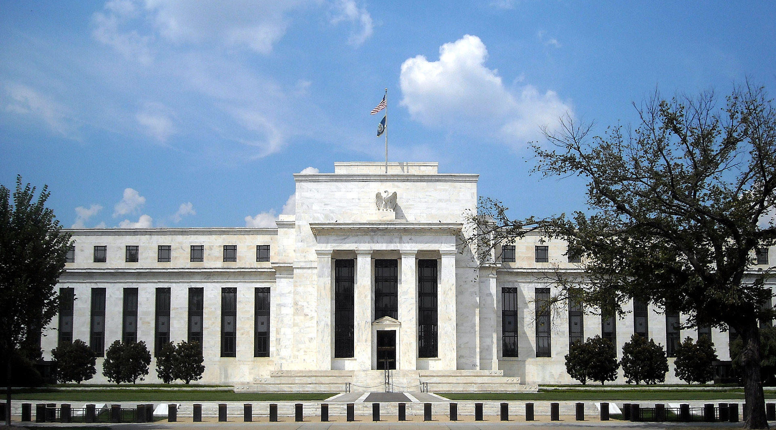
Types of Money
For thousands of years, commodities were used as money. This evolved into commodity-backed money, which later evolved into fiat money in the 1900s.
1) Commodity Money
A) A good used as money in exchanges that has intrinsic value.
B) Similar to barter, but the good is a recognized medium of exchange.
2) Representative Money
A) Signifies ownership of valuable goods, but has no intrinsic value.
B) Example: Paper money that is redeemable for gold (gold standard).
3) Fiat Money
A) Has no intrinsic value and cannot be exchanged for valuable goods.
The U.S. dollar is issued by the nation’s central bank, the Federal Reserve. By government order, or fiat, they have declared this money to be legal tender.
B) Its value derives from its official status as a medium of exchange.

Slide 22
Characteristics of Money
Throughout history, many different items have been used as money with varying success. The best money possesses the following characteristics.
Notes:
I have included seven characteristics. Materials from the Federal Reserve emphasize only the first six. I have included a seventh because it is mentioned in several other sources.

Slide 23
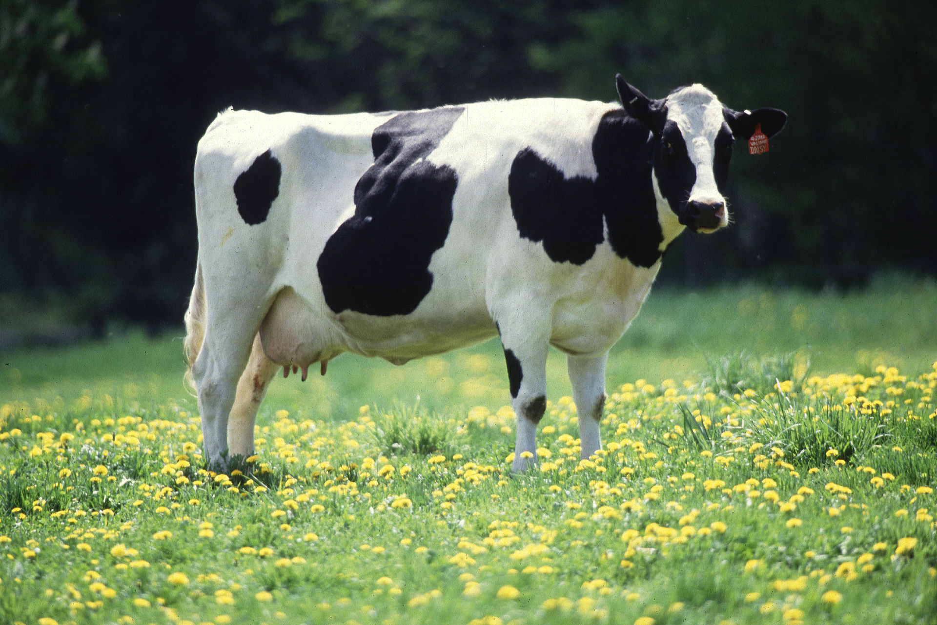
Characteristics of Money
Throughout history, many different items have been used as money with varying success. The best money possesses the following characteristics.
1) Divisible
It can be broken into smaller units.
Around 9000 BCE, cows became units of exchange in some cultures. Clearly indivisible, cows have been very important when negotiating wedding terms.

Slide 24
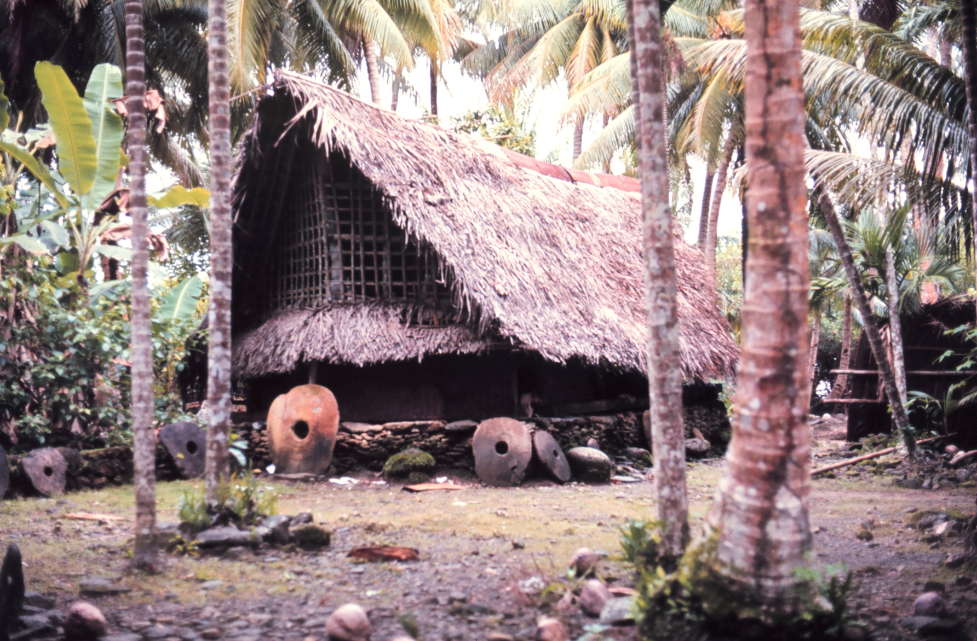
Characteristics of Money
Throughout history, many different items have been used as money with varying success. The best money possesses the following characteristics.
1) Divisible
It can be broken into smaller units.
2) Portable
It can be transported.
On Yap, an island in Micronesia, large stone wheels called rai are used when making certain exchanges. Because they are so large, they are rarely moved.

Slide 25
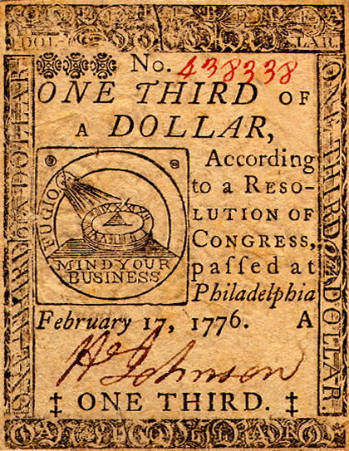
Characteristics of Money
Throughout history, many different items have been used as money with varying success. The best money possesses the following characteristics.
1) Divisible
It can be broken into smaller units.
2) Portable
It can be transported.
3) Acceptable
People accept it as payment.
During the American Revolution, Congress issued paper money called Continentals. By 1781, they were so worthless that people refused to use them.

Slide 26
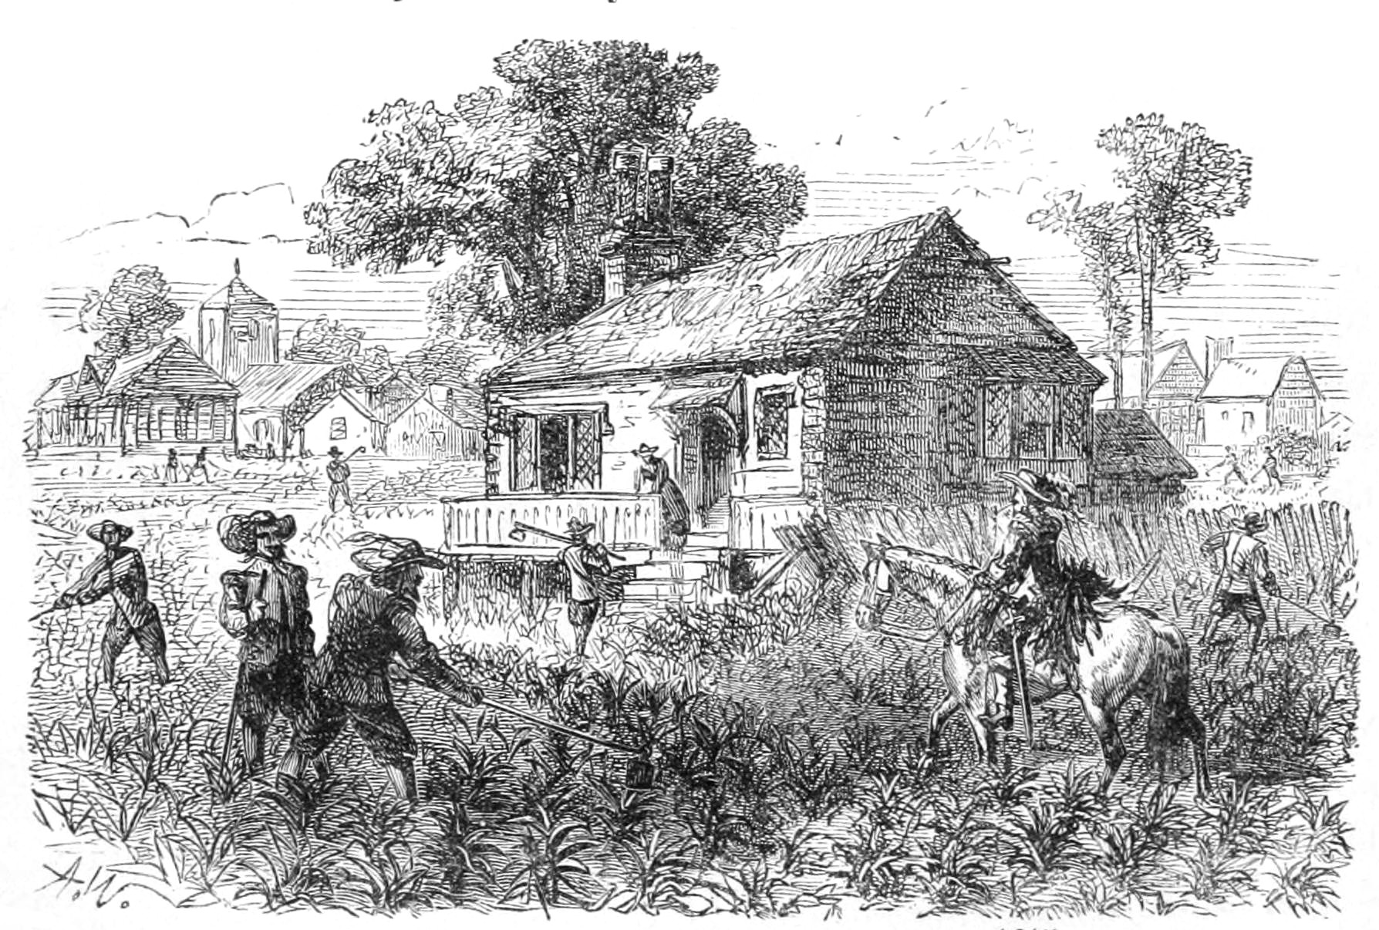
Characteristics of Money
Throughout history, many different items have been used as money with varying success. The best money possesses the following characteristics.
1) Divisible
It can be broken into smaller units.
2) Portable
It can be transported.
3) Acceptable
People accept it as payment.
4) Scarce
It is relatively hard to obtain.
During the 1600s, tobacco was Virginia’s main currency. Because tobacco naturally grows there, this inevitably led to overproduction.

Slide 27
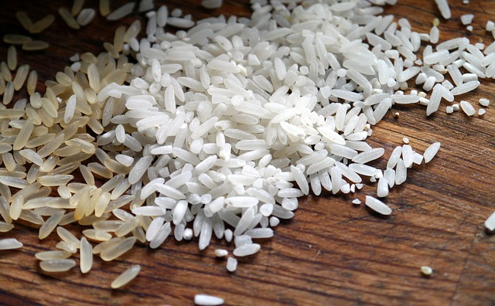
Characteristics of Money
Throughout history, many different items have been used as money with varying success. The best money possesses the following characteristics.
1) Divisible
It can be broken into smaller units.
2) Portable
It can be transported.
3) Acceptable
People accept it as payment.
4) Scarce
It is relatively hard to obtain.
5) Durable
It lasts a long time.
In feudal Japan, rice was a prominent form of currency. Although it can be safely stored for several years, it eventually rots, and loses its value.

Slide 28
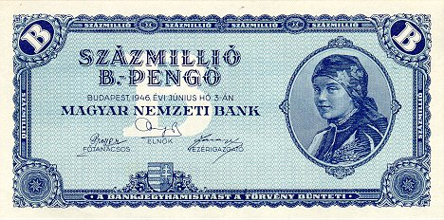
Characteristics of Money
Throughout history, many different items have been used as money with varying success. The best money possesses the following characteristics.
1) Divisible
It can be broken into smaller units.
2) Portable
It can be transported.
3) Acceptable
People accept it as payment.
4) Scarce
It is relatively hard to obtain.
5) Durable
It lasts a long time.
6) Stable
Its value stays constant over time.
The Hungarian pengo experienced the worst inflation in history in 1946. Prices doubled every 15 hours, necessitating the printing of a 100 quintillion pengo.
Notes:
A quintillion is 10 raised to the 18th power, or a 1 with 18 zeroes after it.

Slide 29
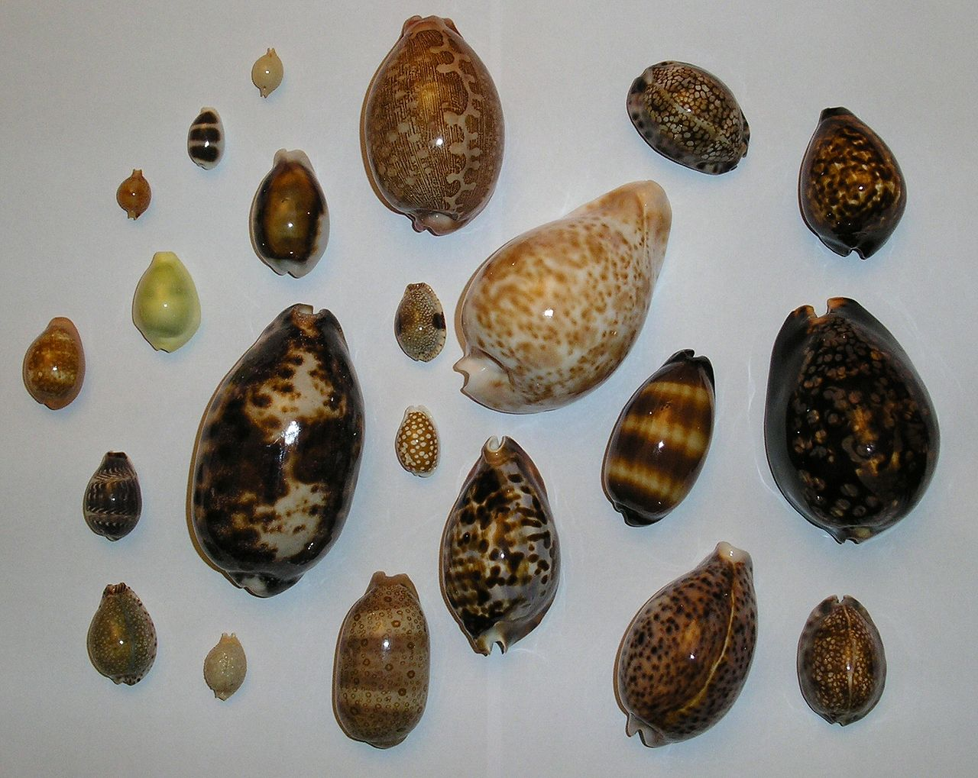
Characteristics of Money
Throughout history, many different items have been used as money with varying success. The best money possesses the following characteristics.
1) Divisible
It can be broken into smaller units.
2) Portable
It can be transported.
3) Acceptable
People accept it as payment.
4) Scarce
It is relatively hard to obtain.
5) Durable
It lasts a long time.
6) Stable
Its value stays constant over time.
Cowry shells, used throughout the world, are one of the longest-lasting forms of money. Including 200 different species, they clearly are not uniform.
7) Uniform (or Fungible)
All units are equivalent.

Slide 30
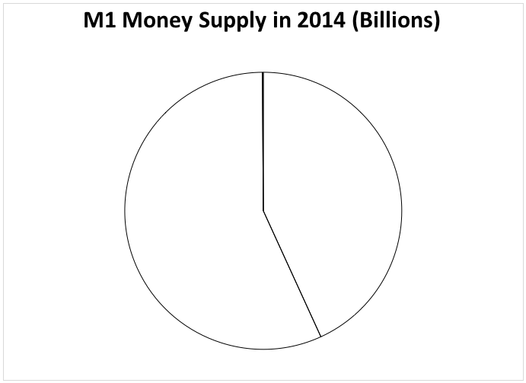
M1 Money Supply
Measures of the money supply are based on liquidity (the ease of converting an asset into cash). M1 is the most liquid measure, consisting of three items.

Slide 31
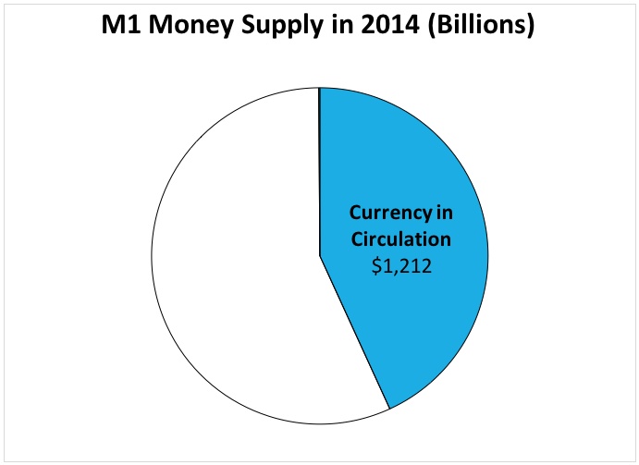
M1 Money Supply
Measures of the money supply are based on liquidity (the ease of converting an asset into cash). M1 is the most liquid measure, consisting of three items.
1) Currency in Circulation
Includes all paper money and coins not stored in banks.
People in other countries hold a great deal of U.S. currency. Estimates differ, but between 25% and 65% of all currency in circulation is held abroad.

Slide 32
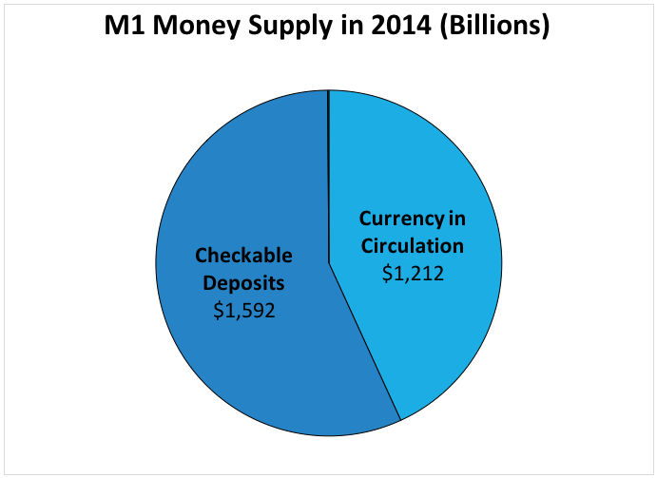
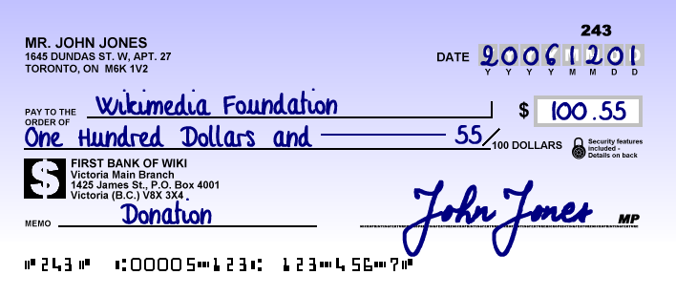
M1 Money Supply
Measures of the money supply are based on liquidity (the ease of converting an asset into cash). M1 is the most liquid measure, consisting of three items.
1) Currency in Circulation
Includes all paper money and coins not stored in banks.
2) Checkable Bank Deposits
Bank accounts that consumers write checks (or use a debit card) from.
Commercial banks, savings and loan associations, and credit unions all issue checking accounts, though each may have its own special name for it.

Slide 33
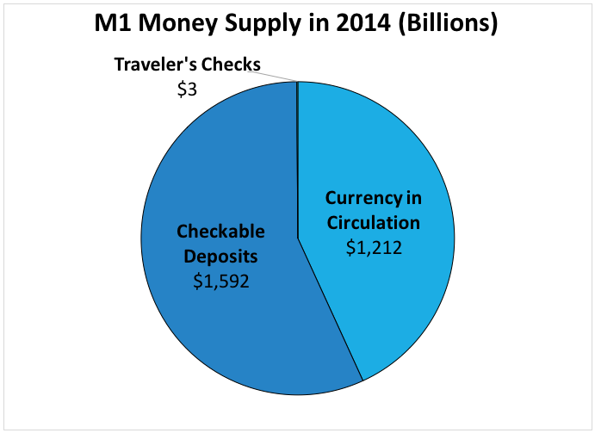
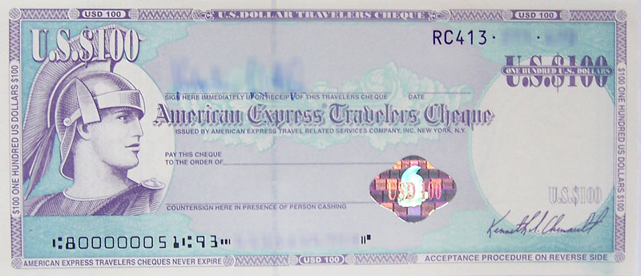
M1 Money Supply
Measures of the money supply are based on liquidity (the ease of converting an asset into cash). M1 is the most liquid measure, consisting of three items.
1) Currency in Circulation
Includes all paper money and coins not stored in banks.
2) Checkable Bank Deposits
Bank accounts that consumers write checks (or use a debit card) from.
3) Traveler’s Checks
Prepaid checks issued by banks (or credit cards) that are used like cash.
In 1891 American Express developed a large-scale system for traveler’s checks. Rarely used today, they are often omitted when making calculations.

Slide 34
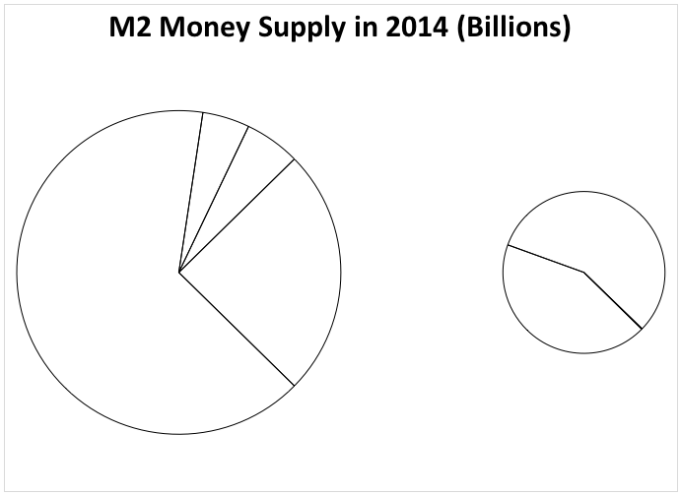
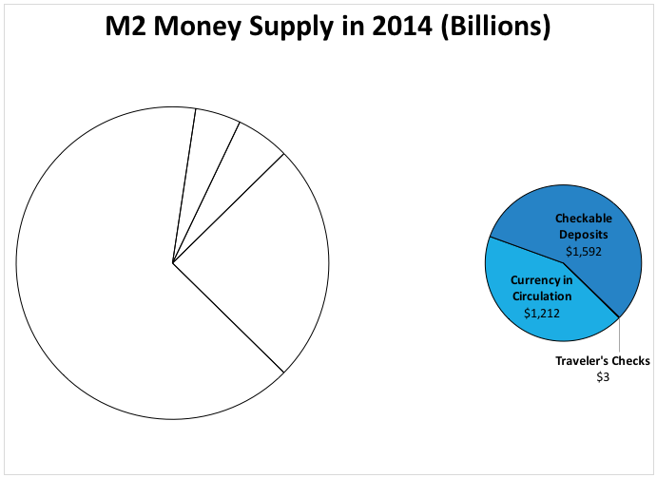
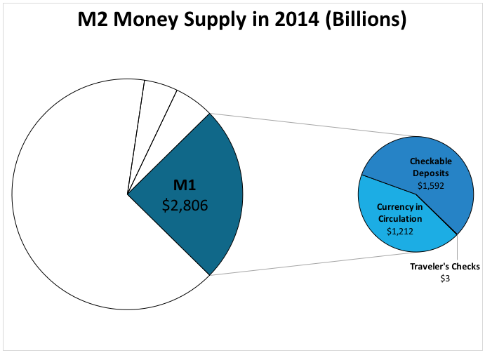
M2 and M3 Money Supply
The M2 and M3 measurements add increasingly less liquid assets to the money supply. M2 includes all M1 assets and adds three “near-monies” to the list.

Slide 35
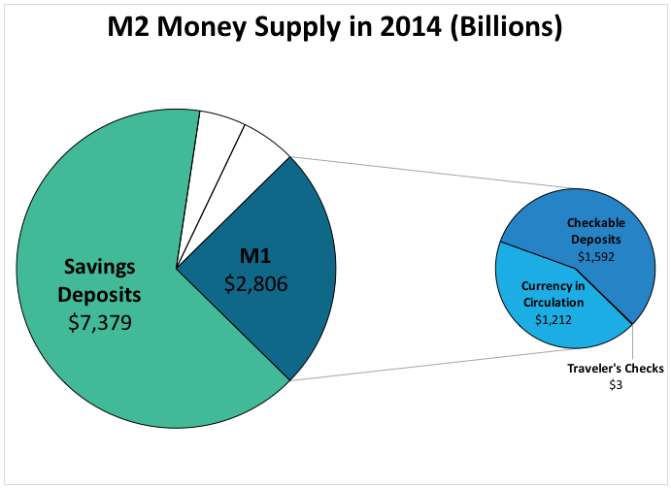
M2 and M3 Money Supply
The M2 and M3 measurements add increasingly less liquid assets to the money supply. M2 includes all M1 assets and adds three “near-monies” to the list.
1) Savings Deposits
Deposit accounts that pay interest but cannot be used for purchases.
Of all the M2 assets, savings deposits pay the least interest because they are so easily converted into cash. They are not intended for long-term growth.

Slide 36
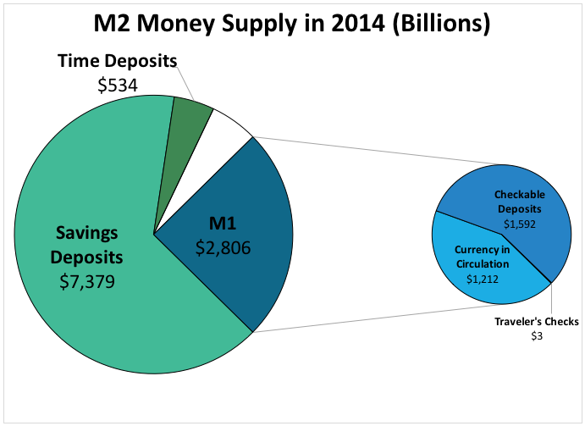
M2 and M3 Money Supply
The M2 and M3 measurements add increasingly less liquid assets to the money supply. M2 includes all M1 assets and adds three “near-monies” to the list.
1) Savings Deposits
Deposit accounts that pay interest but cannot be used for purchases.
2) Time Deposits
Interest-bearing deposits that are held for a fixed amount of time.
Time deposits are ideally held until the date of maturity. Withdrawing the money early usually requires 30 days notice or the payment of a penalty.

Slide 37
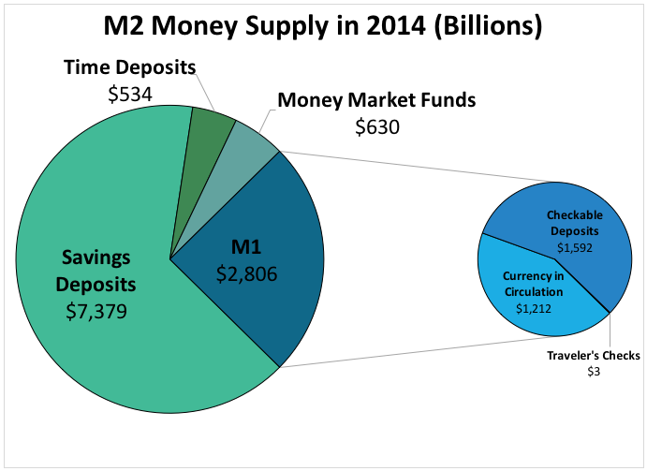
M2 and M3 Money Supply
The M2 and M3 measurements add increasingly less liquid assets to the money supply. M2 includes all M1 assets and adds three “near-monies” to the list.
1) Savings Deposits
Deposit accounts that pay interest but cannot be used for purchases.
2) Time Deposits
Interest-bearing deposits that are held for a fixed amount of time.
3) Money Market Funds
Short-term mutual funds that only invest in liquid assets.
Unlike regular mutual funds, which are usually geared towards retirement, money market funds are short-term, low-risk, and low-return investments.

Slide 38
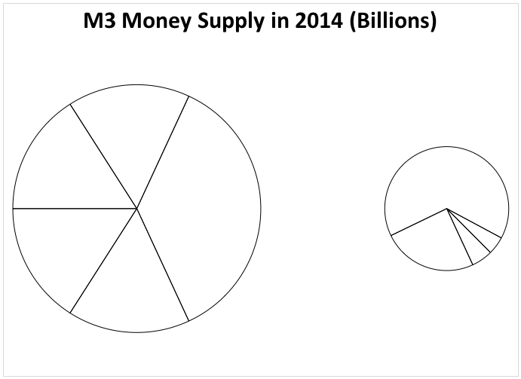
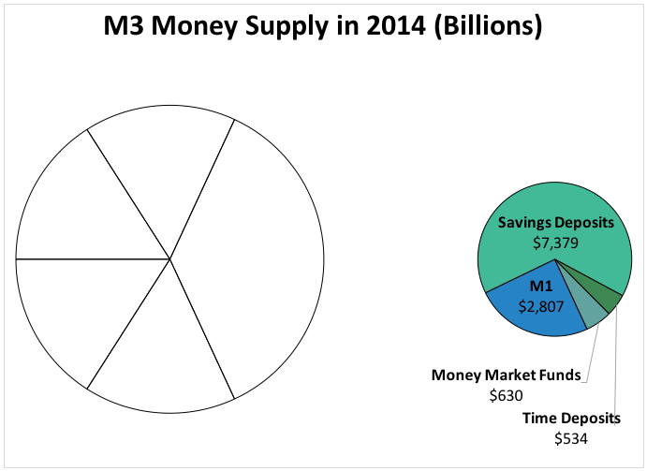
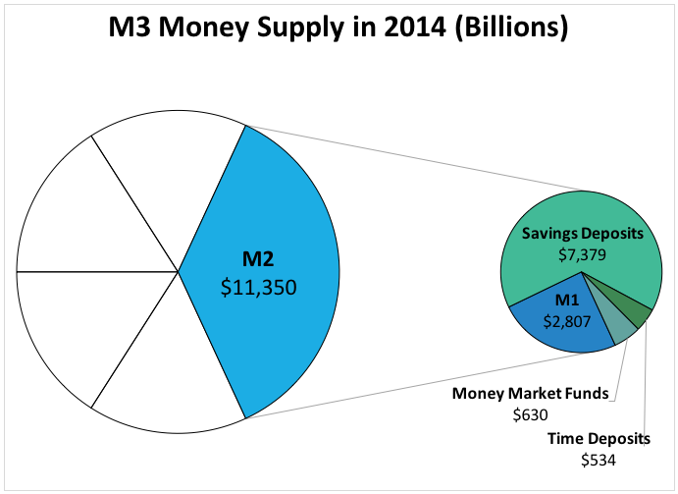
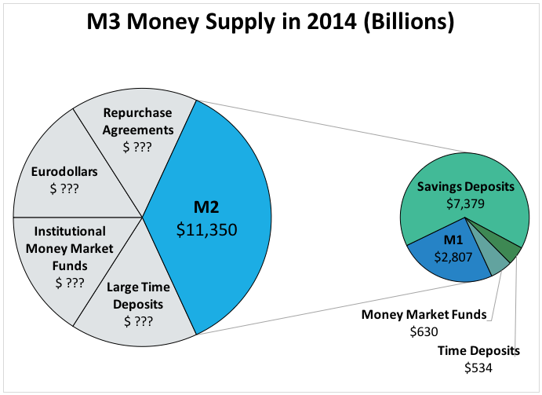
M2 and M3 Money Supply
The M2 and M3 measurements add increasingly less liquid assets to the money supply. M2 includes all M1 assets and adds three “near-monies” to the list.
1) Savings Deposits
Deposit accounts that pay interest but cannot be used for purchases.
2) Time Deposits
Interest-bearing deposits that are held for a fixed amount of time.
3) Money Market Funds
Short-term mutual funds that only invest in liquid assets.
M3 Money Supply
A) M3 includes all M2 assets and adds all remaining assets.
M3 is the broadest measure of the money supply, adding large time deposits, institutional money market funds, Eurodollars, and repurchase agreements.

Slide 39
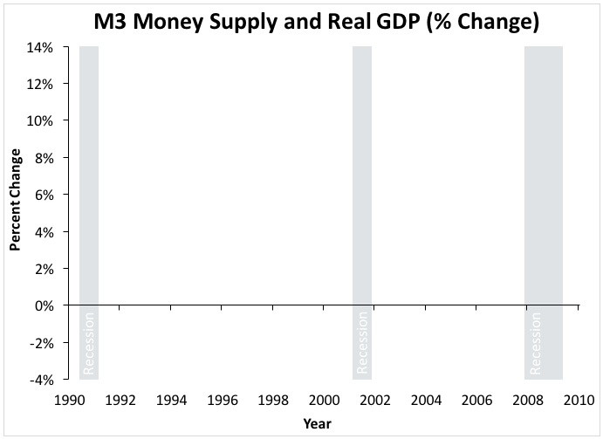
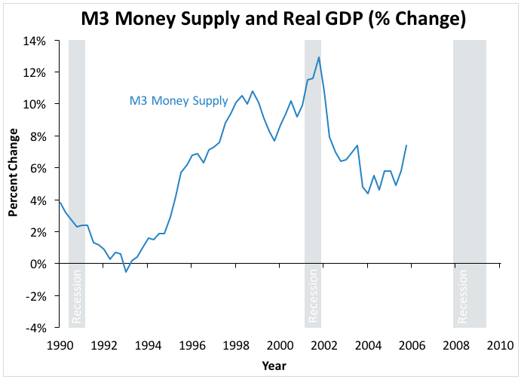
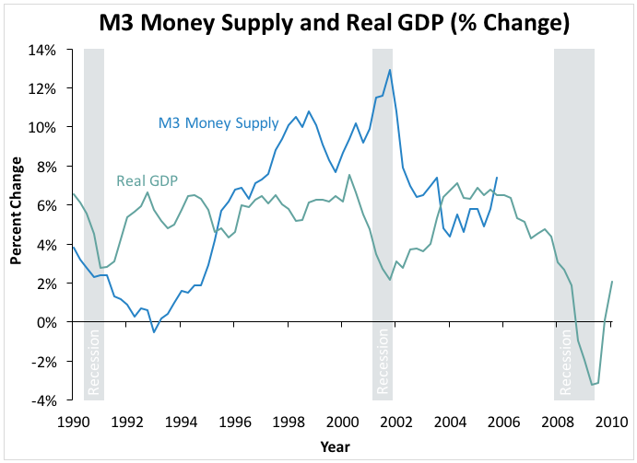
M2 and M3 Money Supply
The M2 and M3 measurements add increasingly less liquid assets to the money supply. M2 includes all M1 assets and adds three “near-monies” to the list.
1) Savings Deposits
Deposit accounts that pay interest but cannot be used for purchases.
2) Time Deposits
Interest-bearing deposits that are held for a fixed amount of time.
3) Money Market Funds
Short-term mutual funds that only invest in liquid assets.
M3 Money Supply
A) M3 includes all M2 assets and adds all remaining assets.
Considered near near-monies, M3 assets are relatively poor predictors of future economic activity. They mainly concern corporations and the wealthy.
B) Since 2006, policy makers no longer track or use M3 data.

Slide 40
The Monetary Base
M1, M2, and M3 measure the money supply. The monetary base is slightly different, measuring the quantity of money the monetary authorities control.
Monetary Base
M1 Money Supply
Notes:
Sometimes the monetary base is referred to as M0 (M-zero) or MB. Because this system of abbreviation does not consistently occur in the United States, it has been omitted.

Slide 41
The Monetary Base
M1, M2, and M3 measure the money supply. The monetary base is slightly different, measuring the quantity of money the monetary authorities control.
1) Currency in Circulation
Monetary Base
M1 Money Supply
A) Cash held by people that is available for spending.
Currency in Circulation
The Federal Reserve--the main monetary authority in the U.S.--controls how much paper money and coins are printed, minted, and distributed into the economy.

Slide 42
The Monetary Base
M1, M2, and M3 measure the money supply. The monetary base is slightly different, measuring the quantity of money the monetary authorities control.
1) Currency in Circulation
Monetary Base
M1 Money Supply
A) Cash held by people that is available for spending.
B) Included in both the monetary base and the money supply.
Currency in Circulation
Currency in circulation meets the criteria for both the monetary base (controlled by the authorities) and for the money supply (available for spending).

Slide 43
The Monetary Base
M1, M2, and M3 measure the money supply. The monetary base is slightly different, measuring the quantity of money the monetary authorities control.
1) Currency in Circulation
Monetary Base
M1 Money Supply
A) Cash held by people that is available for spending.
B) Included in both the monetary base and the money supply.
Currency in Circulation
2) Bank Reserves
Bank Reserves
A) Cash held in bank vaults and as deposits with the Federal Reserve.
The Federal Reserve controls how much cash exists, but they do not control the allocation of that cash between currency in circulation and bank reserves.

Slide 44
The Monetary Base
M1, M2, and M3 measure the money supply. The monetary base is slightly different, measuring the quantity of money the monetary authorities control.
1) Currency in Circulation
Monetary Base
M1 Money Supply
A) Cash held by people that is available for spending.
B) Included in both the monetary base and the money supply.
Currency in Circulation
2) Bank Reserves
Bank Reserves
Checkable Deposits
A) Cash held in bank vaults and as deposits with the Federal Reserve.
B) It is not available for spending, so it is not part of the money supply.
Bank reserves provide the financial backing for a check, but they are not the same thing. Bank reserves are not used up when a check is written.

Slide 45
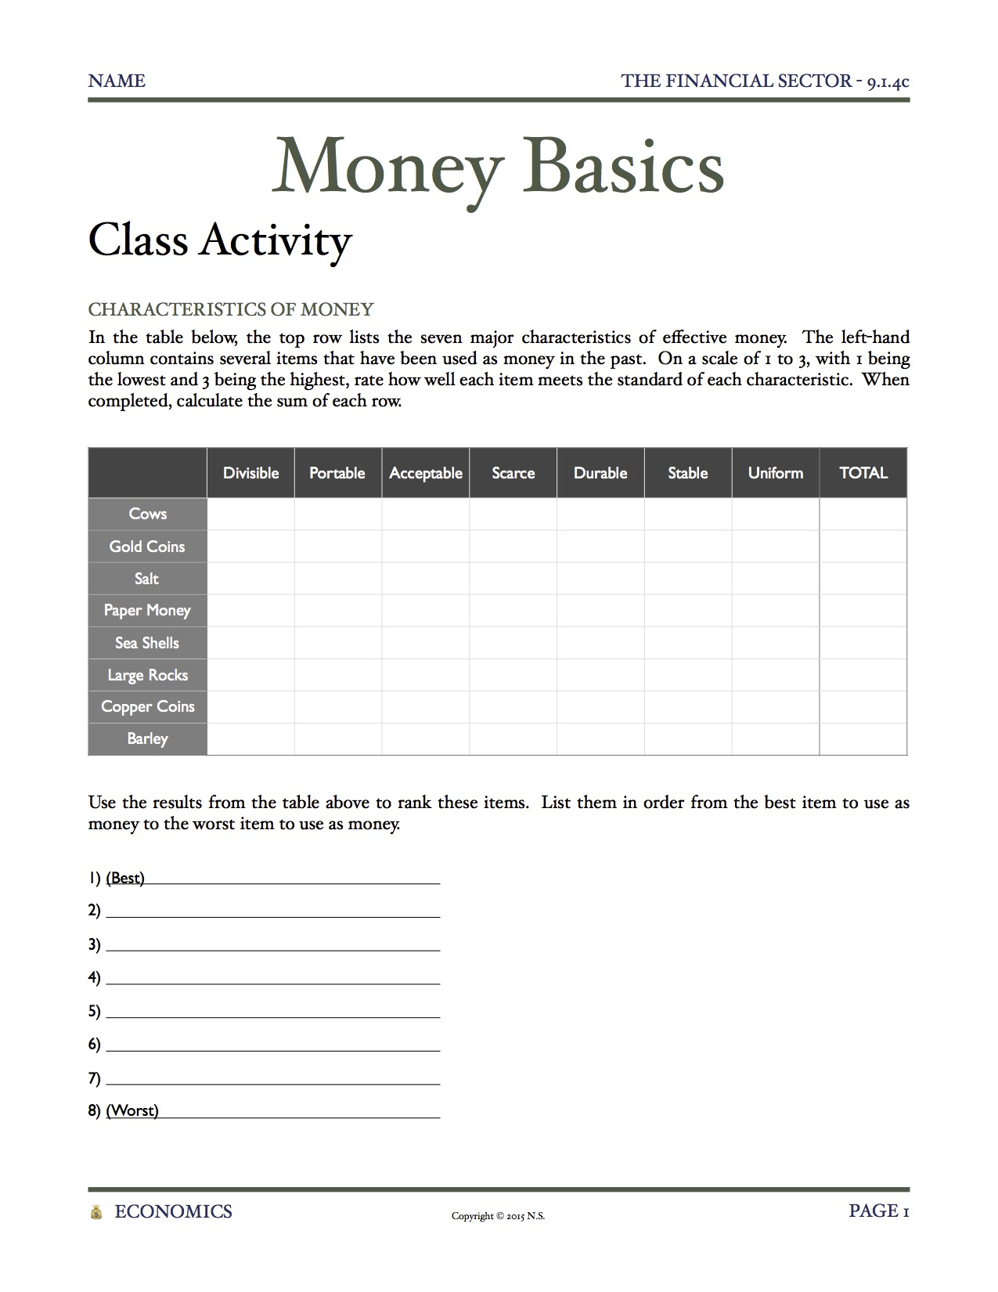
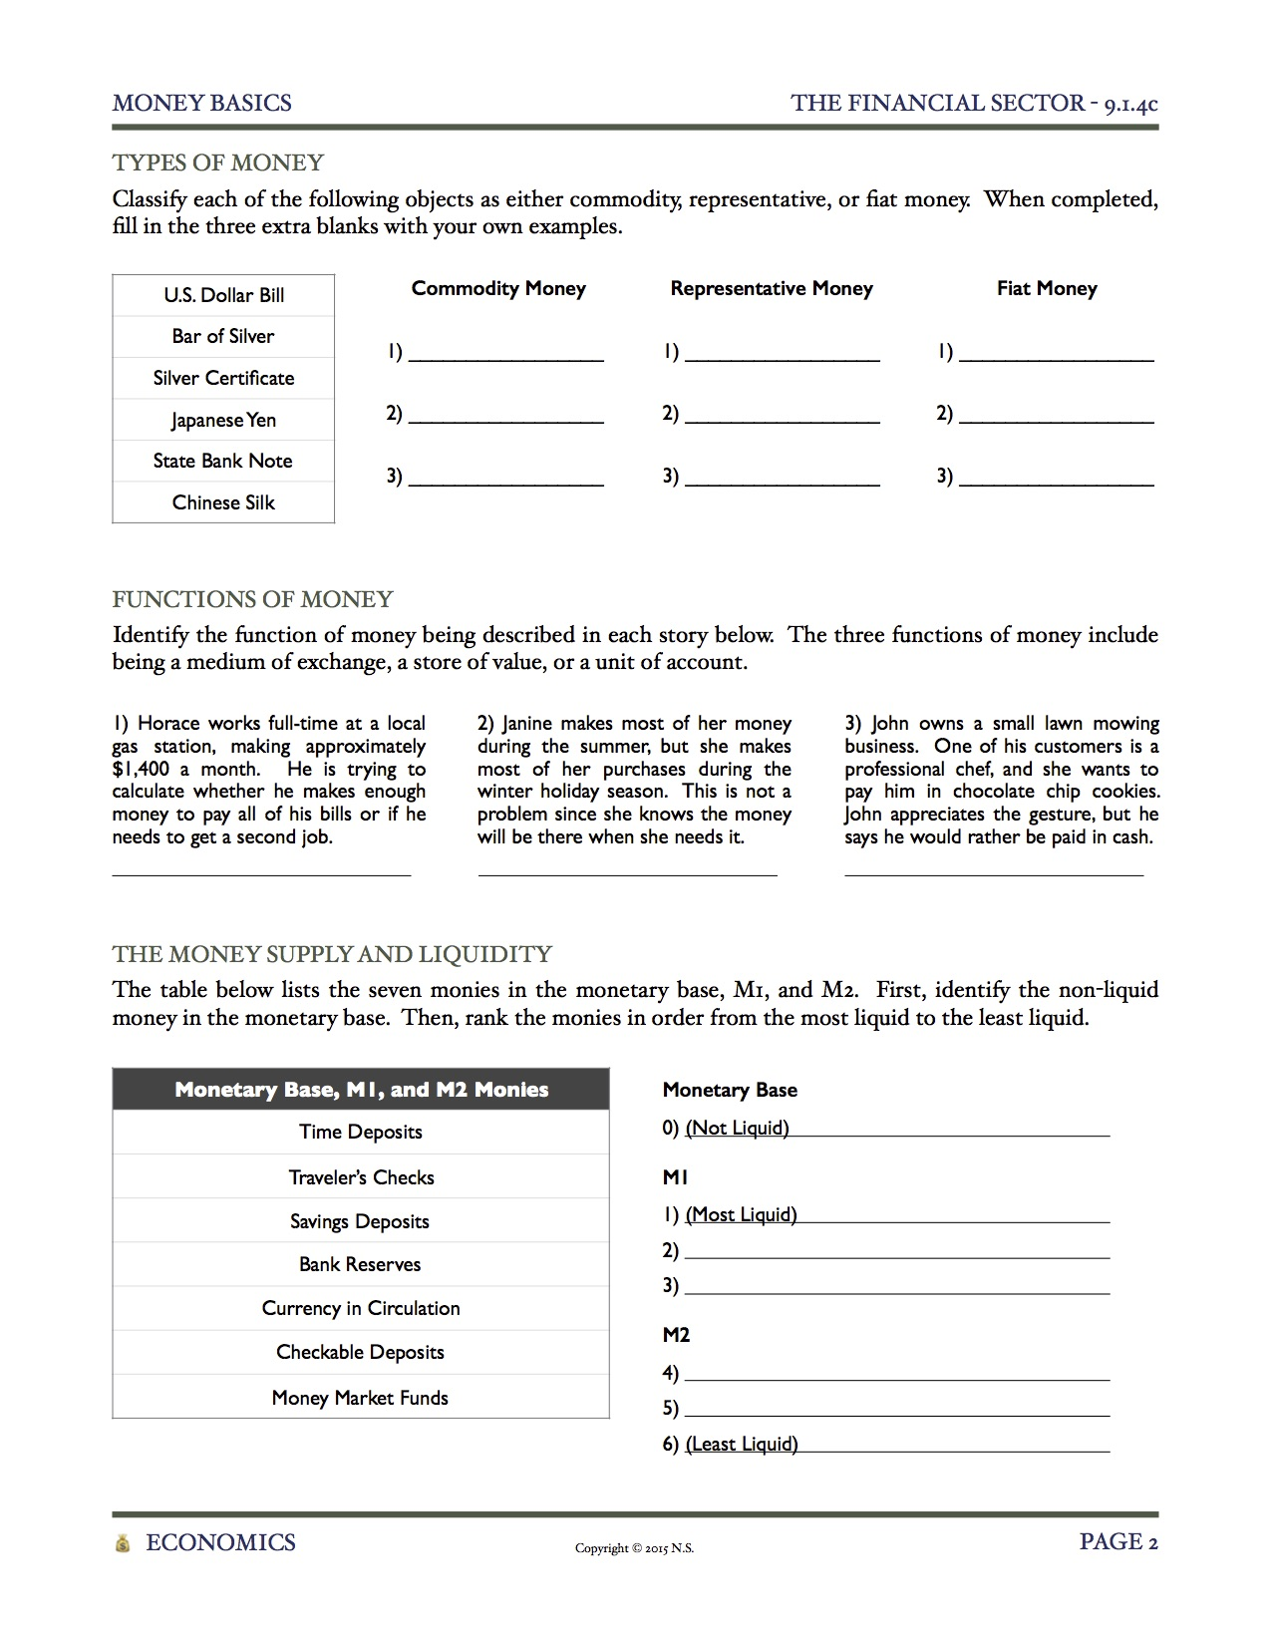
Money Basics
Class Activity
Each student will receive a copy of today’s Class Activity, entitled Money Basics. When completed, use the buttons below to informally assess student understanding.
Characteristics of
Money
Types of Money
Functions of Money
The Money
Supply and Liquidity
Notes:
[Pass out “Money Basics” to each student.] This is the Class Activity included in the download. Assign students one of the three versions. Difficulty increases from (a) to (b) to (c), allowing for differentiation, if desired. Students may either self-identify which difficulty to complete, or the teacher can decide.

Slide 46
Money Basics
Class Activity
Characteristics of Money
In the table below, the top row lists the seven major characteristics of effective money. The left-hand column contains several items that have been used as money in the past. On a scale of 1 to 3, with 1 being the lowest and 3 being the highest, rate how well each item meets the standard of each characteristic. When completed, calculate the sum of each row.
 | Divisible | Portable | Acceptable | Scarce | Durable | Stable | Uniform | TOTAL
Cows
Gold Coins
Salt
Paper Money
Sea Shells
Large Rocks
Copper Coins
Barley
1) (Best)
2)
3)
4)
5)
6)
7)
8) (Worst)
Show Answers
Types of Money
Functions of Money
The Money
Supply and Liquidity

Slide 47
Money Basics
Class Activity
Characteristics of Money
In the table below, the top row lists the seven major characteristics of effective money. The left-hand column contains several items that have been used as money in the past. On a scale of 1 to 3, with 1 being the lowest and 3 being the highest, rate how well each item meets the standard of each characteristic. When completed, calculate the sum of each row.
Characteristics of Money
Use the results from the table above to rank these items. List them in order from the best item to use as money to the worst item to use as money.
1) (Best)
2)
3)
4)
5)
6)
7)
8) (Worst)
 | Divisible | Portable | Acceptable | Scarce | Durable | Stable | Uniform | TOTAL
Cows | 1 | 1 | 1 | 2 | 2 | 2 | 1 | 10
Gold Coins | 3 | 3 | 3 | 3 | 3 | 2 | 3 | 20
Salt | 3 | 2 | 1 | 2 | 1 | 2 | 3 | 14
Paper Money | 3 | 3 | 3 | 3 | 3 | 3 | 3 | 21
Sea Shells | 1 | 2 | 2 | 3 | 1 | 2 | 1 | 12
Large Rocks | 2 | 1 | 1 | 1 | 3 | 2 | 1 | 11
Copper Coins | 3 | 3 | 2 | 2 | 3 | 2 | 3 | 18
Barley | 3 | 2 | 1 | 1 | 1 | 2 | 2 | 12
1) (Best) Paper Money
2) Gold Coins
3) Copper Coins
4) Salt
5) Sea Shells
6) Barley
7) Large Rocks
8) (Worst) Cows
 | Divisible | Portable | Acceptable | Scarce | Durable | Stable | Uniform | TOTAL
Cows
Gold Coins
Salt
Paper Money
Sea Shells
Large Rocks
Copper Coins
Barley
Characteristics of
Money
Types of Money
Functions of Money
The Money
Supply and Liquidity
Notes:
Answers provided for sample purposes only.

Slide 48
Money Basics
Class Activity
Types of Money
Classify each of the following objects as either commodity, representative, or fiat money.
U.S. Dollar Bill
Bar of Silver
Silver Certificate
Japanese Yen
State Bank Note
Chinese Silk
Commodity Money
1)
2)
Representative Money
1)
2)
Fiat Money
1)
2)
Characteristics of
Money
Show Answers
Functions of Money
The Money
Supply and Liquidity

Slide 49
Money Basics
Class Activity
Types of Money
Classify each of the following objects as either commodity, representative, or fiat money.
U.S. Dollar Bill
Bar of Silver
Silver Certificate
Japanese Yen
State Bank Note
Chinese Silk
Representative Money
1)
2)
Fiat Money
1)
2)
Commodity Money
1)
2)
Fiat Money
1) U.S. Dollar Bill
2) Japanese Yen
Commodity Money
1) Bar of Silver
2) Chinese Silk
Representative Money
1) Silver Certificate
2) State Bank Note
Characteristics of
Money
Types of Money
Functions of Money
The Money
Supply and Liquidity

Slide 50
Money Basics
Class Activity
Functions of Money
Identify the function of money being described in each story below. The three functions of money include being a medium of exchange, a store of value, or a unit of account.
1) Horace works full-time at a local gas station, making approximately $1,400 a month. He is trying to calculate whether he makes enough money to pay all of his bills or if he needs to get a second job.
2) Janine makes most of her money during the summer, but she makes most of her purchases during the winter holiday season. This is not a problem since she knows the money will be there when she needs it.
3) John owns a small lawn mowing business. One of his customers is a professional chef, and she wants to pay him in chocolate chip cookies. John appreciates the gesture, but he says he would rather be paid in cash.
Characteristics of
Money
Types of Money
Show Answers
The Money
Supply and Liquidity

Slide 51
Money Basics
Class Activity
Functions of Money
Identify the function of money being described in each story below. The three functions of money include being a medium of exchange, a store of value, or a unit of account.
1) Horace works full-time at a local gas station, making approximately $1,400 a month. He is trying to calculate whether he makes enough money to pay all of his bills or if he needs to get a second job.
2) Janine makes most of her money during the summer, but she makes most of her purchases during the winter holiday season. This is not a problem since she knows the money will be there when she needs it.
3) John owns a small lawn mowing business. One of his customers is a professional chef, and she wants to pay him in chocolate chip cookies. John appreciates the gesture, but he says he would rather be paid in cash.
1) Horace works full-time at a local gas station, making approximately $1,400 a month. He is trying to calculate whether he makes enough money to pay all of his bills or if he needs to get a second job.
Unit of Account
2) Janine makes most of her money during the summer, but she makes most of her purchases during the winter holiday season. This is not a problem since she knows the money will be there when she needs it.
Store of Value
3) John owns a small lawn mowing business. One of his customers is a professional chef, and she wants to pay him in chocolate chip cookies. John appreciates the gesture, but he says he would rather be paid in cash.
Medium of Exchange
Characteristics of
Money
Types of Money
Functions of Money
The Money
Supply and Liquidity

Slide 52
Money Basics
Class Activity
The Money Supply and Liquidity
The table below lists the seven monies in the monetary base, M1, and M2. First, identify the non-liquid money in the monetary base. Then, rank the monies in order from the most liquid to the least liquid.
Monetary Base, M1, and M2, Monies
Time Deposits
Traveler’s Checks
Savings Deposits
Bank Reserves
Currency in Circulation
Checkable Deposits
Money Market Funds
Monetary Base
0) (Not Liquid)
M1
1) (Most Liquid)
2)
3)
M2
4)
5)
6) (Least Liquid)
Characteristics of
Money
Types of Money
Functions of Money
Show Answers

Slide 53
Money Basics
Class Activity
The Money Supply and Liquidity
The table below lists the seven monies in the monetary base, M1, and M2. First, identify the non-liquid money in the monetary base. Then, rank the monies in order from the most liquid to the least liquid.
Monetary Base
0) (Not Liquid)
Monetary Base, M1, and M2, Monies
Time Deposits
Traveler’s Checks
Savings Deposits
Bank Reserves
Currency in Circulation
Checkable Deposits
Money Market Funds
Monetary Base
0) (Not Liquid) Bank Reserves
M1
1) (Most Liquid)
2)
3)
M2
4)
5)
6) (Least Liquid)
M1
1) Currency in Circulation
2) Checkable Deposits
3) Traveler’s Checks
M2
4) Savings Deposits
5) Time Deposits
6) Money Market Funds
Characteristics of
Money
Types of Money
Functions of Money
The Money
Supply and Liquidity

Slide 54
Learning Targets
Knowledge
Understand the functions, types, and characteristics of money.
Understand how the money supply is classified into different categories based on liquidity.
Reasoning
None
Skill
None
Essential Questions
How do economists define money?
Notes:
Help students make connections between the learning targets and the activities from today. If desired, see if students can answer the Essential Questions.

Slide 55
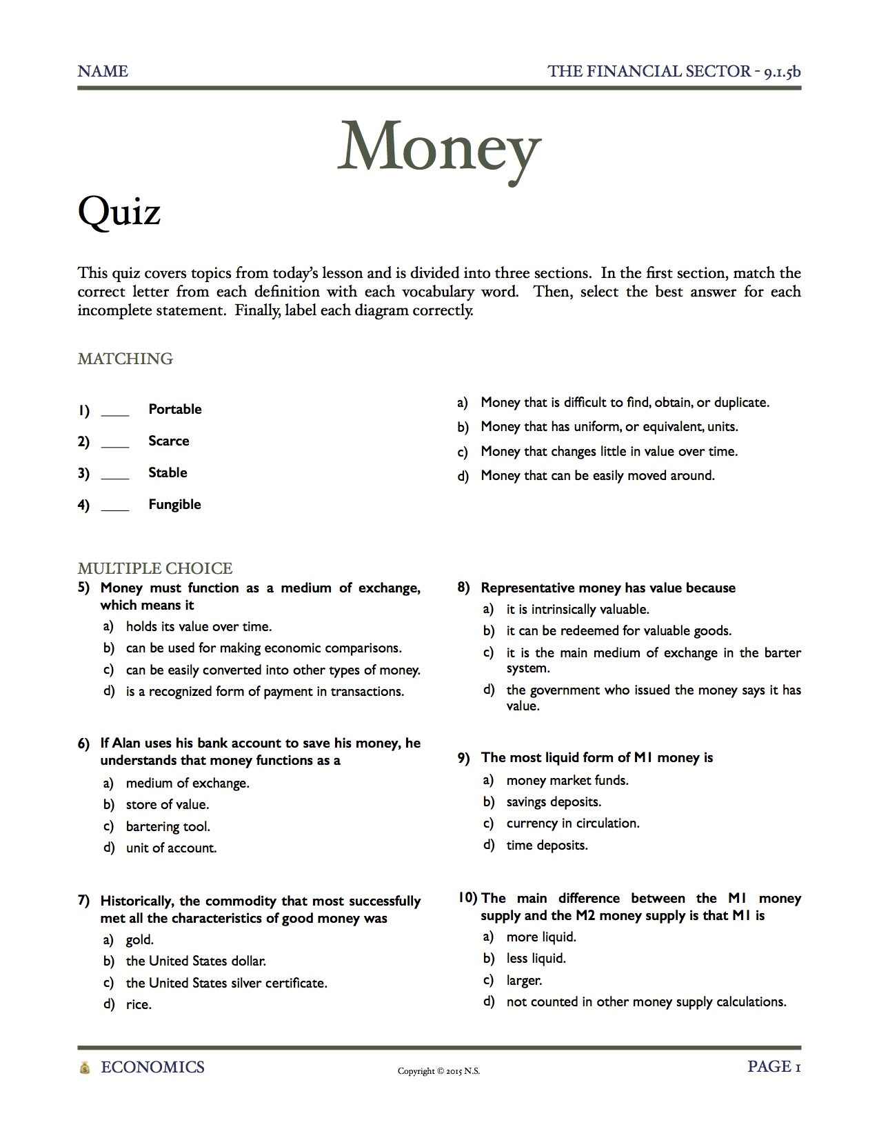
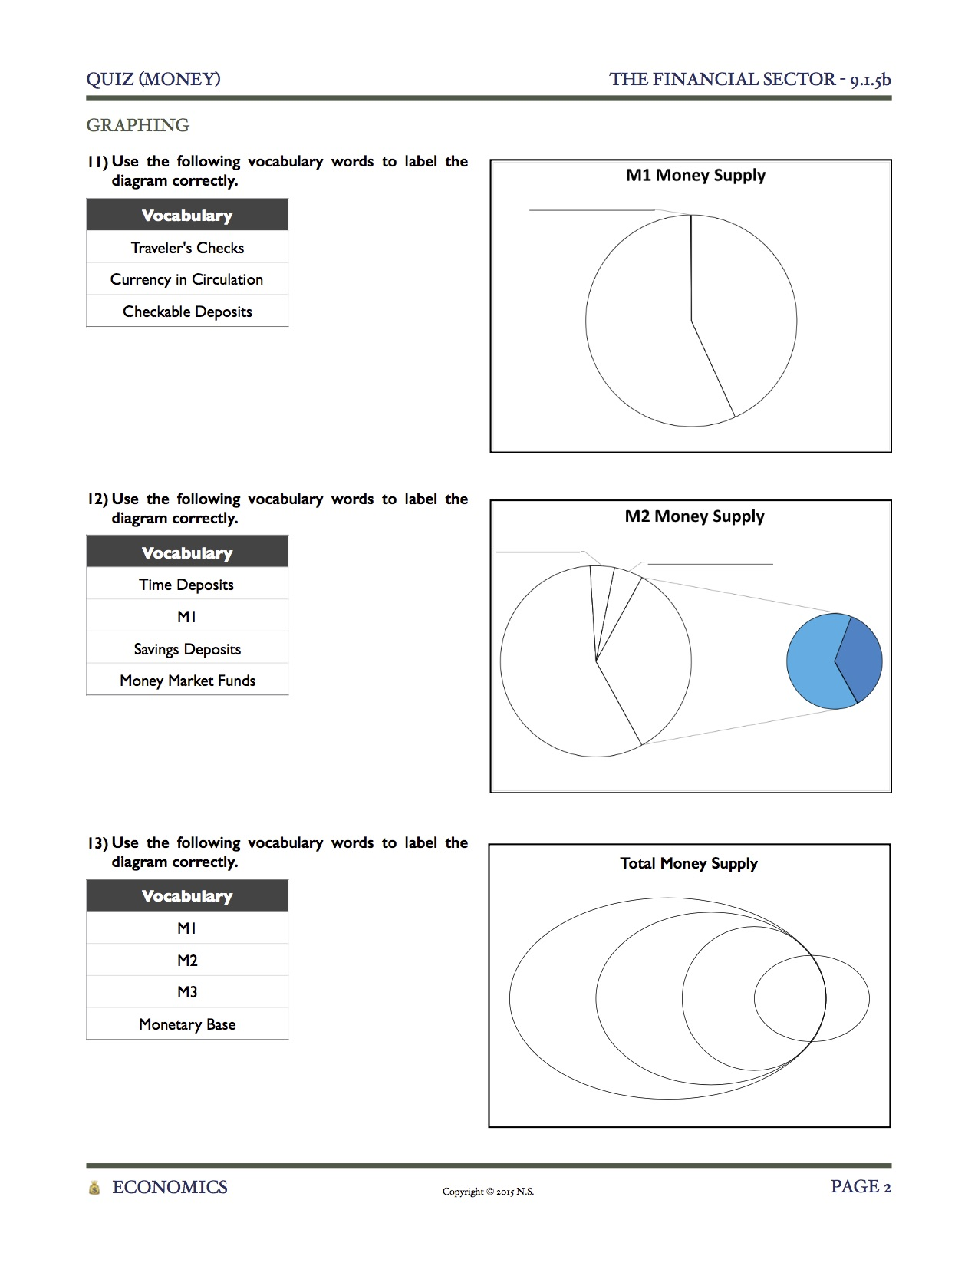
Quiz
This quiz covers topics from today’s lesson and is divided into three sections.
In the first section, match the correct letter from each definition with each vocabulary word, or write the definition of each vocabulary word in your own words. Then, select the best answer for each incomplete statement, or write in the answer for each incomplete statement. Finally, label each diagram correctly.
Matching /
Vocabulary
Multiple Choice /
Short Response
Graphing
Notes:
[Pass out “Money (Quiz)” to each student.] A short quiz has been included, which can be utilized in different ways. Each student can complete the quiz silently, the teacher can read the questions aloud and call on students for informal answers, or it can be given at the beginning of tomorrow’s class. There are three versions, allowing for differentiation. Difficulty increases from (a) to (b) to (c).

Slide 56
Quiz
Matching / Vocabulary
1) Portable
3) Stable
2) Scarce
4) Fungible
Show Answers
Multiple Choice /
Short Response
Graphing

Slide 57
Quiz
Matching / Vocabulary
1) Portable
1) Portable
d) Money that can be easily moved around.
3) Stable
3) Stable
c) Money that changes little in value over time.
2) Scarce
2) Scarce
a) Money that is difficult to find, obtain, or duplicate.
4) Fungible
4) Fungible
b) Money that has uniform, or equivalent, units.
Matching /
Vocabulary
Multiple Choice /
Short Response
Graphing

Slide 58
Quiz
Multiple Choice / Short Response
5) Money must function as a medium of exchange, which means it
7) Historically, the commodity that most successfully met all the characteristics of good money was
9) The most liquid form of M1 money is
6) If Alan uses his bank account to save his money, he understands that money functions as a
8) Representative money has value because
10) The main difference between the M1 money supply and the M2 money supply is that M1 is
Matching /
Vocabulary
Show Answers
Graphing

Slide 59
Quiz
Multiple Choice / Short Response
5) Money must function as a medium of exchange, which means it
5) Money must function as a medium of exchange, which means it
d) is a recognized form of payment in transactions.
7) Historically, the commodity that most successfully met all the characteristics of good money was
7) Historically, the commodity that most successfully met all the characteristics of good money was
a) gold.
9) The most liquid form of M1 money is
9) The most liquid form of M1 money is
c) currency in circulation.
6) If Alan uses his bank account to save his money, he understands that money functions as a
6) If Alan uses his bank account to save his money, he understands that money functions as a
b) store of value.
8) Representative money has value because
8) Representative money has value because
b) it can be redeemed for valuable goods.
10) The main difference between the M1 money supply and the M2 money supply is that M1 is
10) The main difference between the M1 money supply and the M2 money supply is that M1 is
a) more liquid.
Matching /
Vocabulary
Multiple Choice /
Short Response
Graphing

Slide 60
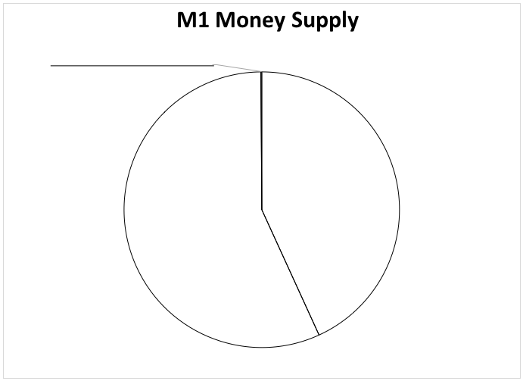
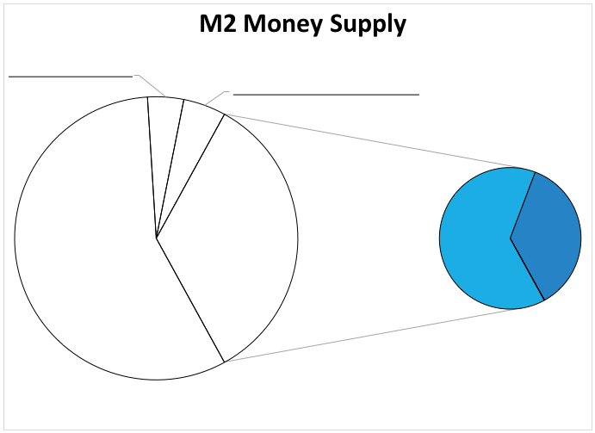
Quiz
Graphing
11) Label the diagram.
Traveler’s Checks
Currency in Circulation
Checkable Deposits
12) Label the diagram.
Time Deposits
M1
Savings Deposits
Money Market Funds
13) Label the diagram.
M1
M2
M3
Monetary Base
Matching /
Vocabulary
Multiple Choice /
Short Response
Show Answers

Slide 61
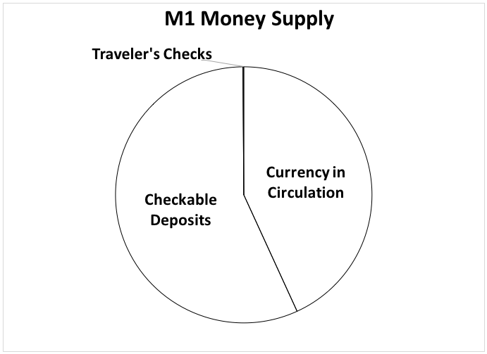
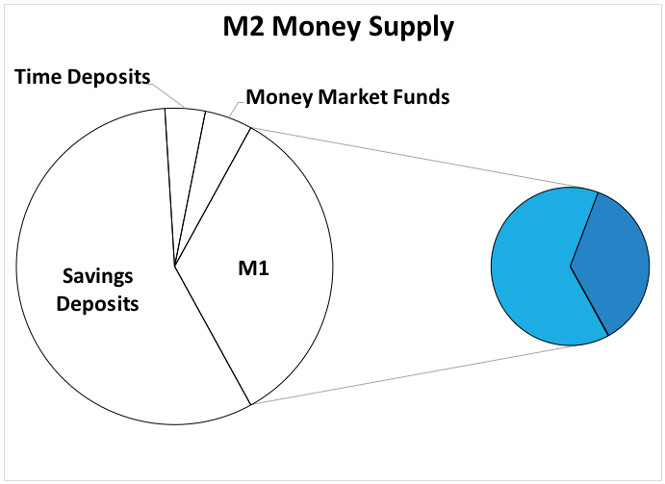
Quiz
Graphing
11) Label the diagram.
Traveler’s Checks
Currency in Circulation
Checkable Deposits
12) Label the diagram.
Time Deposits
M1
Savings Deposits
Money Market Funds
13) Label the diagram.
M1
M2
M3
Monetary Base
M3
M2
M1
Monetary
Base
Matching /
Vocabulary
Multiple Choice /
Short Response
Graphing

Slide 62
Money Homework
Homework
Each student will receive a copy of today’s Homework, entitled Money Homework. Please complete this assignment before our next class period.
Notes:
These are the directions for the Homework that is included in the download, entitled “The Money Supply.” Assign students one of the three versions. Difficulty increases from (a) to (b) to (c), allowing for differentiation, if desired. Students may either self-identify which difficulty to complete, or the teacher can decide.

Slide 63
Resources
Warm Up Activity
https://openclipart.org/detail/171123/yellow-speed-bike-by-bianchessi-171123 - Image of a bicycle
https://openclipart.org/detail/173690/car-sport-automobilis-by-keistutis-173690 - Image of a car
https://openclipart.org/detail/21828/gingerbread-house-by-ericortner - Image of a house, image cropped
https://openclipart.org/detail/16693/business-jet-by-jarno - Image of a private jet
https://openclipart.org/detail/133729/high-heels-by-gnokii - Image of a pair of shoes
Slideshow
http://en.wikipedia.org/wiki/Cattle#mediaviewer/File:Cow_female_black_white.jpg - Image of a Cow
http://en.wikipedia.org/wiki/Yap#mediaviewer/File:Palau_house_with_yapese_stones_NOAA.jpg - Image of Rai Stones
http://en.wikipedia.org/wiki/File:Continental_Currency_One-Third-Dollar_17-Feb-76_obv.jpg - Image of Continental Currency
http://en.wikipedia.org/wiki/History_of_Jamestown,_Virginia_(1607–99) - Image of Tobacco in Virginia
http://pixabay.com/static/uploads/photo/2014/10/22/18/43/rice-498688_640.jpeg - Image of Rice
http://en.wikipedia.org/wiki/Hyperinflation#mediaviewer/File:HUP_100MB_1946_obverse.jpg - Image of Hungarian Pengo
http://en.wikipedia.org/wiki/Cowry#mediaviewer/File:Different_cowries.jpg - Image of Cowry Shells
http://en.wikipedia.org/wiki/Gold_coin#mediaviewer/File:Roman_coin_at_the_Yorkshire_Museum.jpg - Image of a Gold Coin
http://commons.wikimedia.org/wiki/File:The_British_Army_in_Normandy_1944_B5188.jpg - Image of Cigarettes being used as money
http://en.wikipedia.org/wiki/History_of_the_United_States_dollar#mediaviewer/File:Continental_$50_note_1778.jpg - Image of a Bank Note
http://en.wikipedia.org/wiki/File:US-$10-GC-1928-Fr-2400.jpg - Image of $10 Gold Certificate, image cropped
http://en.wikipedia.org/wiki/United_States_dollar#mediaviewer/File:US10dollarbill-Series_2004A.jpg - Image of 2004A Series U.S. $10 bill
http://en.wikipedia.org/wiki/Eccles_Building#mediaviewer/File:Marriner_S._Eccles_Federal_Reserve_Board_Building.jpg - Image of the Federal Reserve
https://c2.staticflickr.com/8/7380/9486792122_d9ebe4dbed_b.jpg - Image of Barley
http://en.wikipedia.org/wiki/Fur_trade#mediaviewer/File:Fur_traders_in_canada_1777.jpg - Image of Fur Trading
http://en.wikipedia.org/wiki/Hyperinflation#mediaviewer/File:5milmkbk.jpg - Image of a German 5 Million Mark
http://en.wikipedia.org/wiki/United_States_dollar#mediaviewer/File:Onedolar2009series.jpg - Image of a One Dollar Bill
http://commons.wikimedia.org/wiki/File:Gold-270438.jpg - Image of a Gold Nugget
http://pixabay.com/en/black-pepper-spice-seeds-seasonings-83086/ - Image of Peppercorns
http://commons.wikimedia.org/wiki/File:Austrian_1_euro.png - Image of One Euro
http://commons.wikimedia.org/wiki/File:May2008gasolineCA.jpg - Image of Gas Prices
http://commons.wikimedia.org/wiki/File:CanadianChequeSample.png - Image of a sample check
http://commons.wikimedia.org/wiki/File:Travelers-Cheques.jpg - Image of a Traveler’s Check

Slide 64
Resources
Slideshow (continued)
http://research.stlouisfed.org/fred2/graph/ - Data on M1, M2, and M3 money supplies
For M1 Money Supply, Federal Reserve Economic Database (all data seasonally adjusted)
Currency Component of M1
Total Checkable Deposits
Travelers Checks Outstanding
For M2 Money Supply, Federal Reserve Economic Database (all data seasonally adjusted)
Savings Deposits - Total
Small Time Deposits - Total
Retail Money Funds
http://mpra.ub.uni-muenchen.de/42169/1/MPRA_paper_42169.pdf - Estimates of how much U.S. currency is held abroad
Class Activity
Homework

Slide 65
Types of Money
Translation
Continental Currency
No 61530 Fifty Dollars
This bill entitles the bearer to receive fifty Spanish milled dollars, or the value thereof in gold or silver, according to a resolution passed by Congress at Philadelphia, September 26th, 1778. 50 Dollars.
Go Back

Slide 66
Types of Money
This certifies that there have been deposited in the Treasury of
The United States of America
Ten dollars
In gold coin payable to the bearer on demand.
Go Back

Slide 67
Types of Money
Go Back

