Slide 2
Table of Contents
1
Access Prior Knowledge
(Warm Up Activity)
2
Set Goals
(Learning Targets)
3
Provide New
Information
(Lecture)
4
Analyze New
Information
(Class Activity)
5
Generalize
(Conclusion)
6
Homework
(Extension Activity)
Using
Monetary Policy
Learning
Targets
The Goals of
Monetary Policy
Closing the
Output Gap
Learning
Targets
Monetary
Neutrality
Expansionary
Monetary Policy
Quiz
Contractionary
Monetary Policy
Effects on
Aggregate Demand
Monetary Policy
In the Short Run
Monetary Policy
In the Long Run
Notes:
This lesson follows a format recommended by Jane E. Pollock in “Improving Student Learning: One Teacher at a Time” (2007), which is itself an outgrowth of a book by Robert J. Marzano, Debra J. Pickering, and Jane E. Pollock entitled, “Classroom Instruction that Works: Research-Based Strategies for Increasing Student Achievement” (2001). This format is broken into six parts, each listed as a subheading in bold on this slide. Use this slideshow to guide your class sequentially through each of these six stages.

Slide 3
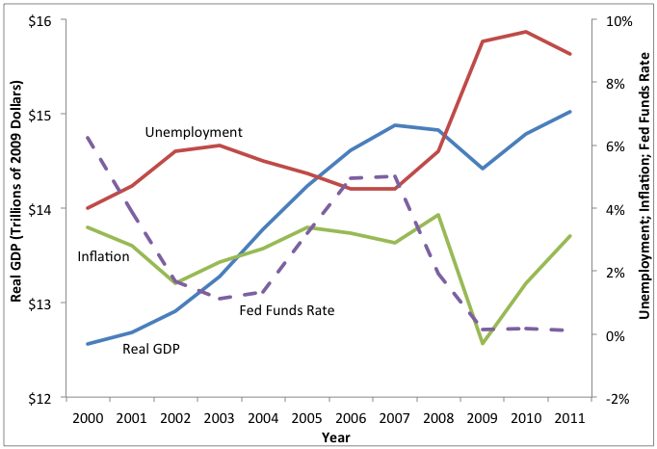
Using Monetary Policy
The Fed Uses Monetary Policy
This graph contains data about the U.S. economy over a 12-year period marked by expansions and recessions. The three major economic indicators--real GDP, unemployment, and inflation--are included along with the federal funds rate. Use the graph (and your previous knowledge) to answer the questions below.
Inflation
If inflation is too high, what can the Federal Reserve do to the fed funds rate to lower inflation?
If inflation is too low, what can the Federal Reserve do to the fed funds rate to raise inflation?
Unemployment
If unemployment is too high, what can the Federal Reserve do to the fed funds rate to lower unemployment?
If unemployment is too low, what can the Federal Reserve do to the fed funds rate to raise unemployment?
Notes:
[Pass out “Using Monetary Policy” to each student.] Divide the class into groups of 3 or 4 students each. Distribute one “Using Monetary Policy Dice,” one stack of “Increase the Fed Funds Rate Cards,” and one stack of “Decrease the Fed Funds Rate Cards” to each group. Use the PowerPoint to walk your class through this activity. Directions are included on the PowerPoint, the student worksheet, and the answer key.

Slide 4
Using Monetary Policy
The Fed Uses Monetary Policy
This graph contains data about the U.S. economy over a 12-year period marked by expansions and recessions. The three major economic indicators--real GDP, unemployment, and inflation--are included along with the federal funds rate. Use the graph (and your previous knowledge) to answer the questions below.
Inflation
If inflation is too high, what can the Federal Reserve do to the fed funds rate to lower inflation?
If inflation is too low, what can the Federal Reserve do to the fed funds rate to raise inflation?
Inflation
If inflation is too high, what can the Federal Reserve do to the fed funds rate to lower inflation?
Increase
If inflation is too low, what can the Federal Reserve do to the fed funds rate to raise inflation?
Decrease
Unemployment
If unemployment is too high, what can the Federal Reserve do to the fed funds rate to lower unemployment?
If unemployment is too low, what can the Federal Reserve do to the fed funds rate to raise unemployment?
Unemployment
If unemployment is too high, what can the Federal Reserve do to the fed funds rate to lower unemployment?
Decrease
If unemployment is too low, what can the Federal Reserve do to the fed funds rate to raise unemployment?
Increase

Slide 5
Using Monetary Policy
You Use Monetary Policy
Now that we have analyzed how the Fed uses monetary policy, let’s try to do it ourselves with a hypothetical economy over a 12-month period. The “Start” row lists the initial values for the three economic indicators and the fed funds rate. By adjusting the fed funds rate, it is your job to ensure real GDP grows moderately--from $7 trillion to $8 trillion--and that unemployment and inflation remain as close to these starting values as possible.
Mo. | Real GDP (trillions) | Unemployment | Inflation | Fed Funds Rate
Start | $7.0 | 5.0% | 2.0% | 4.00%
Jan |  |  |  | -
Feb
Mar |  |  |  | -
Apr
May |  |  |  | -
Jun
Jul |  |  |  | -
Aug
Sep |  |  |  | -
Oct
Nov |  |  |  | -
Dec
Goal | $8.0 | 5.0% | 2.0% | N/A
Skip Instructions
See Instructions

Slide 6
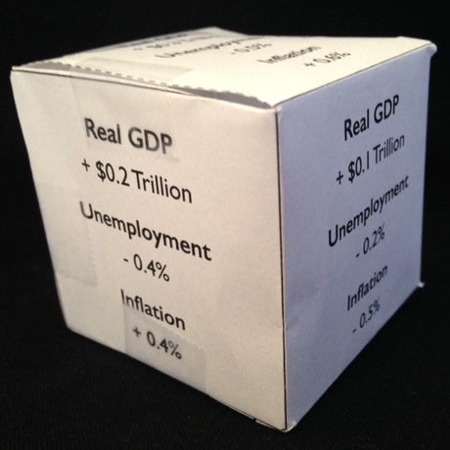
Using Monetary Policy
You Use Monetary Policy
How to Play the Game
1) Set up the materials. Assemble the six-sided die. Place the “Increase the Fed Funds Rate” and “Decrease the Fed Funds Rate” cards face down in respective piles.
Mo. | Real GDP (trillions) | Unemployment | Inflation | Fed Funds Rate
Start | $7.0 | 5.0% | 2.0% | 4.00%
Jan |  |  |  | -
Feb
Mar |  |  |  | -
Apr
May |  |  |  | -
Jun
Jul |  |  |  | -
Aug
Sep |  |  |  | -
Oct
Nov |  |  |  | -
Dec
Goal | $8.0 | 5.0% | 2.0% | N/A
Increase Cards
Decrease Cards

Slide 7
Using Monetary Policy
You Use Monetary Policy
How to Play the Game
2) Begin by rolling the die. Write this economic data in the table in the “January” row.
Mo. | Real GDP (trillions) | Unemployment | Inflation | Fed Funds Rate
Start | $7.0 | 5.0% | 2.0% | 4.00%
Jan |  |  |  | -
Feb
Mar |  |  |  | -
Apr
May |  |  |  | -
Jun
Jul |  |  |  | -
Aug
Sep |  |  |  | -
Oct
Nov |  |  |  | -
Dec
Goal | $8.0 | 5.0% | 2.0% | N/A
6.9
5.4
1.7

Slide 8
Using Monetary Policy
You Use Monetary Policy
How to Play the Game
3) For February, do not roll the die. Instead, decide whether you want to “Increase the Fed Funds Rate” or “Decrease the Fed Funds Rate” based on the changes from January. Draw a card from the appropriate pile and write this information in the “February” row.
Mo. | Real GDP (trillions) | Unemployment | Inflation | Fed Funds Rate
Start | $7.0 | 5.0% | 2.0% | 4.00%
Jan |  |  |  | -
Feb
Mar |  |  |  | -
Apr
May |  |  |  | -
Jun
Jul |  |  |  | -
Aug
Sep |  |  |  | -
Oct
Nov |  |  |  | -
Dec
Goal | $8.0 | 5.0% | 2.0% | N/A
6.9
5.4
1.7
7.0
5.0
2.1
3.25
Increase Cards
Decrease Cards

Slide 9
Using Monetary Policy
You Use Monetary Policy
How to Play the Game
4) Repeat steps 2 and 3 for the remaining months.
Mo. | Real GDP (trillions) | Unemployment | Inflation | Fed Funds Rate
Start | $7.0 | 5.0% | 2.0% | 4.00%
Jan |  |  |  | -
Feb
Mar |  |  |  | -
Apr
May |  |  |  | -
Jun
Jul |  |  |  | -
Aug
Sep |  |  |  | -
Oct
Nov |  |  |  | -
Dec
Goal | $8.0 | 5.0% | 2.0% | N/A
Mo. | Real GDP (trillions) | Unemployment | Inflation | Fed Funds Rate
Start | $7.0 | 5.0% | 2.0% | 4.00%
Jan |  |  |  | -
Feb
Mar | 7.2 | 4.6 | 2.5 | -
Apr | 7.1 | 5.0 | 2.0 | 3.75
May | 7.4 | 4.5 | 2.6 | -
Jun | 7.6 | 4.7 | 2.3 | 4.00
Jul | 7.7 | 4.5 | 1.8 | -
Aug | 7.6 | 5.0 | 1.2 | 4.75
Sep | 7.8 | 4.6 | 1.6 | -
Oct | 7.9 | 4.1 | 2.0 | 4.25
Nov | 8.1 | 3.7 | 2.4 | -
Dec | 7.9 | 4.3 | 1.8 | 5.00
Goal | $8.0 | 5.0% | 2.0% | N/A
6.9
5.4
1.7
7.0
5.0
2.1
3.25
Increase Cards
Decrease Cards

Slide 10
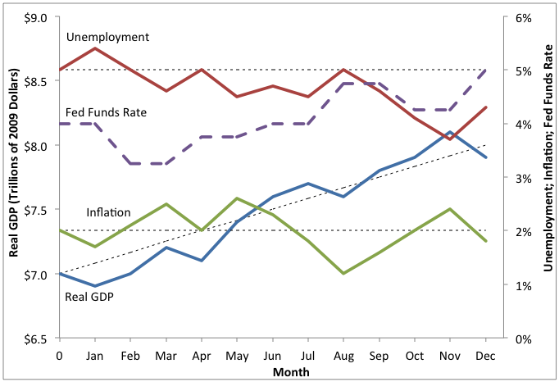
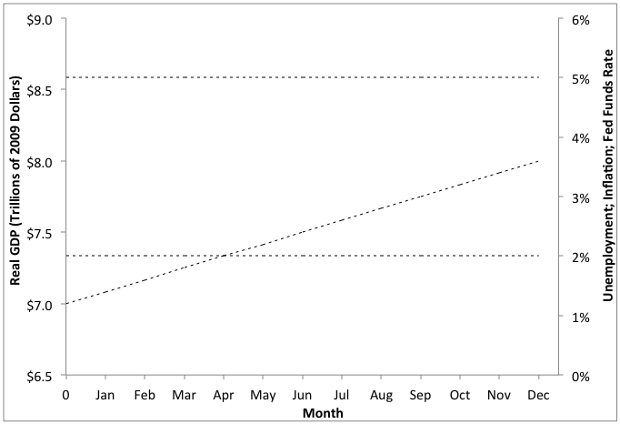
Using Monetary Policy
You Use Monetary Policy
How to Play the Game
5) Plot the data on the graph below. (Use a different color for each line, if possible.)
Mo. | Real GDP (trillions) | Unemployment | Inflation | Fed Funds Rate
Start | $7.0 | 5.0% | 2.0% | 4.00%
Jan |  |  |  | -
Feb
Mar | 7.2 | 4.6 | 2.5 | -
Apr | 7.1 | 5.0 | 2.0 | 3.75
May | 7.4 | 4.5 | 2.6 | -
Jun | 7.6 | 4.7 | 2.3 | 4.00
Jul | 7.7 | 4.5 | 1.8 | -
Aug | 7.6 | 5.0 | 1.2 | 4.75
Sep | 7.8 | 4.6 | 1.6 | -
Oct | 7.9 | 4.1 | 2.0 | 4.25
Nov | 8.1 | 3.7 | 2.4 | -
Dec | 7.9 | 4.3 | 1.8 | 5.00
Goal | $8.0 | 5.0% | 2.0% | N/A
6.9
5.4
1.7
7.0
5.0
2.1
3.25

Slide 11
Using Monetary Policy
You Use Monetary Policy
How to Play the Game
6) What can you conclude about monetary policy from this activity?
Mo. | Real GDP (trillions) | Unemployment | Inflation | Fed Funds Rate
Start | $7.0 | 5.0% | 2.0% | 4.00%
Jan |  |  |  | -
Feb
Mar | 7.2 | 4.6 | 2.5 | -
Apr | 7.1 | 5.0 | 2.0 | 3.75
May | 7.4 | 4.5 | 2.6 | -
Jun | 7.6 | 4.7 | 2.3 | 4.00
Jul | 7.7 | 4.5 | 1.8 | -
Aug | 7.6 | 5.0 | 1.2 | 4.75
Sep | 7.8 | 4.6 | 1.6 | -
Oct | 7.9 | 4.1 | 2.0 | 4.25
Nov | 8.1 | 3.7 | 2.4 | -
Dec | 7.9 | 4.3 | 1.8 | 5.00
Goal | $8.0 | 5.0% | 2.0% | N/A
6.9
5.4
1.7
7.0
5.0
2.1
3.25
Notes:
Because answers will vary, no plausible answers are given on the slideshow. Some possible answers include the following: the Fed increases the fed funds rate when inflation is too high; the Fed decreases the fed funds rate when unemployment is too high; it is difficult to control both inflation and unemployment at the same time; sometimes both inflation and unemployment are at undesirable levels; etc.

Slide 12
Learning Targets
Knowledge
Understand which tools the Federal Reserve employs to combat recession and to fight inflation.
Reasoning
Explain the difference between the liquidity preference model and the loanable funds market when determining the interest rate.
Explain how monetary policy affects the economy in the short run and in the long run.
Skill
None
Essential Questions
How do interest rates get determined?
Why is the Federal Reserve considered such an important part of the United States economy?
Notes:
[If desired, pass out “Learning Targets (Monetary Policy II)” to each student.] They can rewrite each learning target in their own words now, and then answer the essential questions during the “Generalize” stage. There is also a section on their sheet that lists the assignments for this lesson. Providing these three pieces of information at this point helps students know what they are suppose to learn, and it helps them mentally organize information. (The learning targets listed on this slide are part of a larger set of learning targets that go with the full unit, “The Financial Sector.”)

Slide 13
The Goals of Monetary Policy
The Fed uses monetary policy to achieve two competing objectives, known as the dual mandate: maximum employment and price stability.
Notes:
[Pass out “Notes (Monetary Policy II)” to each student.] There are three versions, allowing for differentiated instruction: (a) guided notes, (b) outline notes, and (c) mind map notes. Provide new information to students by giving a lecture using the proper slides in the slideshow. In the Federal Reserve Act, Congress also listed a third objective: moderate long-term interest rates. This objective rarely gets mentioned, and is not part of the so-called dual mandate, so it has been omitted from the slideshow for clarity and simplicity.

Slide 14
The Goals of Monetary Policy
The Fed uses monetary policy to achieve two competing objectives, known as the dual mandate: maximum employment and price stability.
1) Maximum Employment
A) The Fed tries to keep unemployment at acceptable levels.
Full employment does not mean every person has a job. A moderate level of unemployment is desirable so that workers can be matched properly with jobs.

Slide 15
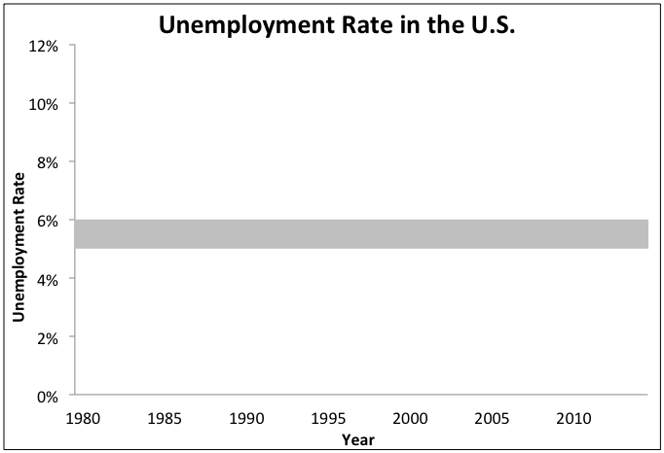
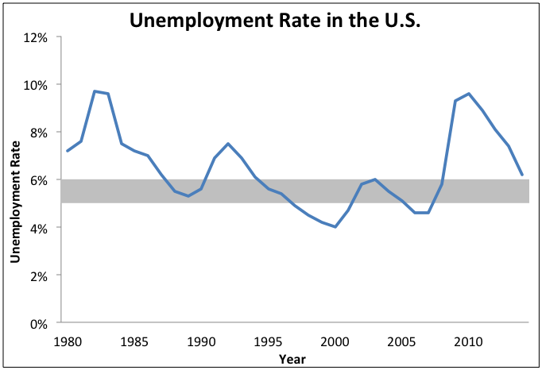
The Goals of Monetary Policy
The Fed uses monetary policy to achieve two competing objectives, known as the dual mandate: maximum employment and price stability.
1) Maximum Employment
A) The Fed tries to keep unemployment at acceptable levels.
B) The Fed considers 5 - 6% unemployment ideal.
Because the maximum level of employment is determined by factors in the labor market, the Fed does not specify a long-run goal for unemployment.

Slide 16
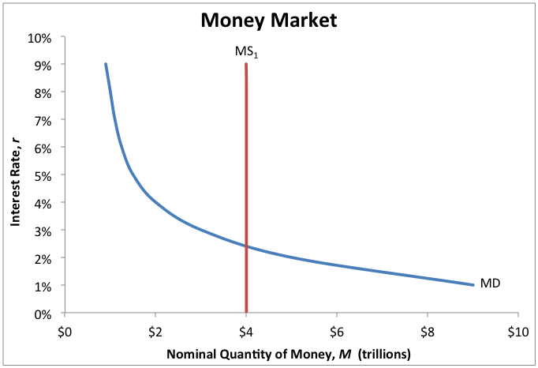
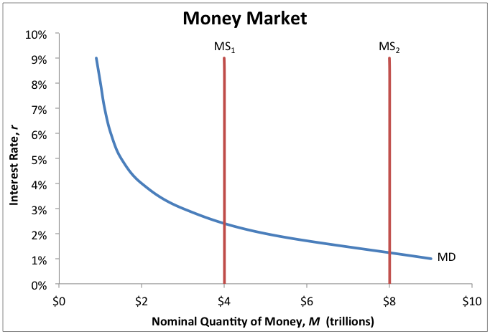
The Goals of Monetary Policy
The Fed uses monetary policy to achieve two competing objectives, known as the dual mandate: maximum employment and price stability.
1) Maximum Employment
A) The Fed tries to keep unemployment at acceptable levels.
B) The Fed considers 5 - 6% unemployment ideal.
C) To lower unemployment, the Fed lowers the fed funds rate.
To lower the fed funds rate, the Fed increases the money supply. As we will see shortly, this increases aggregate demand, inducing more economic activity.

Slide 17
The Goals of Monetary Policy
The Fed uses monetary policy to achieve two competing objectives, known as the dual mandate: maximum employment and price stability.
1) Maximum Employment
A) The Fed tries to keep unemployment at acceptable levels.
B) The Fed considers 5 - 6% unemployment ideal.
C) To lower unemployment, the Fed lowers the fed funds rate.
2) Price Stability
A) The Fed tries to keep inflation at acceptable levels.
Due to its monetary nature, inflation in the long run is largely determined by monetary policy. This allows the Fed to set a firm target for inflation in the long run.

Slide 18
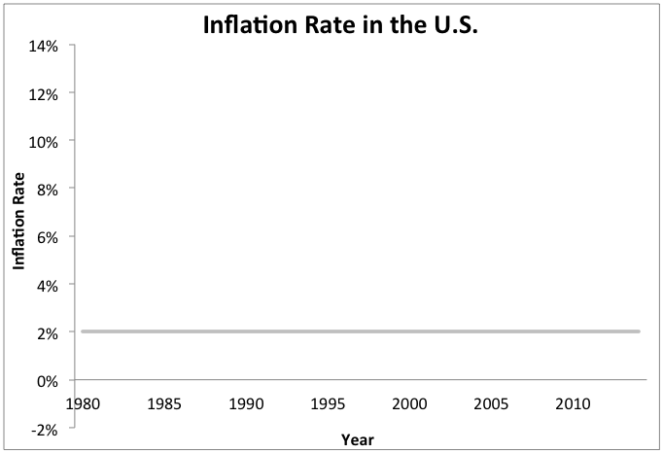
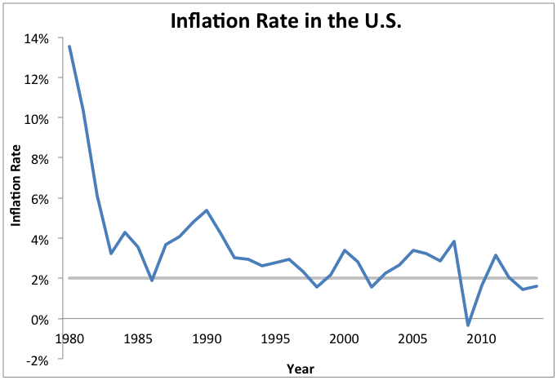
The Goals of Monetary Policy
The Fed uses monetary policy to achieve two competing objectives, known as the dual mandate: maximum employment and price stability.
1) Maximum Employment
A) The Fed tries to keep unemployment at acceptable levels.
B) The Fed considers 5 - 6% unemployment ideal.
C) To lower unemployment, the Fed lowers the fed funds rate.
2) Price Stability
A) The Fed tries to keep inflation at acceptable levels.
B) The Fed considers 2% inflation ideal.
Inflation needs to stay above 0% because deflation is undesirable. Also, monetary policy can only be used to stimulate a sluggish economy if inflation is positive.

Slide 19
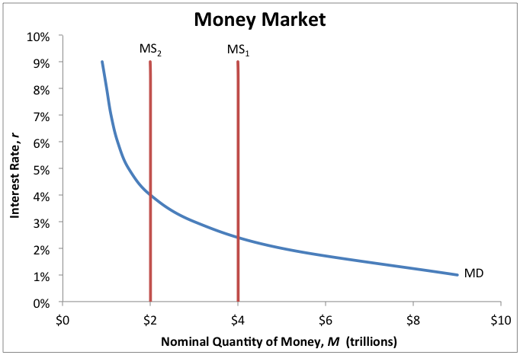
The Goals of Monetary Policy
The Fed uses monetary policy to achieve two competing objectives, known as the dual mandate: maximum employment and price stability.
1) Maximum Employment
A) The Fed tries to keep unemployment at acceptable levels.
B) The Fed considers 5 - 6% unemployment ideal.
C) To lower unemployment, the Fed lowers the fed funds rate.
2) Price Stability
A) The Fed tries to keep inflation at acceptable levels.
B) The Fed considers 2% inflation ideal.
C) To lower inflation, the Fed raises the fed funds rate.
To raise the fed funds rate, the Fed decreases the money supply. As we will see shortly, this decreases aggregate demand, causing prices to fall.

Slide 20
Expansionary Monetary Policy
To prevent the unemployment rate from getting too high, the Fed can adopt an expansionary monetary policy, inducing aggregate demand to increase.
Notes:
By this time in the macroeconomics course, students will likely already have extensive knowledge of aggregate supply, aggregate demand, and the multiplier effect.

Slide 21
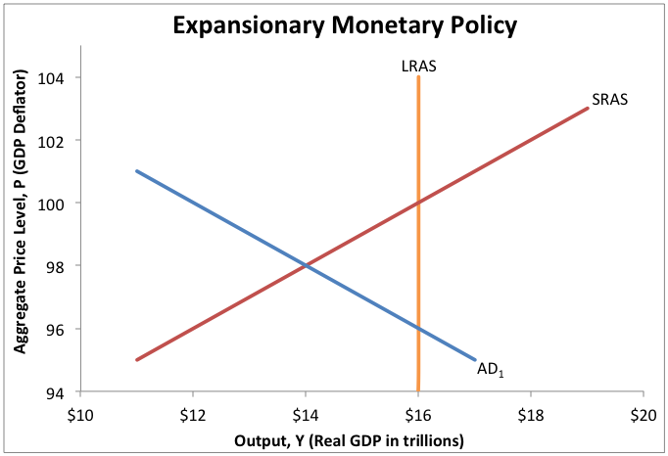
Expansionary Monetary Policy
To prevent the unemployment rate from getting too high, the Fed can adopt an expansionary monetary policy, inducing aggregate demand to increase.
1) Description
A) Monetary policy that increases aggregate demand.
Because it is characterized by an increase in the money supply, economists refer to expansionary monetary policy as “loose” monetary policy.

Slide 22
Expansionary Monetary Policy
To prevent the unemployment rate from getting too high, the Fed can adopt an expansionary monetary policy, inducing aggregate demand to increase.
1) Description
A) Monetary policy that increases aggregate demand.
B) It is used to fight a recessionary gap (and high unemployment).
Recessionary Gap
A recessionary gap exists when actual output ($14 trillion) is less than potential output ($16 trillion). It is usually characterized by sluggish growth in real GDP and high unemployment.

Slide 23
Expansionary Monetary Policy
To prevent the unemployment rate from getting too high, the Fed can adopt an expansionary monetary policy, inducing aggregate demand to increase.
1) Description
2) How It Works
A) Monetary policy that increases aggregate demand.
A) The money supply is increased.
B) It is used to fight a recessionary gap (and high unemployment).
The Federal Reserve controls the money supply in the United States. To increase it, the Fed uses open-market operations to buy government securities, thus injecting money into the economy.

Slide 24
Expansionary Monetary Policy
To prevent the unemployment rate from getting too high, the Fed can adopt an expansionary monetary policy, inducing aggregate demand to increase.
1) Description
2) How It Works
A) Monetary policy that increases aggregate demand.
A) The money supply is increased.
B) Interest rates decrease.
B) It is used to fight a recessionary gap (and high unemployment).
Because the demand for money is downward sloping, increases in the money supply will cause the interest rate to decrease. (The interest rate cannot go lower than 0%.)

Slide 25
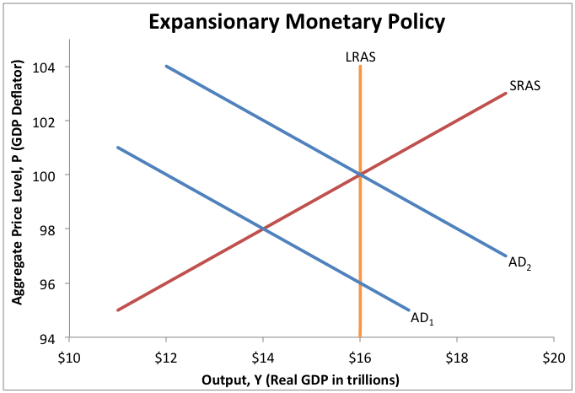
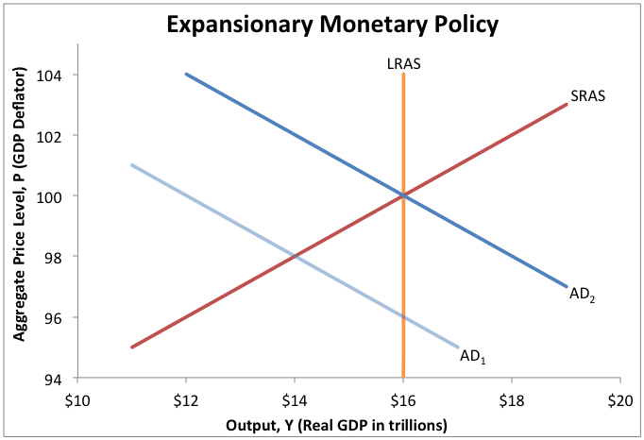
Expansionary Monetary Policy
To prevent the unemployment rate from getting too high, the Fed can adopt an expansionary monetary policy, inducing aggregate demand to increase.
1) Description
2) How It Works
A) Monetary policy that increases aggregate demand.
A) The money supply is increased.
B) Interest rates decrease.
B) It is used to fight a recessionary gap (and high unemployment).
C) Spending (or AD) increases.
Lower interest rates induce autonomous aggregate spending, such as investment spending, to increase. This is represented by an increase in aggregate demand.

Slide 26
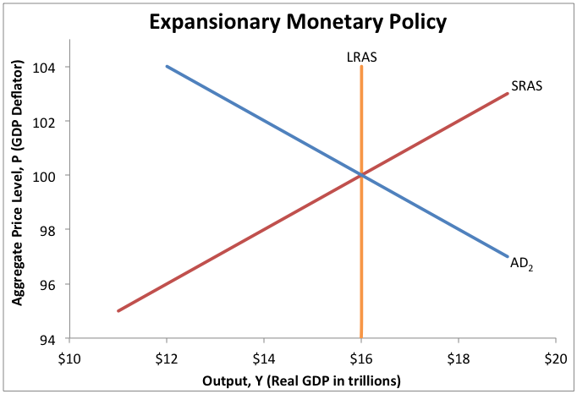
Expansionary Monetary Policy
To prevent the unemployment rate from getting too high, the Fed can adopt an expansionary monetary policy, inducing aggregate demand to increase.
1) Description
2) How It Works
A) Monetary policy that increases aggregate demand.
A) The money supply is increased.
B) Interest rates decrease.
B) It is used to fight a recessionary gap (and high unemployment).
C) Spending (or AD) increases.
D) The recessionary gap closes.
This is a simplified explanation of expansionary monetary policy. Note that the chain of events described above assumes we are operating in the short run.

Slide 27
Contractionary Monetary Policy
To prevent the inflation rate from getting too high, the Fed can adopt a contractionary monetary policy, inducing aggregate demand to decrease.

Slide 28
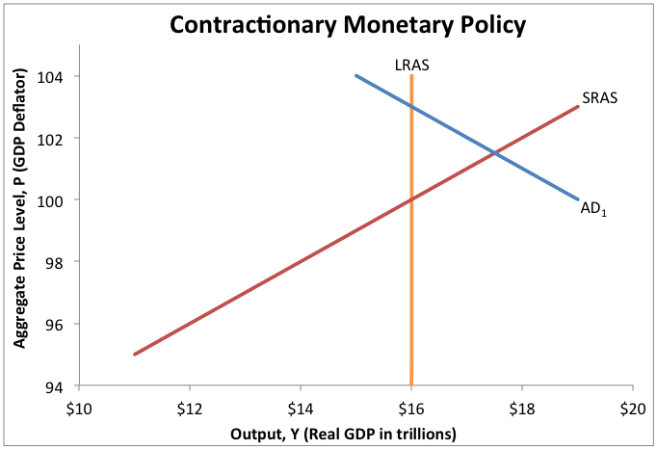
Contractionary Monetary Policy
To prevent the inflation rate from getting too high, the Fed can adopt a contractionary monetary policy, inducing aggregate demand to decrease.
1) Description
A) Monetary policy that decreases aggregate demand.
Because it is characterized by a decrease in the money supply, economists refer to contractionary monetary policy as “tight” monetary policy.

Slide 29
Contractionary Monetary Policy
To prevent the inflation rate from getting too high, the Fed can adopt a contractionary monetary policy, inducing aggregate demand to decrease.
1) Description
A) Monetary policy that decreases aggregate demand.
B) It is used to fight an inflationary gap.
Inflationary Gap
An inflationary gap exists when actual output ($17.5 trillion) is greater than potential output ($16 trillion). It is usually characterized by high inflation.

Slide 30
Contractionary Monetary Policy
To prevent the inflation rate from getting too high, the Fed can adopt a contractionary monetary policy, inducing aggregate demand to decrease.
1) Description
2) How It Works
A) Monetary policy that decreases aggregate demand.
A) The money supply is decreased.
B) It is used to fight an inflationary gap.
The Federal Reserve controls the money supply in the United States. To decrease it, the Fed uses open-market operations to sell government securities, thus pulling money out of the economy.

Slide 31
Contractionary Monetary Policy
To prevent the inflation rate from getting too high, the Fed can adopt a contractionary monetary policy, inducing aggregate demand to decrease.
1) Description
2) How It Works
A) Monetary policy that decreases aggregate demand.
A) The money supply is decreased.
B) Interest rates increase.
B) It is used to fight an inflationary gap.
Because the demand for money is downward sloping, decreases in the money supply will cause the interest rate to increase.

Slide 32
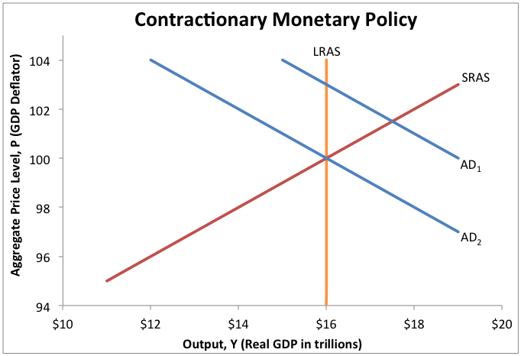
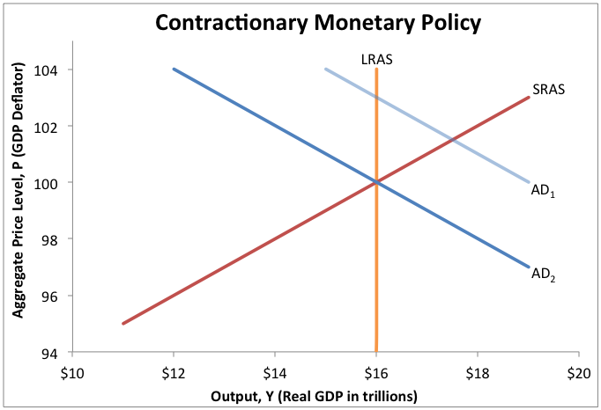
Contractionary Monetary Policy
To prevent the inflation rate from getting too high, the Fed can adopt a contractionary monetary policy, inducing aggregate demand to decrease.
1) Description
2) How It Works
A) Monetary policy that decreases aggregate demand.
A) The money supply is decreased.
B) Interest rates increase.
B) It is used to fight an inflationary gap.
C) Spending (or AD) decreases.
Higher interest rates cause autonomous aggregate spending, such as investment spending, to decrease. This is represented by a decrease in aggregate demand.

Slide 33
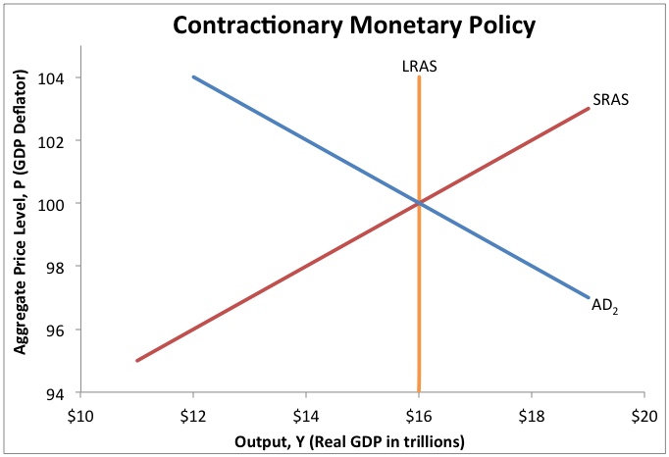
Contractionary Monetary Policy
To prevent the inflation rate from getting too high, the Fed can adopt a contractionary monetary policy, inducing aggregate demand to decrease.
1) Description
2) How It Works
A) Monetary policy that decreases aggregate demand.
A) The money supply is decreased.
B) Interest rates increase.
B) It is used to fight an inflationary gap.
C) Spending (or AD) decreases.
D) The inflationary gap closes.
By altering the money supply, the Fed can close an inflationary gap (or a recessionary gap). Also, note that only aggregate demand is affected by monetary policy, not aggregate supply.

Slide 34
Effects on Aggregate Demand
When the Fed uses monetary policy to affect aggregate demand, the size of the change is determined by the initial change in spending and the multiplier effect.

Slide 35
Effects on Aggregate Demand
When the Fed uses monetary policy to affect aggregate demand, the size of the change is determined by the initial change in spending and the multiplier effect.
1) The Multiplier Effect
Symbol | Definition
𝚫 | Change in
Y | Output (as measured by real GDP)
MPC | Marginal Propensity to Consume
AAS | Autonomous Aggregate Spending
A) Calculates the change in real GDP due to a change in spending.
1
𝚫Y
=
x
𝚫 AAS
1 -
MPC
Injections of extra spending (AAS) cause real GDP to rise more than the original injection. This equation calculates the total increase/decrease in real GDP.
Notes:
This equation is not explained in detail here because it should be a review for students by this time in the course. It is a concept from material related to aggregate demand and aggregate supply.

Slide 36
Effects on Aggregate Demand
When the Fed uses monetary policy to affect aggregate demand, the size of the change is determined by the initial change in spending and the multiplier effect.
1) The Multiplier Effect
Symbol | Definition
𝚫 | Change in
Y | Output (as measured by real GDP)
MPC | Marginal Propensity to Consume
AAS | Autonomous Aggregate Spending
I | Investment Spending
Symbol | Definition
𝚫 | Change in
Y | Output (as measured by real GDP)
MPC | Marginal Propensity to Consume
AAS | Autonomous Aggregate Spending
A) Calculates the change in real GDP due to a change in spending.
B) In the case of monetary policy, AAS refers to investment spending.
1
𝚫Y
=
x
𝚫 AAS
𝚫 I
1 -
MPC
An autonomous change in aggregate spending can include any of the following types of spending: investment, consumer, government, or export.
Notes:
To make this concept simpler to understand, we will ignore the effects of taxes or foreign trade, and we will hold the price level constant. In the case of monetary policy, they generally look at the effects on investment spending, assuming those changes will be “multiplied” by the subsequent changes in consumer spending.

Slide 37
Effects on Aggregate Demand
When the Fed uses monetary policy to affect aggregate demand, the size of the change is determined by the initial change in spending and the multiplier effect.
1) The Multiplier Effect
A) Calculates the change in real GDP due to a change in spending.
B) In the case of monetary policy, AAS refers to investment spending.
2) When Interest Rates Are Lowered
A) Lower interest rates induce more investment, so 𝚫I is positive.
1
𝚫Y
=
x
$1 trillion
𝚫 I
1 -
MPC
Suppose the Fed increases the money supply by $4 trillion in order to lower interest rates; assume this increases investment spending by $1 trillion.
Notes:
These are just sample numbers and are for demonstration purposes only.

Slide 38
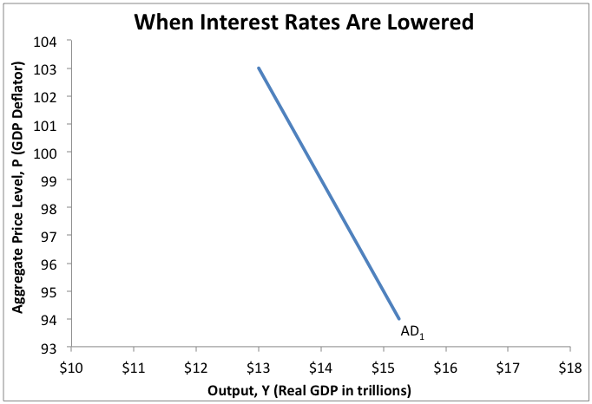
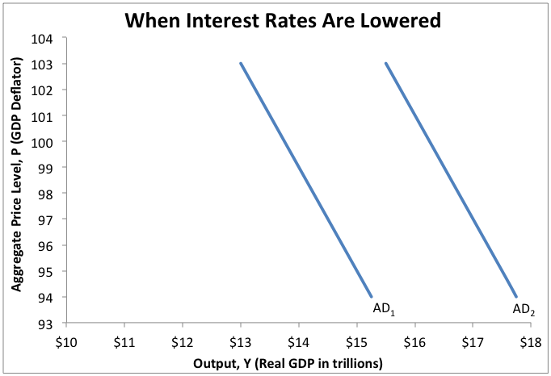
Effects on Aggregate Demand
When the Fed uses monetary policy to affect aggregate demand, the size of the change is determined by the initial change in spending and the multiplier effect.
1) The Multiplier Effect
A) Calculates the change in real GDP due to a change in spending.
Multiplier Effect
Initial Increase
B) In the case of monetary policy, AAS refers to investment spending.
2) When Interest Rates Are Lowered
A) Lower interest rates induce more investment, so 𝚫I is positive.
B) This causes aggregate demand to shift to the right.
$2.5 trillion
1
𝚫Y
=
x
$1 trillion
1 -
MPC
0.60
If we assume the marginal propensity to consume is 0.60, then a $1 trillion rise in investment spending will lead to a $2.5 trillion rise in output (real GDP).
Notes:
Note that if the right side of the equation is calculated out, it will result in the answer on the left side of the equation.

Slide 39
Effects on Aggregate Demand
When the Fed uses monetary policy to affect aggregate demand, the size of the change is determined by the initial change in spending and the multiplier effect.
1) The Multiplier Effect
A) Calculates the change in real GDP due to a change in spending.
B) In the case of monetary policy, AAS refers to investment spending.
2) When Interest Rates Are Lowered
A) Lower interest rates induce more investment, so 𝚫I is positive.
B) This causes aggregate demand to shift to the right.
1
3) When Interest Rates Are Raised
𝚫Y
=
x
-$1 trillion
𝚫 I
1 -
MPC
A) Higher interest rates deter investors, so 𝚫I is negative.
Suppose the Fed decreases the money supply by $2 trillion in order to raise interest rates; assume this decreases investment spending by $1 trillion.
Notes:
These are just sample numbers and are for demonstration purposes only.

Slide 40
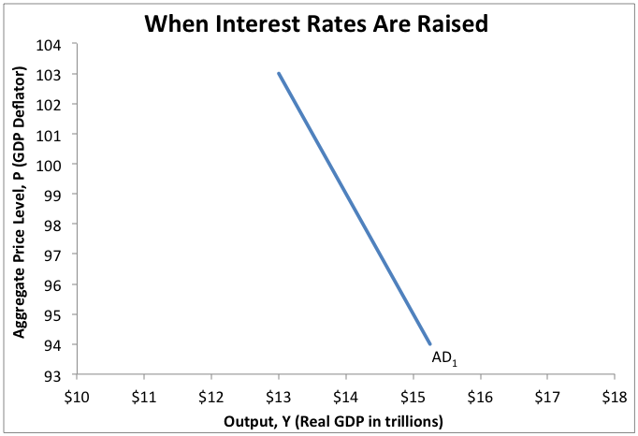
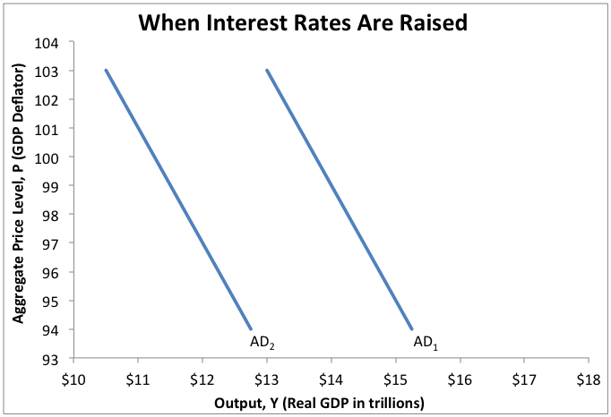
Effects on Aggregate Demand
When the Fed uses monetary policy to affect aggregate demand, the size of the change is determined by the initial change in spending and the multiplier effect.
1) The Multiplier Effect
A) Calculates the change in real GDP due to a change in spending.
Multiplier Effect
Initial Decrease
B) In the case of monetary policy, AAS refers to investment spending.
2) When Interest Rates Are Lowered
A) Lower interest rates induce more investment, so 𝚫I is positive.
B) This causes aggregate demand to shift to the right.
-$2.5 trillion
1
3) When Interest Rates Are Raised
𝚫Y
=
x
-$1 trillion
1 -
MPC
0.60
A) Higher interest rates deter investors, so 𝚫I is negative.
If we assume the marginal propensity to consume is 0.60, then a $1 trillion fall in investment spending will lead to a $2.5 trillion fall in output (real GDP).
B) This causes aggregate demand to shift to the left.
Notes:
Note that if the right side of the equation is calculated out, it will result in the answer on the left side of the equation.

Slide 41
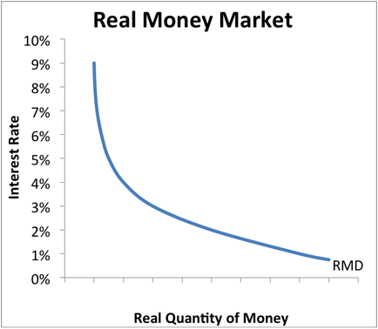
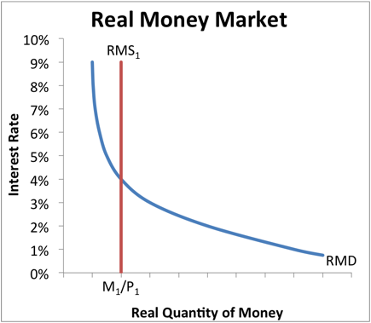
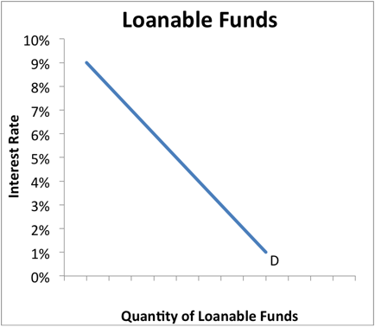
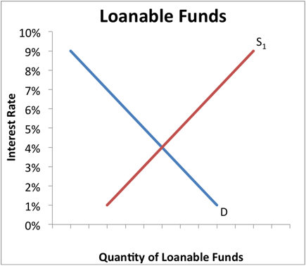
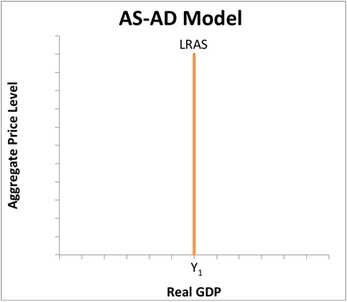
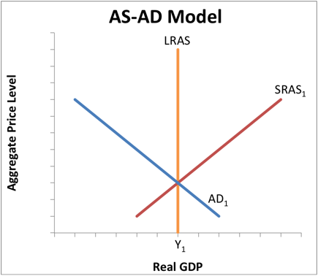
Monetary Policy in the Short Run
Monetary policy can stabilize the economy in the short run because the money market (not the loanable funds market) determines the short-run interest rate.
Real Money Market
Loanable Funds
AS-AD Model

Slide 42
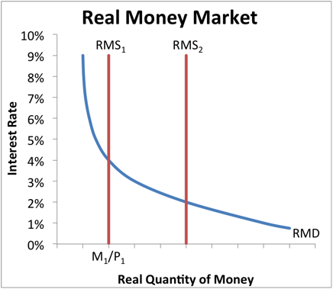
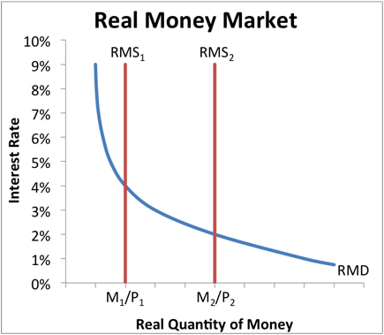
Monetary Policy in the Short Run
Monetary policy can stabilize the economy in the short run because the money market (not the loanable funds market) determines the short-run interest rate.
Real Money Market
Loanable Funds
AS-AD Model
1) The Fed decides to raise the money supply.
In this example, the Fed is engaging in expansionary monetary policy when the economy is in long-run equilibrium. Normally, the Fed only uses expansionary monetary policy to close a recessionary gap.

Slide 43
Monetary Policy in the Short Run
Monetary policy can stabilize the economy in the short run because the money market (not the loanable funds market) determines the short-run interest rate.
Real Money Market
Loanable Funds
AS-AD Model
1) The Fed decides to raise the money supply.
2) The interest rate falls in the money market.
Notice that the money market and the loanable funds market are initially in equilibrium at the same interest rate. As you will see shortly, these two interest rates always move together.

Slide 44
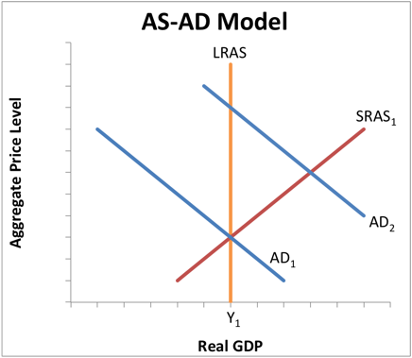
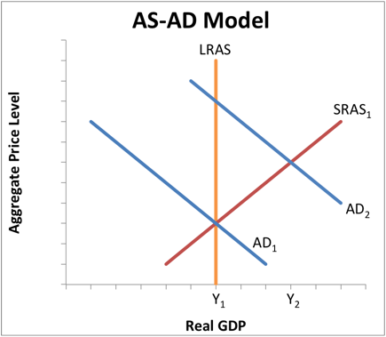
Monetary Policy in the Short Run
Monetary policy can stabilize the economy in the short run because the money market (not the loanable funds market) determines the short-run interest rate.
Real Money Market
Loanable Funds
AS-AD Model
1) The Fed decides to raise the money supply.
3) This causes real GDP (or AD) to rise.
2) The interest rate falls in the money market.
Lower interest rates increase investment spending, which sets off the ripple effect of the multiplier. This leads to a rise in both real GDP and consumer spending, along with the necessary rise in savings.

Slide 45
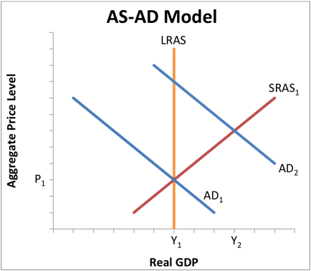
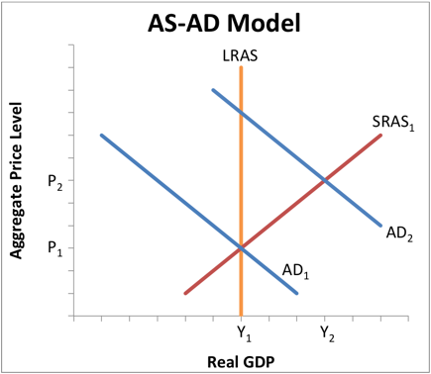
Monetary Policy in the Short Run
Monetary policy can stabilize the economy in the short run because the money market (not the loanable funds market) determines the short-run interest rate.
Real Money Market
Loanable Funds
AS-AD Model
1) The Fed decides to raise the money supply.
3) This causes real GDP (or AD) to rise.
2) The interest rate falls in the money market.
4) The aggregate price level increases.
Whenever aggregate demand increases, we know both output and price will rise in the short run. This rise in the aggregate price level is more commonly referred to as inflation.

Slide 46
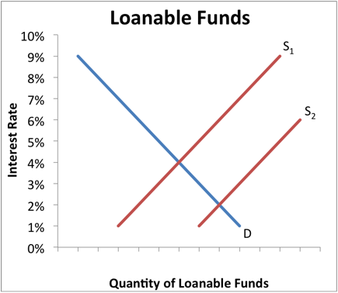
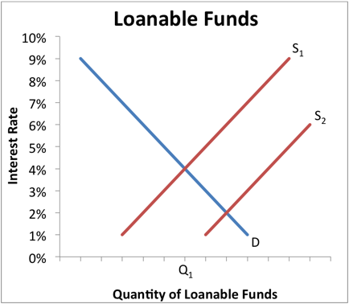
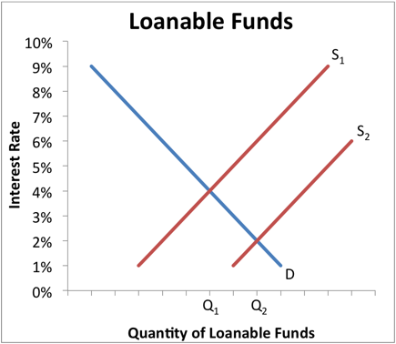
Monetary Policy in the Short Run
Monetary policy can stabilize the economy in the short run because the money market (not the loanable funds market) determines the short-run interest rate.
Real Money Market
Loanable Funds
AS-AD Model
1) The Fed decides to raise the money supply.
5) More savings means more loanable funds.
3) This causes real GDP (or AD) to rise.
2) The interest rate falls in the money market.
4) The aggregate price level increases.
Because investment has increased, the savings-investment spending identity tells us that savings must also increase by an equal amount. This is represented by an increase in the supply of loanable funds.

Slide 47
Monetary Policy in the Short Run
Monetary policy can stabilize the economy in the short run because the money market (not the loanable funds market) determines the short-run interest rate.
Real Money Market
Loanable Funds
AS-AD Model
1) The Fed decides to raise the money supply.
5) More savings means more loanable funds.
3) This causes real GDP (or AD) to rise.
2) The interest rate falls in the money market.
6) The interest rate falls for loanable funds.
4) The aggregate price level increases.
Thus, the supply and demand for money determine the short-run interest rate, and the loanable funds market follows the lead of the money market; each has a new and equal equilibrium interest rate.

Slide 48
Monetary Policy in the Long Run
Monetary policy has no real effects in the long run because the loanable funds market (not the money market) determines the long-run interest rate.
Real Money Market
Loanable Funds
AS-AD Model

Slide 49
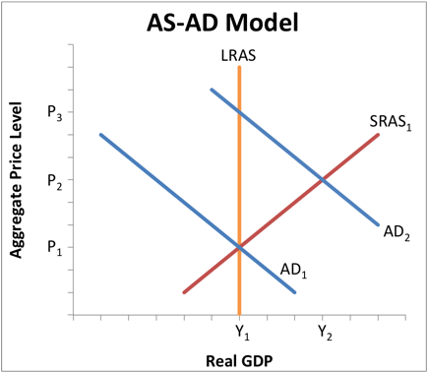
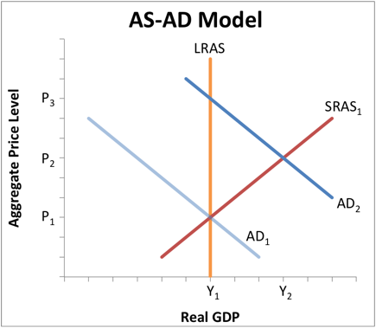
Monetary Policy in the Long Run
Monetary policy has no real effects in the long run because the loanable funds market (not the money market) determines the long-run interest rate.
Real Money Market
Loanable Funds
AS-AD Model
1) Wages eventually adjust to higher prices.
Notice that the output level Y₂ is above potential, which means the aggregate price level P₂ is above equilibrium. In the long run, nominal wages will rise to meet these higher costs, increasing prices to P₃.

Slide 50
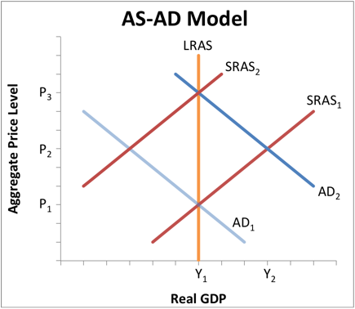
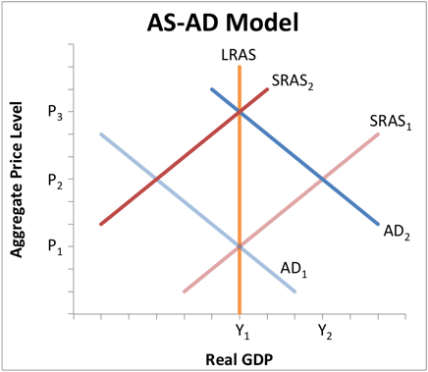
Monetary Policy in the Long Run
Monetary policy has no real effects in the long run because the loanable funds market (not the money market) determines the long-run interest rate.
Real Money Market
Loanable Funds
AS-AD Model
1) Wages eventually adjust to higher prices.
2) This causes SRAS to drop back to potential.
Higher wages increase the costs of production. Higher costs cause firms to reduce production, leading to a decrease in aggregate supply.

Slide 51
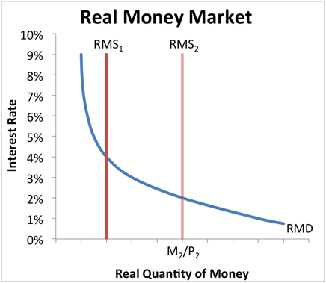
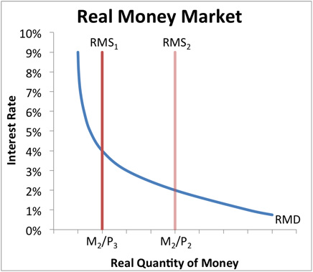
Monetary Policy in the Long Run
Monetary policy has no real effects in the long run because the loanable funds market (not the money market) determines the long-run interest rate.
Real Money Market
Loanable Funds
AS-AD Model
3) Real money supply falls to original quantity.
1) Wages eventually adjust to higher prices.
2) This causes SRAS to drop back to potential.
In the long run, increases in the nominal supply of money will be matched by equal increases in the price level. Thus, the increase in all prices reduces the real money supply back to its original level (M₂/P₃ = M₁/P₁).

Slide 52
Monetary Policy in the Long Run
Monetary policy has no real effects in the long run because the loanable funds market (not the money market) determines the long-run interest rate.
Real Money Market
Loanable Funds
AS-AD Model
3) Real money supply falls to original quantity.
1) Wages eventually adjust to higher prices.
4) The interest rate rises to its original level.
2) This causes SRAS to drop back to potential.
The reduction in the real quantity of money restores the interest rate to its original level. The only long-term effect of increasing the money supply is to increase the aggregate price level.

Slide 53
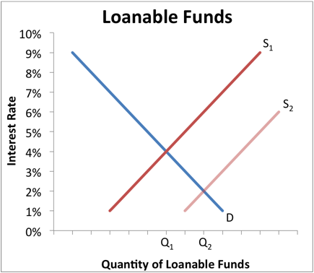
Monetary Policy in the Long Run
Monetary policy has no real effects in the long run because the loanable funds market (not the money market) determines the long-run interest rate.
Real Money Market
Loanable Funds
AS-AD Model
3) Real money supply falls to original quantity.
5) As real GDP falls, savings also decreases.
1) Wages eventually adjust to higher prices.
4) The interest rate rises to its original level.
2) This causes SRAS to drop back to potential.
As real GDP (output) and the real money supply decrease, people do not have as much money to put into savings. This is represented by a decrease in the supply of loanable funds.

Slide 54
Monetary Policy in the Long Run
Monetary policy has no real effects in the long run because the loanable funds market (not the money market) determines the long-run interest rate.
Real Money Market
Loanable Funds
AS-AD Model
3) Real money supply falls to original quantity.
5) As real GDP falls, savings also decreases.
1) Wages eventually adjust to higher prices.
4) The interest rate rises to its original level.
6) Loanable funds model decides interest rate.
2) This causes SRAS to drop back to potential.
This analysis demonstrates that monetary policy has no long-term effects on real GDP, a concept called monetary neutrality. Changes in the money supply only affect real GDP in the short run, not the long run.

Slide 55
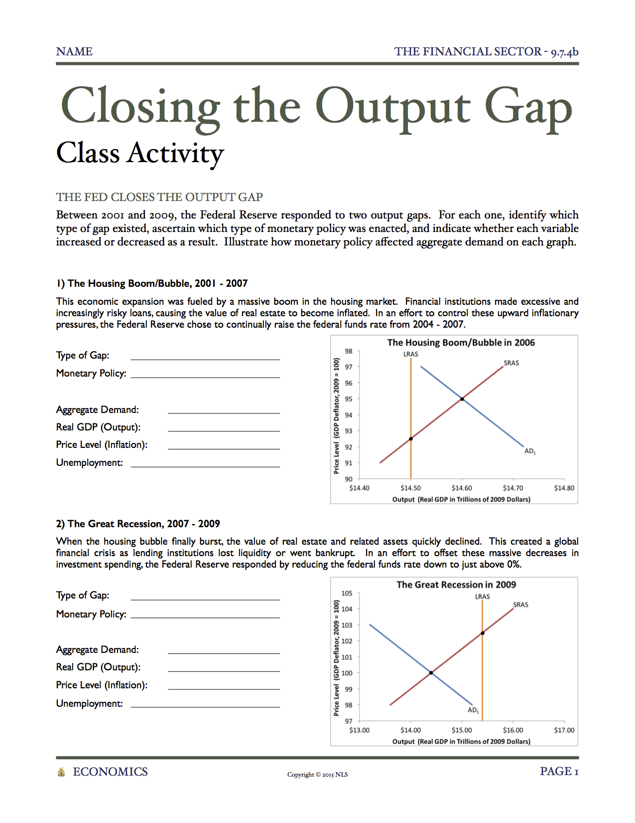
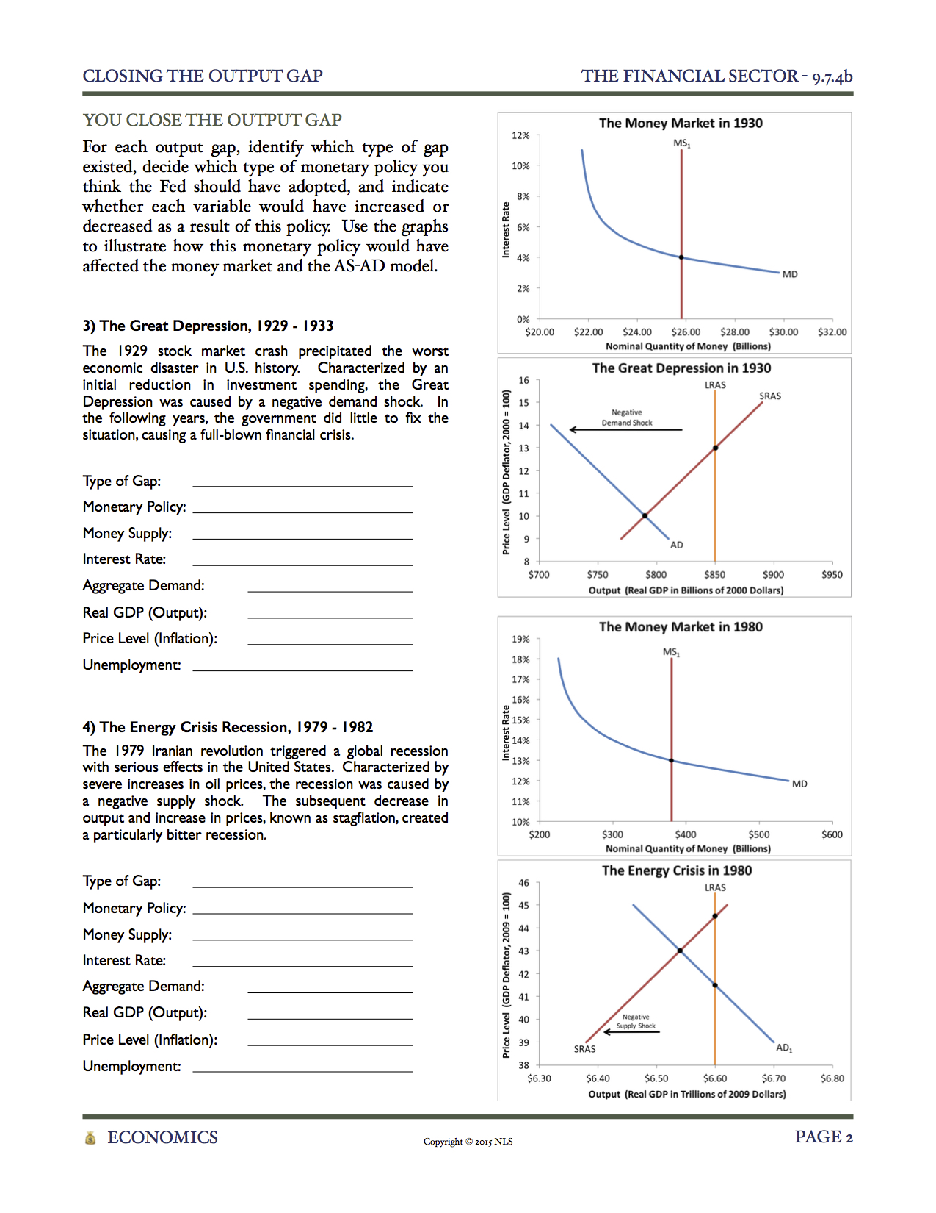
Closing the Output Gap
Class Activity
Each student will receive a copy of today’s Class Activity, entitled Closing the Output Gap. When completed, use the buttons below to informally assess student understanding.
The Fed Closes the Output Gap
Between 2001 and 2009, the Federal Reserve responded to two output gaps. For each one, identify which type of gap existed, ascertain which type of monetary policy was enacted, and indicate whether each variable increased or decreased as a result. Illustrate how monetary policy affected aggregate demand on each graph.
You Close the Output Gap
For each output gap, identify which type of gap existed, decide which type of monetary policy you think the Fed should have adopted, and indicate whether each variable would have increased or decreased as a result of this policy. Use the graphs to illustrate how this monetary policy would have affected the money market and the AS-AD model.
1) The Housing
Boom/Bubble
2) The Great
Recession
3) The Great
Depression
4) The Energy
Crisis Recession
Notes:
[Pass out “Closing the Output Gap” to each student.] There are three versions, allowing for differentiated instruction. Difficulty increases from (a) to (b) to (c). If using more than one version, note that the answers for each version are essentially identical; only one answer key is necessary. Students may work on this assignment individually or in groups.

Slide 56
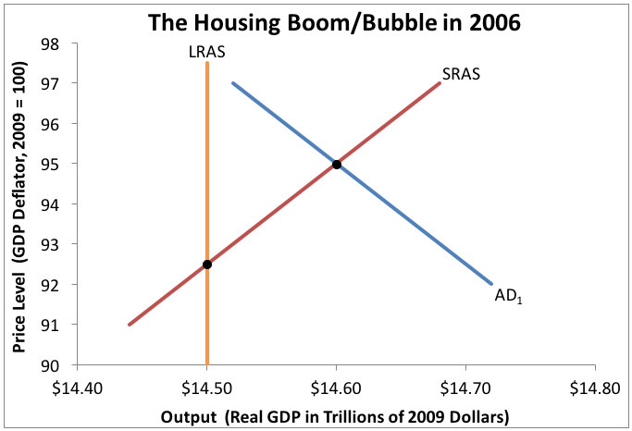
Closing the Output Gap
Class Activity
1) The Housing Boom/Bubble, 2001 - 2007
This economic expansion was fueled by a massive boom in the housing market. Financial institutions made excessive and increasingly risky loans, causing the value of real estate to become inflated. In an effort to control these upward inflationary pressures, the Federal Reserve chose to continually raise the federal funds rate from 2004 – 2007.
Type of Gap:
Monetary Policy:
Money Supply:
Interest Rate:
Aggregate Demand:
Real GDP (Output):
Price Level (Inflation):
Unemployment:
Show Answers
2) The Great
Recession
3) The Great
Depression
4) The Energy
Crisis Recession

Slide 57
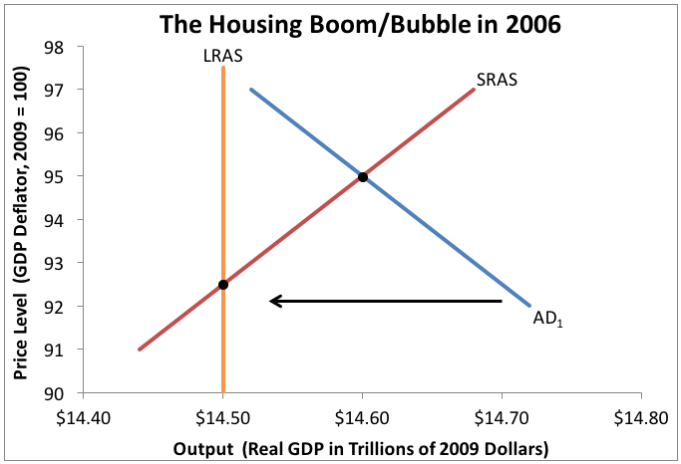
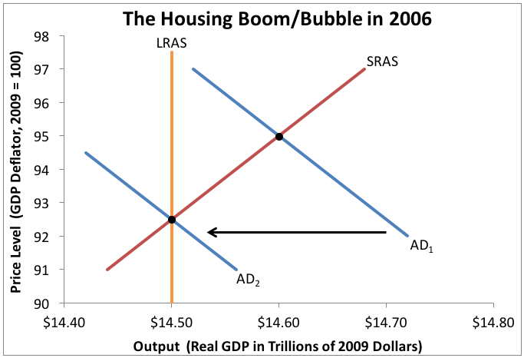
Closing the Output Gap
Class Activity
1) The Housing Boom/Bubble, 2001 - 2007
This economic expansion was fueled by a massive boom in the housing market. Financial institutions made excessive and increasingly risky loans, causing the value of real estate to become inflated. In an effort to control these upward inflationary pressures, the Federal Reserve chose to continually raise the federal funds rate from 2004 – 2007.
Type of Gap:
Monetary Policy:
Money Supply:
Interest Rate:
Aggregate Demand:
Real GDP (Output):
Price Level (Inflation):
Unemployment:
Type of Gap: Inflationary
Monetary Policy: Contractionary
Money Supply: Decrease
Interest Rate: Increase
Aggregate Demand: Decrease
Real GDP (Output): Decrease
Price Level (Inflation): Decrease
Unemployment: Increase
1) The Housing
Boom/Bubble
2) The Great
Recession
3) The Great
Depression
4) The Energy
Crisis Recession

Slide 58
Closing the Output Gap
Class Activity
2) The Great Recession, 2007 - 2009
When the housing bubble finally burst, the value of real estate and related assets quickly declined. This created a global financial crisis as lending institutions lost liquidity or went bankrupt. In an effort to offset these massive decreases in investment spending, the Federal Reserve responded by reducing the federal funds rate down to just above 0%.
Type of Gap:
Monetary Policy:
Money Supply:
Interest Rate:
Aggregate Demand:
Real GDP (Output):
Price Level (Inflation):
Unemployment:
1) The Housing
Boom/Bubble
Show Answers
3) The Great
Depression
4) The Energy
Crisis Recession

Slide 59
Closing the Output Gap
Class Activity
2) The Great Recession, 2007 - 2009
When the housing bubble finally burst, the value of real estate and related assets quickly declined. This created a global financial crisis as lending institutions lost liquidity or went bankrupt. In an effort to offset these massive decreases in investment spending, the Federal Reserve responded by reducing the federal funds rate down to just above 0%.
Type of Gap:
Monetary Policy:
Money Supply:
Interest Rate:
Aggregate Demand:
Real GDP (Output):
Price Level (Inflation):
Unemployment:
Type of Gap: Recessionary
Monetary Policy: Expansionary
Money Supply: Increase
Interest Rate: Decrease
Aggregate Demand: Increase
Real GDP (Output): Increase
Price Level (Inflation): Increase
Unemployment: Decrease
1) The Housing
Boom/Bubble
2) The Great
Recession
3) The Great
Depression
4) The Energy
Crisis Recession

Slide 60
Closing the Output Gap
Class Activity
3) The Great Depression, 1929 - 1933
The 1929 stock market crash precipitated the worst economic disaster in U.S. history. Characterized by an initial reduction in investment spending, the Great Depression was caused by a negative demand shock. In the following years, the government did little to fix the situation, causing a full-blown financial crisis.
Type of Gap:
Monetary Policy:
Money Supply:
Interest Rate:
Aggregate Demand:
Real GDP (Output):
Price Level (Inflation):
Unemployment:
1) The Housing
Boom/Bubble
2) The Great
Recession
Show Answers
4) The Energy
Crisis Recession

Slide 61
Closing the Output Gap
Class Activity
3) The Great Depression, 1929 - 1933
The 1929 stock market crash precipitated the worst economic disaster in U.S. history. Characterized by an initial reduction in investment spending, the Great Depression was caused by a negative demand shock. In the following years, the government did little to fix the situation, causing a full-blown financial crisis.
Type of Gap:
Monetary Policy:
Money Supply:
Interest Rate:
Aggregate Demand:
Real GDP (Output):
Price Level (Inflation):
Unemployment:
Type of Gap: Recessionary
Monetary Policy: Expansionary
Money Supply: Increase
Interest Rate: Decrease
Aggregate Demand: Increase
Real GDP (Output): Increase
Price Level (Inflation): Increase
Unemployment: Decrease
1) The Housing
Boom/Bubble
2) The Great
Recession
3) The Great
Depression
4) The Energy
Crisis Recession
Notes:
It should be noted that most, but not all, economists agree with this analysis.

Slide 62
Closing the Output Gap
Class Activity
4) The Energy Crisis Recession, 1979 - 1982
The 1979 Iranian revolution triggered a global recession with serious effects in the United States. Characterized by severe increases in oil prices, the recession was caused by a negative supply shock. The subsequent decrease in output and increase in prices, known as stagflation, created a particularly bitter recession.
Type of Gap:
Monetary Policy:
Money Supply:
Interest Rate:
Aggregate Demand:
Real GDP (Output):
Price Level (Inflation):
Unemployment:
1) The Housing
Boom/Bubble
2) The Great
Recession
3) The Great
Depression
Show Answers

Slide 63
Closing the Output Gap
Class Activity
4) The Energy Crisis Recession, 1979 - 1982
The 1979 Iranian revolution triggered a global recession with serious effects in the United States. Characterized by severe increases in oil prices, the recession was caused by a negative supply shock. The subsequent decrease in output and increase in prices, known as stagflation, created a particularly bitter recession.
Type of Gap:
Monetary Policy:
Money Supply:
Interest Rate:
Aggregate Demand:
Real GDP (Output):
Price Level (Inflation):
Unemployment:
Type of Gap: Recessionary
Monetary Policy: Contractionary
Money Supply: Decrease
Interest Rate: Increase
Aggregate Demand: Decrease
Real GDP (Output): Decrease
Price Level (Inflation): Decrease
Unemployment: Increase
1) The Housing
Boom/Bubble
2) The Great
Recession
3) The Great
Depression
4) The Energy
Crisis Recession
Notes:
A negative supply shock increases inflation and unemployment, but the Fed can only deal with one at a time. They have historically chosen to promote price stability at the expense of output and employment.

Slide 64
Learning Targets
Knowledge
Understand which tools the Federal Reserve employs to combat recession and to fight inflation.
Reasoning
Explain the difference between the liquidity preference model and the loanable funds market when determining the interest rate.
Explain how monetary policy affects the economy in the short run and in the long run.
Skill
None
Essential Questions
How do interest rates get determined?
Why is the Federal Reserve considered such an important part of the United States economy?
Notes:
Help students make connections between the learning targets and the activities from today. If desired, see if students can answer the essential questions.

Slide 65
Quiz
This quiz covers topics from today’s lesson and is divided into three sections.
In the first section, match the correct letter from each definition with each vocabulary word, or write the definition of each vocabulary word in your own words. Then, select the best answer for each incomplete statement, or write in the answer for each incomplete statement. Finally, complete each graph correctly.
Matching /
Vocabulary
Multiple Choice /
Short Response
Graphing
Notes:
[Pass out “Quiz (Monetary Policy II)” to each student.] This quiz can be utilized in different ways. Each student can complete the quiz silently, the teacher can read the questions aloud and call on students for informal answers, or it can be given at the beginning of tomorrow’s class. There are three versions, allowing for differentiated instruction. Difficulty increases from (a) to (b) to (c).

Slide 66
Quiz
Matching / Vocabulary
1) Dual Mandate
3) Expansionary Monetary Policy
2) Output Gap
4) Contractionary Monetary Policy
Show Answers
Multiple Choice /
Short Response
Graphing

Slide 67
Quiz
Matching / Vocabulary
1) Dual Mandate
1) Dual Mandate
c) The Fed’s monetary policy objectives, which include maintaining maximum employment and price stability.
3) Expansionary Monetary Policy
3) Expansionary Monetary Policy
a) An approach used by the Federal Reserve to lower the interest rate, causing aggregate demand to increase.
2) Output Gap
2) Output Gap
b) The difference between actual and potential real GDP.
4) Contractionary Monetary Policy
4) Contractionary Monetary Policy
d) An approach used by the Federal Reserve to raise the interest rate, causing aggregate demand to decrease.
Matching /
Vocabulary
Multiple Choice /
Short Response
Graphing

Slide 68
Quiz
Multiple Choice / Short Response
5) The Federal Reserve considers the ideal amount of inflation to be
7) When monetary policy alters aggregate demand, the total size of the change is determined by
9) In the long run, monetary neutrality states that changes in the money supply will only affect
6) When the Federal Reserve wants to decrease unemployment, it engages in
8) In the short run, monetary policy is effective because changes in the money supply can alter
10) In the long run, the equilibrium interest rate is determined by the
Matching /
Vocabulary
Show Answers
Graphing

Slide 69
Quiz
Multiple Choice / Short Response
5) The Federal Reserve considers the ideal amount of inflation to be
5) The Federal Reserve considers the ideal amount of inflation to be
b) 2%.
7) When monetary policy alters aggregate demand, the total size of the change is determined by
7) When monetary policy alters aggregate demand, the total size of the change is determined by
a) the size of the initial change and the multiplier.
9) In the long run, monetary neutrality states that changes in the money supply will only affect
9) In the long run, monetary neutrality states that changes in the money supply will only affect
b) the price level.
6) When the Federal Reserve wants to decrease unemployment, it engages in
6) When the Federal Reserve wants to decrease unemployment, it engages in
a) expansionary monetary policy.
8) In the short run, monetary policy is effective because changes in the money supply can alter
8) In the short run, monetary policy is effective because changes in the money supply can alter
d) the interest rate, which affects aggregate demand.
10) In the long run, the equilibrium interest rate is determined by the
10) In the long run, the equilibrium interest rate is determined by the
d) loanable funds market.
Matching /
Vocabulary
Multiple Choice /
Short Response
Graphing

Slide 70
Quiz
Graphing
11)
Draw and label a recessionary gap on the graph.
12)
Draw and label an inflationary gap on the graph.
13) Suppose the Federal Reserve wants to engage in contractionary monetary policy. Illustrate how this would affect the money market, the AS-AD model, and the loanable funds market in the short run.
Matching /
Vocabulary
Multiple Choice /
Short Response
Show Answers

Slide 71
Quiz
Graphing
11)
Draw and label a recessionary gap on the graph.
12)
Draw and label an inflationary gap on the graph.
13) Suppose the Federal Reserve wants to engage in contractionary monetary policy. Illustrate how this would affect the money market, the AS-AD model, and the loanable funds market in the short run.
Matching /
Vocabulary
Multiple Choice /
Short Response
Graphing

Slide 72
Monetary Neutrality
Homework
Each student will receive a copy of today’s Homework, entitled Monetary Neutrality. Please complete this assignment before our next class period. At the beginning of class, use the buttons below to informally assess student understanding.
Money Is Neutral
in the Long Run
Evidence of
Monetary Neutrality
Questions
Notes:
[Pass out “Monetary Neutrality” to each student.] This Homework assignment is an extension of today’s lesson. There are three versions, allowing for differentiated instruction. Difficulty increases from (a) to (b) to (c).

Slide 73
Monetary Neutrality
Money Is Neutral in the Long Run
1) The real money supply increases. Events 4) The short-run aggregate supply decreases.
2) Aggregate demand increases. 5) The real money supply decreases.
3) The supply of loanable funds increases. 6) The supply of loanable funds decreases.
Causes
A) The savings-investment spending identity states that a rise in investment is matched by a rise in savings.
B) The Federal Reserve uses open-market operations to buy T-bills.
C) Since actual output is greater than potential, nominal wages will rise in response to the higher price level.
D) Since real GDP has decreased, the savings-investment spending identity states that savings must also fall.
E) Lower interest rates increase autonomous aggregate spending, which is investment spending in this case.
F) The rise in the price level causes the supply of real money to fall (not the supply of nominal money).
Monetary policy has no real effects on real GDP in the long run, a concept known as monetary neutrality. To see why this is true, match each Event and Cause from the boxes with the correct graph. Also, indicate how each Event affected quantity and the interest rate or price level. (This is expansionary monetary policy.)
Short Run
Event:
Quantity:
Interest Rate:
Cause:
Long Run
Event:
Quantity:
Interest Rate:
Cause:
Short Run
Event:
Quantity:
Interest Rate:
Cause:
Long Run
Event:
Quantity:
Interest Rate:
Cause:
Short Run
Event:
Quantity:
Interest Rate:
Cause:
Long Run
Event:
Quantity:
Interest Rate:
Cause:
Show Answers
Evidence of
Monetary Neutrality
Questions

Slide 74
Monetary Neutrality
Money Is Neutral in the Long Run
1) The real money supply increases. Events 4) The short-run aggregate supply decreases.
2) Aggregate demand increases. 5) The real money supply decreases.
3) The supply of loanable funds increases. 6) The supply of loanable funds decreases.
Causes
A) The savings-investment spending identity states that a rise in investment is matched by a rise in savings.
B) The Federal Reserve uses open-market operations to buy T-bills.
C) Since actual output is greater than potential, nominal wages will rise in response to the higher price level.
D) Since real GDP has decreased, the savings-investment spending identity states that savings must also fall.
E) Lower interest rates increase autonomous aggregate spending, which is investment spending in this case.
F) The rise in the price level causes the supply of real money to fall (not the supply of nominal money).
Short Run
Event:
Quantity:
Interest Rate:
Cause:
Short Run
Event: 1
Quantity: Increase
Interest Rate: Decrease
Cause: B
Long Run
Event:
Quantity:
Interest Rate:
Cause:
Long Run
Event: 5
Quantity: Decrease
Interest Rate: Increase
Cause: F
Short Run
Event:
Quantity:
Interest Rate:
Cause:
Short Run
Event: 3
Quantity: Increase
Interest Rate: Decrease
Cause: A
Long Run
Event:
Quantity:
Interest Rate:
Cause:
Long Run
Event: 6
Quantity: Decrease
Interest Rate: Increase
Cause: D
Short Run
Event:
Quantity:
Interest Rate:
Cause:
Short Run
Event: 2
Quantity: Increase
Interest Rate: Increase
Cause: E
Long Run
Event:
Quantity:
Interest Rate:
Cause:
Long Run
Event: 4
Quantity: Decrease
Interest Rate: Increase
Cause: C
Money Is Neutral
in the Long Run
Evidence of
Monetary Neutrality
Questions

Slide 75
Monetary Neutrality
Evidence of Monetary Neutrality
We can use real world data to verify the theory of monetary neutrality. This table contains data on several countries from 1980 - 2010. Plot the average annual percent increase in the money supply and the price level on the graph. Then, answer the questions.
Country | Money Supply Average Annual Percent Increase 1980 - 2010 | Price Level Average Annual Percent Increase 1980 - 2010
United States | 7% | 3%
Albania | 18 | 18
Canada | 10 | 3
Colombia | 22 | 18
Germany | 5 | 2
Iran | 27 | 20
Jamaica | 23 | 20
Mexico | 34 | 31
Mongolia | 44 | 33
Nigeria | 27 | 25
Pakistan | 15 | 10
Romania | 40 | 46
Uruguay | 40 | 36
Zambia | 36 | 41
Money Is Neutral
in the Long Run
Show Answers
Questions

Slide 76
Monetary Neutrality
Evidence of Monetary Neutrality
We can use real world data to verify the theory of monetary neutrality. This table contains data on several countries from 1980 - 2010. Plot the average annual percent increase in the money supply and the price level on the graph. Then, answer the questions.
Country | Money Supply Average Annual Percent Increase 1980 - 2010 | Price Level Average Annual Percent Increase 1980 - 2010
United States | 7% | 3%
Albania | 18 | 18
Canada | 10 | 3
Colombia | 22 | 18
Germany | 5 | 2
Iran | 27 | 20
Jamaica | 23 | 20
Mexico | 34 | 31
Mongolia | 44 | 33
Nigeria | 27 | 25
Pakistan | 15 | 10
Romania | 40 | 46
Uruguay | 40 | 36
Zambia | 36 | 41
Money Is Neutral
in the Long Run
Evidence of
Monetary Neutrality
Questions

Slide 77
Monetary Neutrality
Questions
1) Monetary neutrality theorizes that any increase in the money supply will be matched by an equal increase in the price level in the long run. If this is the case, where should all of the points on the graph lie?
3) Monetary neutrality also theorizes that changes in the money supply only affect nominal variables, not real variables. How would expansionary monetary policy affect each of the following variables in the long run? Write increase, decrease, or no change.
a) Nominal Money Supply:
b) Real Money Supply:
c) Nominal GDP:
d) Real GDP:
e) Nominal Price Level:
f) Real Price Level:
g) Nominal Wages:
h) Real Wages:
i) Unemployment Rate:
4) If monetary policy has no long-run effects, why is it so important for the economy?
2) Does the data support the theory of monetary neutrality? Explain.
Money Is Neutral
in the Long Run
Evidence of
Monetary Neutrality
Show Answers

Slide 78
Monetary Neutrality
Questions
1) Monetary neutrality theorizes that any increase in the money supply will be matched by an equal increase in the price level in the long run. If this is the case, where should all of the points on the graph lie?
1) Monetary neutrality theorizes that any increase in the money supply will be matched by an equal increase in the price level in the long run. If this is the case, where should all of the points on the graph lie?
On the 45-degree line.
3) Monetary neutrality also theorizes that changes in the money supply only affect nominal variables, not real variables. How would expansionary monetary policy affect each of the following variables in the long run? Write increase, decrease, or no change.
a) Nominal Money Supply:
b) Real Money Supply:
c) Nominal GDP:
d) Real GDP:
e) Nominal Price Level:
f) Real Price Level:
g) Nominal Wages:
h) Real Wages:
i) Unemployment Rate:
3) Monetary neutrality also theorizes that changes in the money supply only affect nominal variables, not real variables. How would expansionary monetary policy affect each of the following variables in the long run? Write increase, decrease, or no change.
a) Nominal Money Supply: Increase
b) Real Money Supply: No Change
c) Nominal GDP: Increase
d) Real GDP: No Change
e) Nominal Price Level: Increase
f) Real Price Level: No Change
g) Nominal Wages: Increase
h) Real Wages: No Change
i) Unemployment Rate: No Change
4) If monetary policy has no long-run effects, why is it so important for the economy?
4) If monetary policy has no long-run effects, why is it so important for the economy?
Monetary policy may have no effects in the long run, but it creates meaningful changes in the short run. By increasing the money supply, the Federal Reserve can help lessen the burdens of a recession: high unemployment and reduced output. And by decreasing the money supply, the Federal Reserve can help lessen the inflationary burdens of an expansion. The actions taken by the Federal Reserve in the short run make a significant impact on the welfare of society.
2) Does the data support the theory of monetary neutrality? Explain.
2) Does the data support the theory of monetary neutrality? Explain.
Yes. The data points might not lie directly on the line, but they are very close. Because the data points lie near the line, it means that increases in the money supply are roughly equaled by increases in inflation. (The relationship is not exact because other factors besides money affect the price level.)
Money Is Neutral
in the Long Run
Evidence of
Monetary Neutrality
Questions

Slide 79
Resources
Warm Up Activity
http://research.stlouisfed.org/fred2/series/GDPCA - Data on real GDP in the United States (Retrieved 12 Jan. 2015)
http://research.stlouisfed.org/fred2/series/UNRATE - Data on the unemployment rate in the United States (Retrieved 12 Jan. 2015)
http://research.stlouisfed.org/fred2/series/CPIAUCSL - Data on the inflation rate in the United States (Retrieved 12 Jan. 2015)
http://research.stlouisfed.org/fred2/series/FEDFUNDS - Data on the Federal Reserve’s fed funds rate (Retrieved 12 Jan. 2015)
Slideshow
http://www.federalreserve.gov/newsevents/press/monetary/20120125c.htm - Information regarding the dual mandate
http://research.stlouisfed.org/fred2/series/CPIAUCNS# - Data on the inflation rate in the United States (Retrieved 20 Jan. 2015)
https://openclipart.org/detail/175132/craftsman-penguin-by-moini-175132 - Image of a handyman penguin
https://openclipart.org/detail/174634/painter-penguin-by-moini-174634 - Image of a painter penguin
https://openclipart.org/detail/189178/veggie-penguin-by-moini-189178 - Image of a chef penguin
http://research.stlouisfed.org/fred2/series/UNRATE# - Data on the unemployment rate in the United States (Retrieved 24 Jan. 2015)
Class Activity
https://research.stlouisfed.org/fred2/graph/?g=4za - Data on Real Potential GDP and Real GDP in U.S. History (Retrieved 25 Nov. 2015)
https://research.stlouisfed.org/fred2/series/GDPDEF - Data on the GDP Price Deflator in U.S. History (Retrieved 25 Nov. 2015)
https://research.stlouisfed.org/fred2/series/FEDFUNDS - Data on the federal funds rate in U.S. History (Retrieved 25 Nov. 2015)
https://research.stlouisfed.org/fred2/series/M1 - Data on the M1 money supply in U.S. History (Retrieved 25 Nov. 2015)
http://www2.census.gov/prod2/statcomp/documents/HistoricalStatisticsoftheUnitedStates1789-1945.pdf - Data on the Great Depression
http://www.sjsu.edu/faculty/watkins/depmon.htm - Data on the Great Depression
http://2012books.lardbucket.org/books/theory-and-applications-of-macroeconomics/s11-01-what-happened-during-the-great.html (Retrieved 25 Nov. 2015)
- Data on real GDP during the Great Depression, cited from the Bureau of Economic Analysis (BEA)
- Data on the GDP deflator during the Great Depression, cited from the Bureau of Labor Statistics (BLS)
http://data.bls.gov/cgi-bin/cpicalc.pl - Inflation Calculator
Homework
http://api.worldbank.org/v2/en/indicator/fm.lbl.mqmy.zg?downloadformat=excel - Data on international money supply growth rates (Retrieved 6 Dec. 2015)
http://api.worldbank.org/v2/en/indicator/ny.gdp.defl.kd.zg?downloadformat=excel - Data on international inflation rates (Retrieved 6 Dec. 2015)

