Slide 2
Table of Contents
Access Prior Knowledge
(Warm Up)
Set Goals
(Learning Targets)
Provide New Information
(Lecture)
Analyze New Information
(Class Activity)
Generalize
(Conclusion)
Homework
(Extension Activity)
The Fed
Creates Money
Learning
Targets
The Supply
Of Money
The
Money Market
Learning
Targets
Money Velocity
The Demand
For Money
Quiz
Changes in Real
Money Demand
The Velocity
Of Money
Equilibrium in the
Money Market
The Different
Interest Rates
Notes:
This lesson follows a format recommended by Jane E. Pollock in “Improving Student Learning: One Teacher at a Time” (2007), which is itself an outgrowth of a book by Robert J. Marzano, Debra J. Pickering, and Jane E. Pollock entitled, “Classroom Instruction that Works: Research-Based Strategies for Increasing Student Achievement” (2001). This format is broken into six parts, each listed as a subheading in bold on this slide. Use this slideshow to guide your class sequentially through each of these six stages.

Slide 3
The Fed Creates Money
DIRECTIONS
Three students are consumers, three are bankers, and one is the Federal Reserve. Each consumer starts with a $1 bill and each banker holds one T-Bill, which is a short-term financial security. For simplicity, assets and liabilities do not begin equal to each other; however, be sure they stay balanced as we calculate each round. (Assume banks hold all reserves with the Fed and there is no reserve requirement.)
Consumers
Bankers
The Federal Reserve
 | Assets |  | Liabilities
 | Cash | Deposits | Loans
0
1
2
3
4
5
6
7
T
 | Assets |  |  | Liabilities
 | T-Bills | Loans | Reserves | Deposits
0
1
2
3
4
5
6
7
T
 | Assets | Liabilities
 | T-Bills | Cash | Reserves
0
1
2
3
4
5
6
7
T

Slide 4
The Fed Creates Money
ROUND DESCRIPTIONS
Round 0 - The Starting Situation
Consumers hold cash, banks hold T-Bills, and the Fed’s balance sheet reflects this.
Consumers
Bankers
The Federal Reserve
 | Assets |  | Liabilities
 | Cash | Deposits | Loans
0
1
2
3
4
5
6
7
T
 | Assets |  |  | Liabilities
 | T-Bills | Loans | Reserves | Deposits
0
1
2
3
4
5
6
7
T
 | Assets | Liabilities
 | T-Bills | Cash | Reserves
0
1
2
3
4
5
6
7
T
3
0
0
3
0
0
0
0
3
0

Slide 5
The Fed Creates Money
ROUND DESCRIPTIONS
Round 1 - Consumers Deposit Money
Each consumer deposits his/her dollar at a bank. Each bank now has a $1 bill, and each consumer has a deposit slip.
Consumers
Bankers
The Federal Reserve
 | Assets |  | Liabilities
 | Cash | Deposits | Loans
0
1
2
3
4
5
6
7
T
 | Assets |  |  | Liabilities
 | T-Bills | Loans | Reserves | Deposits
0
1
2
3
4
5
6
7
T
 | Assets | Liabilities
 | T-Bills | Cash | Reserves
0
1
2
3
4
5
6
7
T
3
0
0
3
0
0
0
0
3
0
-3
+3
NC
NC
NC
+3
+3
NC
-3
+3

Slide 6
The Fed Creates Money
ROUND DESCRIPTIONS
Round 2 - Banks Issue Loans
Because banks have no reserve requirement, they are willing to loan all of their reserves. Each consumer takes out a loan for $1.
Consumers
Bankers
The Federal Reserve
 | Assets |  | Liabilities
 | Cash | Deposits | Loans
0
1
2
3
4
5
6
7
T
 | Assets |  |  | Liabilities
 | T-Bills | Loans | Reserves | Deposits
0
1
2
3
4
5
6
7
T
 | Assets | Liabilities
 | T-Bills | Cash | Reserves
0
1
2
3
4
5
6
7
T
3
0
0
3
0
0
0
0
3
0
-3
+3
NC
NC
NC
+3
+3
NC
-3
+3
+3
NC
+3
NC
+3
-3
NC
NC
+3
-3

Slide 7
The Fed Creates Money
ROUND DESCRIPTIONS
Round 3 - Open-Market Purchase
The Fed decides to pump money into the economy. It buys a T-bill from each banker using money it created out of thin air.
Consumers
Bankers
The Federal Reserve
 | Assets |  | Liabilities
 | Cash | Deposits | Loans
0
1
2
3
4
5
6
7
T
 | Assets |  |  | Liabilities
 | T-Bills | Loans | Reserves | Deposits
0
1
2
3
4
5
6
7
T
 | Assets | Liabilities
 | T-Bills | Cash | Reserves
0
1
2
3
4
5
6
7
T
3
0
0
3
0
0
0
0
3
0
-3
+3
NC
NC
NC
+3
+3
NC
-3
+3
+3
NC
+3
NC
+3
-3
NC
NC
+3
-3
NC
NC
NC
-3
NC
+3
NC
+3
NC
+3

Slide 8
The Fed Creates Money
ROUND DESCRIPTIONS
Round 4 - Banks Issue New Loans
Banks have more money in reserves, so they can make another loan. Each consumer takes out a loan for $1.
Consumers
Bankers
The Federal Reserve
 | Assets |  | Liabilities
 | Cash | Deposits | Loans
0
1
2
3
4
5
6
7
T
 | Assets |  |  | Liabilities
 | T-Bills | Loans | Reserves | Deposits
0
1
2
3
4
5
6
7
T
 | Assets | Liabilities
 | T-Bills | Cash | Reserves
0
1
2
3
4
5
6
7
T
3
0
0
3
0
0
0
0
3
0
-3
+3
NC
NC
NC
+3
+3
NC
-3
+3
+3
NC
+3
NC
+3
-3
NC
NC
+3
-3
NC
NC
NC
-3
NC
+3
NC
+3
NC
+3
+3
NC
+3
NC
+3
-3
NC
NC
+3
-3

Slide 9
The Fed Creates Money
ROUND DESCRIPTIONS
Round 5 - Consumers Deposit Money
Consumers want to deposit this new loan in the bank. Each bank receives a $1 bill, and each consumer receives a deposit slip.
Consumers
Bankers
The Federal Reserve
 | Assets |  | Liabilities
 | Cash | Deposits | Loans
0
1
2
3
4
5
6
7
T
 | Assets |  |  | Liabilities
 | T-Bills | Loans | Reserves | Deposits
0
1
2
3
4
5
6
7
T
 | Assets | Liabilities
 | T-Bills | Cash | Reserves
0
1
2
3
4
5
6
7
T
3
0
0
3
0
0
0
0
3
0
-3
+3
NC
NC
NC
+3
+3
NC
-3
+3
+3
NC
+3
NC
+3
-3
NC
NC
+3
-3
NC
NC
NC
-3
NC
+3
NC
+3
NC
+3
+3
NC
+3
NC
+3
-3
NC
NC
+3
-3
-3
+3
NC
NC
NC
+3
+3
NC
-3
+3

Slide 10
The Fed Creates Money
ROUND DESCRIPTIONS
Round 6 - Open-Market Sale
The Fed realizes the economy may be overheating. It decides to sell T-bills to the banks. Each bank uses a $1 bill to buy a T-bill from the Fed.
Consumers
Bankers
The Federal Reserve
 | Assets |  | Liabilities
 | Cash | Deposits | Loans
0
1
2
3
4
5
6
7
T
 | Assets |  |  | Liabilities
 | T-Bills | Loans | Reserves | Deposits
0
1
2
3
4
5
6
7
T
 | Assets | Liabilities
 | T-Bills | Cash | Reserves
0
1
2
3
4
5
6
7
T
3
0
0
3
0
0
0
0
3
0
-3
+3
NC
NC
NC
+3
+3
NC
-3
+3
+3
NC
+3
NC
+3
-3
NC
NC
+3
-3
NC
NC
NC
-3
NC
+3
NC
+3
NC
+3
+3
NC
+3
NC
+3
-3
NC
NC
+3
-3
-3
+3
NC
NC
NC
+3
+3
NC
-3
+3
NC
NC
NC
+3
NC
-3
NC
-3
NC
-3

Slide 11
The Fed Creates Money
ROUND DESCRIPTIONS
Round 7 - Banks Call in Loans
Because bank reserves were depleted last round, bankers decide to replenish their reserves. They each call in one loan, causing each consumer to pay $1 to a banker.
Consumers
Bankers
The Federal Reserve
 | Assets |  | Liabilities
 | Cash | Deposits | Loans
0
1
2
3
4
5
6
7
T
 | Assets |  |  | Liabilities
 | T-Bills | Loans | Reserves | Deposits
0
1
2
3
4
5
6
7
T
 | Assets | Liabilities
 | T-Bills | Cash | Reserves
0
1
2
3
4
5
6
7
T
3
0
0
3
0
0
0
0
3
0
-3
+3
NC
NC
NC
+3
+3
NC
-3
+3
+3
NC
+3
NC
+3
-3
NC
NC
+3
-3
NC
NC
NC
-3
NC
+3
NC
+3
NC
+3
+3
NC
+3
NC
+3
-3
NC
NC
+3
-3
-3
+3
NC
NC
NC
+3
+3
NC
-3
+3
NC
NC
NC
+3
NC
-3
NC
-3
NC
-3
-3
NC
-3
NC
-3
+3
NC
NC
-3
+3
0
6
3
3
3
3
6
0
0
3

Slide 12
The Fed Creates Money
THE MONETARY BASE AND THE MONEY SUPPLY
Use the data tables on the front side to calculate the monetary base and the money supply for each round. Note that T-bills are not part of the monetary base or the money supply.
Monetary Base
The monetary base consists of money controlled by the Federal Reserve. It is equal to cash plus bank reserves.
 | Round Description | Monetary Base |  |  | Money Supply
 |  | Cash | Reserves | Total | Cash | Deposits | Total
0 | The Starting Situation
1 | Consumers Deposit Money
2 | Banks Issue Loans
3 | Open-Market Purchase
4 | Banks Issue New Loans
5 | Consumers Deposit Money
6 | Open-Market Sale
7 | Banks Call in Loans
Money Supply
The money supply consists of money available for spending. It is equal to cash plus checkable bank deposits.
Skip
Answers
Show
Answers

Slide 13
The Fed Creates Money
THE MONETARY BASE AND THE MONEY SUPPLY
Use the data tables on the front side to calculate the monetary base and the money supply for each round. Note that T-bills are not part of the monetary base or the money supply.
Monetary Base
The monetary base consists of money controlled by the Federal Reserve. It is equal to cash plus bank reserves.
 | Round Description | Monetary Base |  |  | Money Supply
 |  | Cash | Reserves | Total | Cash | Deposits | Total
0 | The Starting Situation
1 | Consumers Deposit Money
2 | Banks Issue Loans
3 | Open-Market Purchase
4 | Banks Issue New Loans
5 | Consumers Deposit Money
6 | Open-Market Sale
7 | Banks Call in Loans
 | Round Description | Monetary Base |  |  | Money Supply
 |  | Cash | Reserves | Total | Cash | Deposits | Total
0 | The Starting Situation | 3 | 0 | 3 | 3 | 0 | 3
1 | Consumers Deposit Money | 0 | 3 | 3 | 0 | 3 | 3
2 | Banks Issue Loans | 3 | 0 | 3 | 3 | 3 | 6
3 | Open-Market Purchase | 3 | 3 | 6 | 3 | 3 | 6
4 | Banks Issue New Loans | 6 | 0 | 6 | 6 | 3 | 9
5 | Consumers Deposit Money | 3 | 3 | 6 | 3 | 6 | 9
6 | Open-Market Sale | 3 | 0 | 3 | 3 | 6 | 9
7 | Banks Call in Loans | 0 | 3 | 3 | 0 | 6 | 6
Money Supply
The money supply consists of money available for spending. It is equal to cash plus checkable bank deposits.

Slide 14
The Fed Creates Money
CONCLUSION QUESTIONS
Use the data collected during this exercise (and your prior knowledge) to answer the following questions.
1) Monetary Base
a) The monetary base increased once during this exercise. What caused it to increase?
 | Round Description | Monetary Base |  |  | Money Supply
 |  | Cash | Reserves | Total | Cash | Deposits | Total
0 | The Starting Situation | 3 | 0 | 3 | 3 | 0 | 3
1 | Consumers Deposit Money | 0 | 3 | 3 | 0 | 3 | 3
2 | Banks Issue Loans | 3 | 0 | 3 | 3 | 3 | 6
3 | Open-Market Purchase | 3 | 3 | 6 | 3 | 3 | 6
4 | Banks Issue New Loans | 6 | 0 | 6 | 6 | 3 | 9
5 | Consumers Deposit Money | 3 | 3 | 6 | 3 | 6 | 9
6 | Open-Market Sale | 3 | 0 | 3 | 3 | 6 | 9
7 | Banks Call in Loans | 0 | 3 | 3 | 0 | 6 | 6
b) The monetary base decreased once during this exercise. What caused it to decrease?
Skip
Answers
Show
Answers

Slide 15
The Fed Creates Money
CONCLUSION QUESTIONS
Use the data collected during this exercise (and your prior knowledge) to answer the following questions.
1) Monetary Base
a) The monetary base increased once during this exercise. What caused it to increase?
 | Round Description | Monetary Base |  |  | Money Supply
 |  | Cash | Reserves | Total | Cash | Deposits | Total
0 | The Starting Situation | 3 | 0 | 3 | 3 | 0 | 3
1 | Consumers Deposit Money | 0 | 3 | 3 | 0 | 3 | 3
2 | Banks Issue Loans | 3 | 0 | 3 | 3 | 3 | 6
3 | Open-Market Purchase | 3 | 3 | 6 | 3 | 3 | 6
4 | Banks Issue New Loans | 6 | 0 | 6 | 6 | 3 | 9
5 | Consumers Deposit Money | 3 | 3 | 6 | 3 | 6 | 9
6 | Open-Market Sale | 3 | 0 | 3 | 3 | 6 | 9
7 | Banks Call in Loans | 0 | 3 | 3 | 0 | 6 | 6
The Federal Reserve made an open-market purchase of T-bills (Round 3).
b) The monetary base decreased once during this exercise. What caused it to decrease?
The Federal Reserve made an open-market sale of T-bills (Round 6).

Slide 16
The Fed Creates Money
CONCLUSION QUESTIONS
Use the data collected during this exercise (and your prior knowledge) to answer the following questions.
2) Money Supply
a) The money supply increased twice during this exercise. What caused it to increase each time?
 | Round Description | Monetary Base |  |  | Money Supply
 |  | Cash | Reserves | Total | Cash | Deposits | Total
0 | The Starting Situation | 3 | 0 | 3 | 3 | 0 | 3
1 | Consumers Deposit Money | 0 | 3 | 3 | 0 | 3 | 3
2 | Banks Issue Loans | 3 | 0 | 3 | 3 | 3 | 6
3 | Open-Market Purchase | 3 | 3 | 6 | 3 | 3 | 6
4 | Banks Issue New Loans | 6 | 0 | 6 | 6 | 3 | 9
5 | Consumers Deposit Money | 3 | 3 | 6 | 3 | 6 | 9
6 | Open-Market Sale | 3 | 0 | 3 | 3 | 6 | 9
7 | Banks Call in Loans | 0 | 3 | 3 | 0 | 6 | 6
b) The money supply decreased once during this exercise. What caused it to decrease?
Skip
Answers
Show
Answers

Slide 17
The Fed Creates Money
CONCLUSION QUESTIONS
Use the data collected during this exercise (and your prior knowledge) to answer the following questions.
2) Money Supply
a) The money supply increased twice during this exercise. What caused it to increase each time?
 | Round Description | Monetary Base |  |  | Money Supply
 |  | Cash | Reserves | Total | Cash | Deposits | Total
0 | The Starting Situation | 3 | 0 | 3 | 3 | 0 | 3
1 | Consumers Deposit Money | 0 | 3 | 3 | 0 | 3 | 3
2 | Banks Issue Loans | 3 | 0 | 3 | 3 | 3 | 6
3 | Open-Market Purchase | 3 | 3 | 6 | 3 | 3 | 6
4 | Banks Issue New Loans | 6 | 0 | 6 | 6 | 3 | 9
5 | Consumers Deposit Money | 3 | 3 | 6 | 3 | 6 | 9
6 | Open-Market Sale | 3 | 0 | 3 | 3 | 6 | 9
7 | Banks Call in Loans | 0 | 3 | 3 | 0 | 6 | 6
Banks issued loans (Round 2 and Round 4).
b) The money supply decreased once during this exercise. What caused it to decrease?
Banks called in loans (Round 7).

Slide 18
The Fed Creates Money
CONCLUSION QUESTIONS
Use the data collected during this exercise (and your prior knowledge) to answer the following questions.
3) The Federal Reserve
a) Strictly speaking, does the Federal Reserve control the monetary base? Or does it control the money supply?
 | Round Description | Monetary Base |  |  | Money Supply
 |  | Cash | Reserves | Total | Cash | Deposits | Total
0 | The Starting Situation | 3 | 0 | 3 | 3 | 0 | 3
1 | Consumers Deposit Money | 0 | 3 | 3 | 0 | 3 | 3
2 | Banks Issue Loans | 3 | 0 | 3 | 3 | 3 | 6
3 | Open-Market Purchase | 3 | 3 | 6 | 3 | 3 | 6
4 | Banks Issue New Loans | 6 | 0 | 6 | 6 | 3 | 9
5 | Consumers Deposit Money | 3 | 3 | 6 | 3 | 6 | 9
6 | Open-Market Sale | 3 | 0 | 3 | 3 | 6 | 9
7 | Banks Call in Loans | 0 | 3 | 3 | 0 | 6 | 6
b) How can the Federal Reserve alter the amount of money in the economy? Explain.
Skip
Answers
Show
Answers

Slide 19
The Fed Creates Money
CONCLUSION QUESTIONS
Use the data collected during this exercise (and your prior knowledge) to answer the following questions.
3) The Federal Reserve
a) Strictly speaking, does the Federal Reserve control the monetary base? Or does it control the money supply?
 | Round Description | Monetary Base |  |  | Money Supply
 |  | Cash | Reserves | Total | Cash | Deposits | Total
0 | The Starting Situation | 3 | 0 | 3 | 3 | 0 | 3
1 | Consumers Deposit Money | 0 | 3 | 3 | 0 | 3 | 3
2 | Banks Issue Loans | 3 | 0 | 3 | 3 | 3 | 6
3 | Open-Market Purchase | 3 | 3 | 6 | 3 | 3 | 6
4 | Banks Issue New Loans | 6 | 0 | 6 | 6 | 3 | 9
5 | Consumers Deposit Money | 3 | 3 | 6 | 3 | 6 | 9
6 | Open-Market Sale | 3 | 0 | 3 | 3 | 6 | 9
7 | Banks Call in Loans | 0 | 3 | 3 | 0 | 6 | 6
Monetary Base
b) How can the Federal Reserve alter the amount of money in the economy? Explain.
The Fed can buy or sell T-bills. The Fed influences the money supply by altering the monetary base.

Slide 20
Learning Targets
Knowledge
None
Reasoning
Explain how the supply and demand of money determine the equilibrium interest rate.
Explain how the Federal Reserve uses open-market operations to achieve a target federal funds rate.
Skill
Calculate data using the velocity approach to money demand.
Essential Questions
How do interest rates get determined?
Why is the Federal Reserve considered such an important part of the United States economy?
Notes:
[If desired, pass out “Learning Targets (Monetary Policy I)” to each student.] Learning targets allow students to know what they are supposed to learn before delving into new material. Using learning targets (similar to objectives, goals, outcomes, etc.) comes from Classroom Assessment for Student Learning” by Richard J. Stiggins, Judith A. Arter, Jan Chappuis, and Stephen Chappuis (2006). Learning targets are broken into five categories: knowledge, reasoning, skill, product, and disposition. To write them, I first examine the national standards from the Council for Economic Education, and then I translate those ideas into student-friendly language, ensuring each category gets addressed. The learning targets listed on this slide are part of a larger set of learning targets that go with the full unit, “The Financial Sector.”

Slide 21
The Supply of Money
We have just witnessed how the Fed can increase or decrease the money supply. Let’s take a closer look at the supply and demand for money.
We have just witnessed how the Fed can increase or decrease the money supply. Let’s take a closer look at the supply and demand for money.
Notes:
[Pass out “Notes (Monetary Policy I)” to each student.] There are three versions, allowing for differentiation: guided notes, outline notes, and mind map notes.

Slide 22
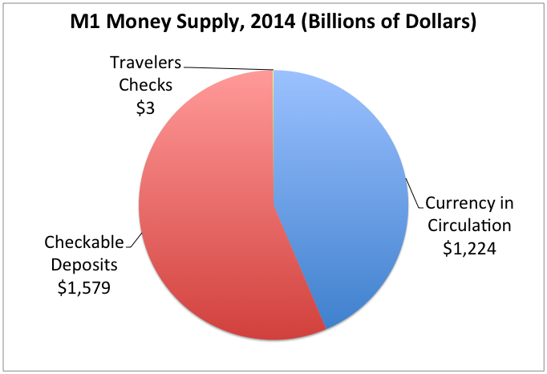
The Supply of Money
We have just witnessed how the Fed can increase or decrease the money supply. Let’s take a closer look at the supply and demand for money.
1) Definition of the Money Supply
A) When discussing monetary policy, money refers to M1.
M1 monies are currency in circulation, checkable bank deposits, and traveler’s checks. We can omit traveler’s checks for simplicity.

Slide 23
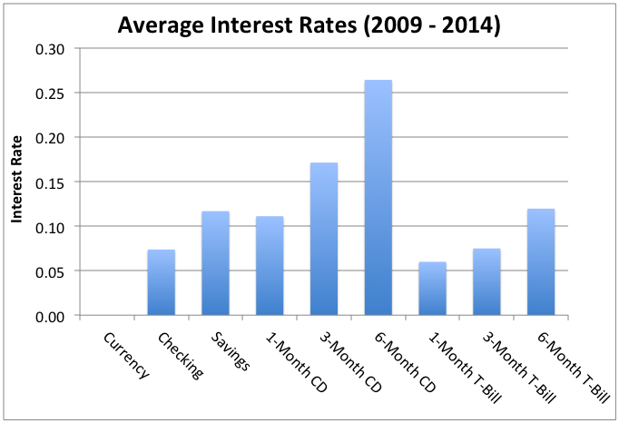
The Supply of Money
We have just witnessed how the Fed can increase or decrease the money supply. Let’s take a closer look at the supply and demand for money.
1) Definition of the Money Supply
A) When discussing monetary policy, money refers to M1.
B) Interest-bearing assets are not money, but are a close substitute.
Interest-bearing assets (except checking accounts) are not considered money because they cannot be immediately used for purchases.

Slide 24
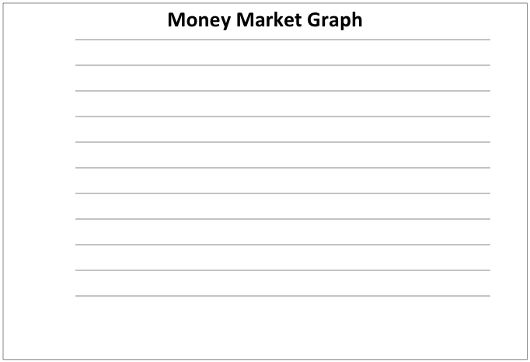
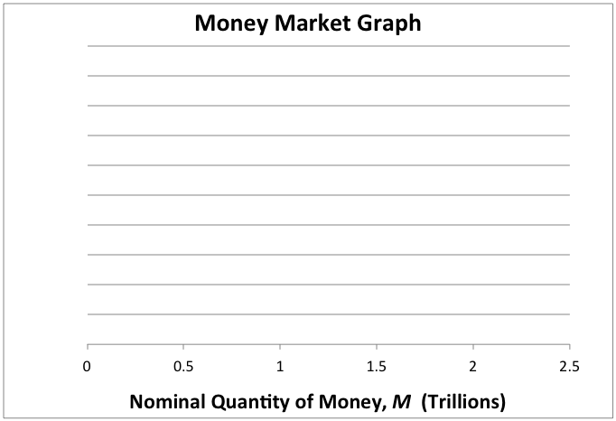
The Supply of Money
We have just witnessed how the Fed can increase or decrease the money supply. Let’s take a closer look at the supply and demand for money.
1) Definition of the Money Supply
A) When discussing monetary policy, money refers to M1.
B) Interest-bearing assets are not money, but are a close substitute.
2) Money Market Graph
A) The nominal quantity of money, M, goes on the x-axis.
Remember that “nominal” means the quantity of money is not adjusted for inflation. If it was adjusted for inflation, it would be the “real” quantity of money.

Slide 25
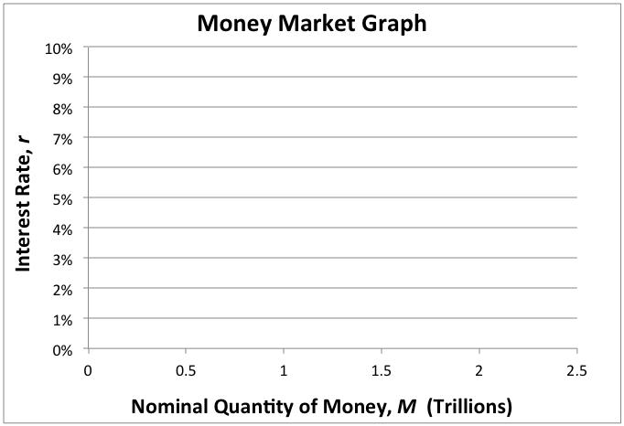
The Supply of Money
We have just witnessed how the Fed can increase or decrease the money supply. Let’s take a closer look at the supply and demand for money.
1) Definition of the Money Supply
A) When discussing monetary policy, money refers to M1.
B) Interest-bearing assets are not money, but are a close substitute.
2) Money Market Graph
A) The nominal quantity of money, M, goes on the x-axis.
B) The interest rate, r, goes on the y-axis.
The interest rate combines all short-term interest rates on liquid assets. We can use just one interest rate because they all tend to be similar.

Slide 26
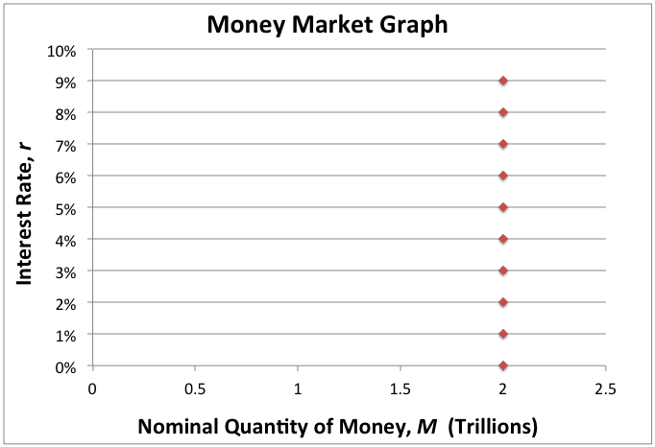
The Supply of Money
We have just witnessed how the Fed can increase or decrease the money supply. Let’s take a closer look at the supply and demand for money.
1) Definition of the Money Supply
A) When discussing monetary policy, money refers to M1.
B) Interest-bearing assets are not money, but are a close substitute.
2) Money Market Graph
A) The nominal quantity of money, M, goes on the x-axis.
B) The interest rate, r, goes on the y-axis.
3) The Money Supply Curve
A) Amount of money supplied by the Fed at each interest rate.
In practice, the Federal Reserve chooses an interest rate target. Then, they increase or decrease the money supply to achieve that target.

Slide 27
The Supply of Money
We have just witnessed how the Fed can increase or decrease the money supply. Let’s take a closer look at the supply and demand for money.
1) Definition of the Money Supply
A) When discussing monetary policy, money refers to M1.
B) Interest-bearing assets are not money, but are a close substitute.
2) Money Market Graph
A) The nominal quantity of money, M, goes on the x-axis.
B) The interest rate, r, goes on the y-axis.
3) The Money Supply Curve
A) Amount of money supplied by the Fed at each interest rate.
Strictly speaking, the Fed only controls the monetary base. But by controlling the monetary base, they exert a great deal of influence over the money supply.
B) Because the Fed chooses a money supply, it is a vertical line.

Slide 28
The Demand for Money
People hold wealth either as money or as less liquid assets. The demand for money refers to how much M1 money people hold based on the interest rate.

Slide 29
The Demand for Money
People hold wealth either as money or as less liquid assets. The demand for money refers to how much M1 money people hold based on the interest rate.
1) Money and Opportunity Cost
A) The opportunity cost of holding M1 money is the lost interest.
 | Asset | Interest Rate (Opportunity Cost of Holding Cash) 2010
M1 Monies | Cash | -
 | Checking Acct. | 0.13%
Less Liquid Assets | Savings Acct. | 0.21%
 | 6-Month CD | 0.60%
 | 6-Month T-Bill | 0.15%
While some checking accounts earn interest, cash clearly pays no interest. By holding cash, people are losing out on the interest it could have earned.
Notes:
The opportunity cost of holding cash is the interest rate of non-cash assets. This is true because cash pays no interest. If desired, you can point out that there is also an opportunity cost to holding money in a checking account. The opportunity cost in this case would be the interest rate of the less liquid asset minus the interest rate of the checking account. For example, holding money in checking as opposed to savings has an opportunity cost of (0.21% - 0.13%) = 0.08%

Slide 30
The Demand for Money
People hold wealth either as money or as less liquid assets. The demand for money refers to how much M1 money people hold based on the interest rate.
1) Money and Opportunity Cost
A) The opportunity cost of holding M1 money is the lost interest.
 | Asset | Interest Rate (Opportunity Cost of Holding Cash) 2010
M1 Monies | Cash | -
 | Checking Acct. | 0.13%
Less Liquid Assets | Savings Acct. | 0.21%
 | 6-Month CD | 0.60%
 | 6-Month T-Bill | 0.15%
 | Asset | Interest Rate (Opportunity Cost of Holding Cash) 2010 | Interest Rate (Opportunity Cost of Holding Cash) 2014
M1 Monies | Cash | - | -
 | Checking Acct. | 0.13% | 0.04%
Less Liquid Assets | Savings Acct. | 0.21% | 0.06%
 | 6-Month CD | 0.60% | 0.12%
 | 6-Month T-Bill | 0.15% | 0.07%
B) The size of the interest rate affects how much M1 money is held.
If interest rates are high, people pay a high cost for holding money. Thus, they will only hold a small amount. If interest rates are low, the reverse is true.
Notes:
In the example on this slide, the interest rates are much smaller in 2014 than in 2010. Thus, people are willing to hold more cash in 2014 than they were willing to hold in 2010.

Slide 31
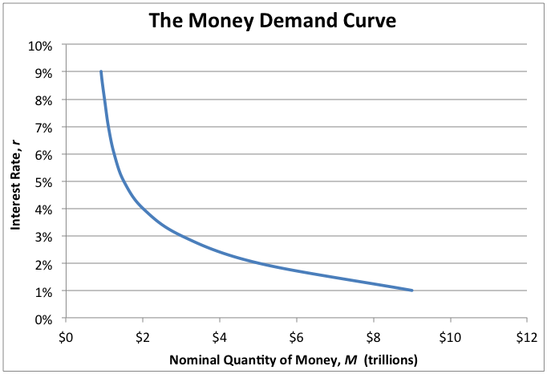
The Demand for Money
People hold wealth either as money or as less liquid assets. The demand for money refers to how much M1 money people hold based on the interest rate.
1) Money and Opportunity Cost
A) The opportunity cost of holding M1 money is the lost interest.
B) The size of the interest rate affects how much M1 money is held.
2) Nominal Money Demand
A) It is the amount of M1 money the public wants to hold.
MD₁
Less money is held when interest rates are high, and more money is held when interest rates are low. Thus, the money demand curve is downward sloping.

Slide 32
The Demand for Money
People hold wealth either as money or as less liquid assets. The demand for money refers to how much M1 money people hold based on the interest rate.
1) Money and Opportunity Cost
A) The opportunity cost of holding M1 money is the lost interest.
B) The size of the interest rate affects how much M1 money is held.
2) Nominal Money Demand
A) It is the amount of M1 money the public wants to hold.
B) Quantity of money demanded changes with the interest rate.
MD₁
When the interest rate changes, the nominal money demand curve does not shift. We simply move from one quantity on the curve to another quantity.

Slide 33
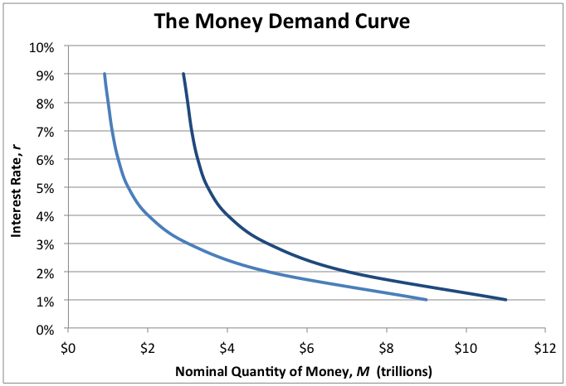
The Demand for Money
People hold wealth either as money or as less liquid assets. The demand for money refers to how much M1 money people hold based on the interest rate.
1) Money and Opportunity Cost
A) The opportunity cost of holding M1 money is the lost interest.
B) The size of the interest rate affects how much M1 money is held.
2) Nominal Money Demand
A) It is the amount of M1 money the public wants to hold.
B) Quantity of money demanded changes with the interest rate.
C) Quantity of money demanded matches changes in the price level.
MD₁
MD₁
MD₂
A rise in the aggregate price level, such as inflation, shifts the nominal demand for money to the right. This shift is proportional to the change in prices.
Notes:
If we think about this intuitively, it makes perfect sense. An increase in the aggregate price level means a given basket of goods and services now costs more money. Consumers still need to consume their desired basket of goods, so they must now hold an equally larger amount of money. The nominal quantity of money has increased even though there is no change to the interest rate.

Slide 34
The Demand for Money
People hold wealth either as money or as less liquid assets. The demand for money refers to how much M1 money people hold based on the interest rate.
1) Money and Opportunity Cost
A) The opportunity cost of holding M1 money is the lost interest.
Description | Variable
Nominal Quantity of Money, Initial | M₁
Aggregate Price Level, Initial | P₁
Nominal Quantity of Money, New | M₂
Aggregate Price Level, New | P₂
B) The size of the interest rate affects how much M1 money is held.
2) Nominal Money Demand
A) It is the amount of M1 money the public wants to hold.
B) Quantity of money demanded changes with the interest rate.
Real Money Demand =
M₁
=
M₂
C) Quantity of money demanded matches changes in the price level.
P₁
P₂
3) Real Money Demand
A) Equals the nominal quantity of money divided by the price level.
Because changes in the nominal demand for money are proportionate to changes in the price level, we can set these two proportions equal to each other.

Slide 35
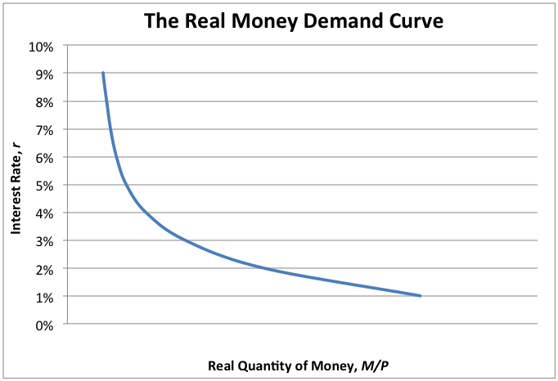
The Demand for Money
People hold wealth either as money or as less liquid assets. The demand for money refers to how much M1 money people hold based on the interest rate.
1) Money and Opportunity Cost
A) The opportunity cost of holding M1 money is the lost interest.
B) The size of the interest rate affects how much M1 money is held.
2) Nominal Money Demand
A) It is the amount of M1 money the public wants to hold.
B) Quantity of money demanded changes with the interest rate.
C) Quantity of money demanded matches changes in the price level.
M₁ / P₁ = M₂ / P₂
3) Real Money Demand
A) Equals the nominal quantity of money divided by the price level.
A change in the price level does not shift the real money demand curve. The quantity before a change in prices (M₁/P₁) is equal to the quantity after (M₂/P₂).
B) It measures money demand adjusted for inflation.
Notes:
This assumes there is no change in the interest rate.

Slide 36
Changes in Real Money Demand
When prices increase due to inflation, only the nominal demand for money rises. The following factors cause the real demand for money to change.

Slide 37
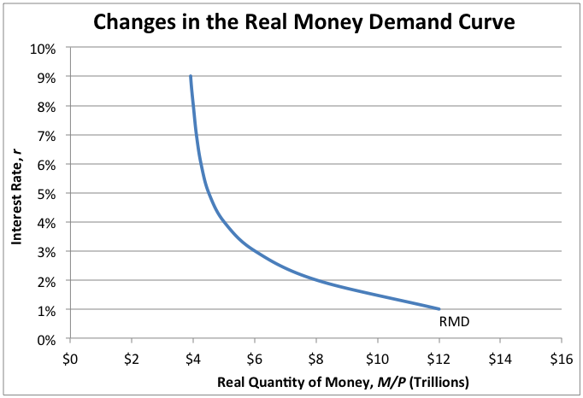
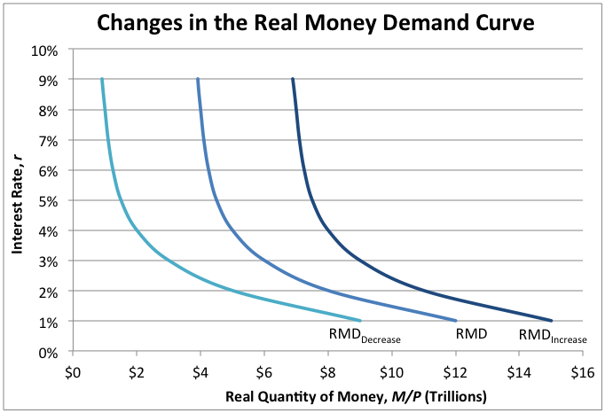
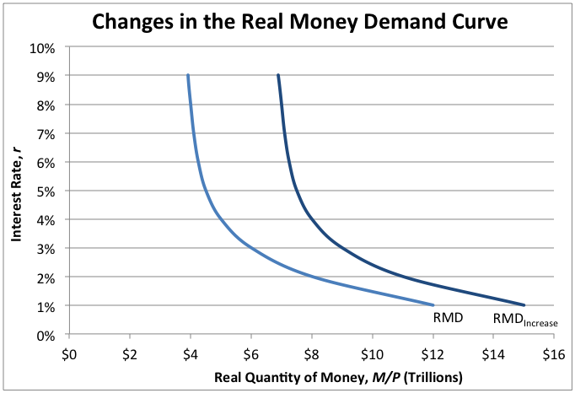
Changes in Real Money Demand
When prices increase due to inflation, only the nominal demand for money rises. The following factors cause the real demand for money to change.
1) Consumer Spending
Consumers hold enough money to cover any desired purchases.
To spend more, consumers must hold more money, which increases real money demand. If they spend less, they hold less money, which decreases demand.
Notes:
The real money demand curve (and the nominal money demand curve) can increase or decrease. These shifts are visually represented the same way as other demand curves.

Slide 38
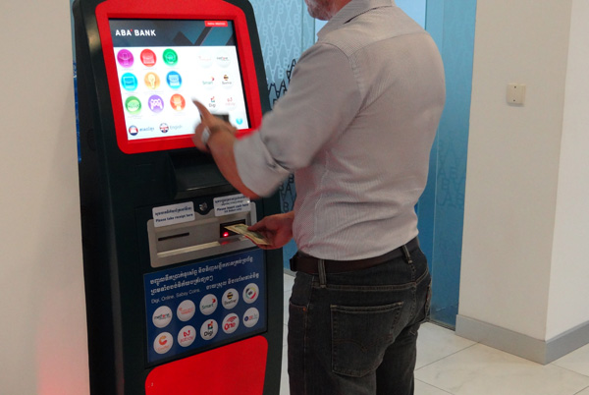
Changes in Real Money Demand
When prices increase due to inflation, only the nominal demand for money rises. The following factors cause the real demand for money to change.
1) Consumer Spending
Consumers hold enough money to cover any desired purchases.
2) Technology
Innovations like ATMs and online banking reduce transaction costs.
Increases in technology actually tend to have an opposite effect on money demand. As technology improves, people do not need to hold as much cash.

Slide 39
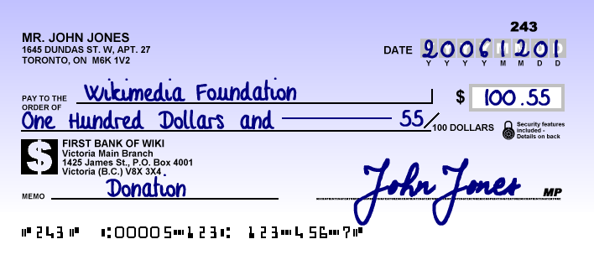
Changes in Real Money Demand
When prices increase due to inflation, only the nominal demand for money rises. The following factors cause the real demand for money to change.
1) Consumer Spending
Consumers hold enough money to cover any desired purchases.
2) Technology
Innovations like ATMs and online banking reduce transaction costs.
3) Financial Innovation
Includes improvements to banking regulations and procedures.
In the 1980s, checking accounts became eligible to earn interest. Holding money in checking accounts became more attractive, increasing money demand.

Slide 40
Changes in Real Money Demand
When prices increase due to inflation, only the nominal demand for money rises. The following factors cause the real demand for money to change.
1) Consumer Spending
Consumers hold enough money to cover any desired purchases.
2) Technology
Innovations like ATMs and online banking reduce transaction costs.
3) Financial Innovation
Includes improvements to banking regulations and procedures.
4) Precautionary Motives
Expectations about the future can alter a person’s need for money.
When people expect to make purchases in the near future, they will hold onto more money. This occurs during the holiday shopping season in December.

Slide 41
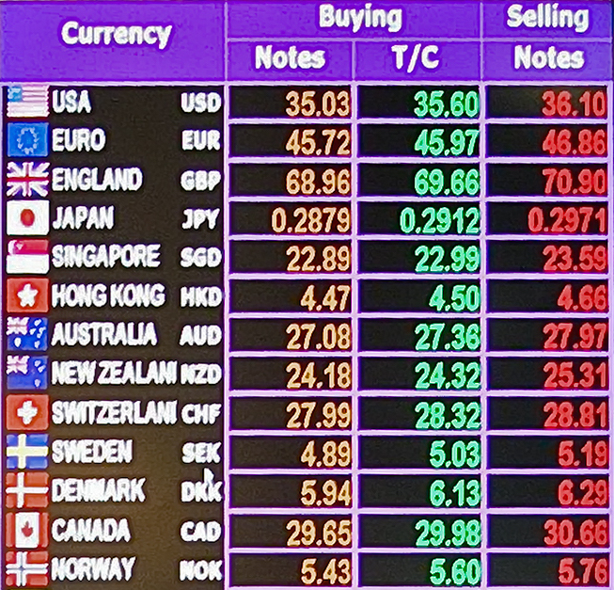
Changes in Real Money Demand
When prices increase due to inflation, only the nominal demand for money rises. The following factors cause the real demand for money to change.
1) Consumer Spending
Consumers hold enough money to cover any desired purchases.
2) Technology
Innovations like ATMs and online banking reduce transaction costs.
3) Financial Innovation
Includes improvements to banking regulations and procedures.
4) Precautionary Motives
Expectations about the future can alter a person’s need for money.
5) International Factors
The demand for U.S. dollars by foreigners will rise if American products become more popular abroad, or if the exchange rate is expected to improve.
Foreigners also contribute to the demand for the U.S. dollar.

Slide 42
The Velocity of Money
The velocity of money refers to how many times a unit of money is spent during a year. It is another way of illustrating the concept of money demand.

Slide 43
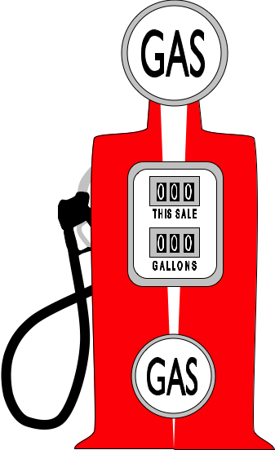
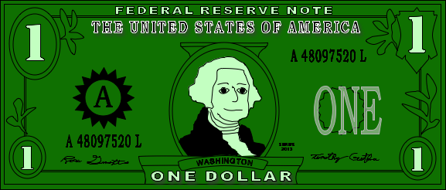
The Velocity of Money
The velocity of money refers to how many times a unit of money is spent during a year. It is another way of illustrating the concept of money demand.
1) The Velocity of Money Equation
A) Calculates how many times a unit of money is spent in a year.
For example, the same dollar bill might be used to buy a gallon of gas. The gas station uses that dollar to pay an employee, who then purchases a soda.
Notes:
If these were the only three transactions this dollar bill was used for in a year’s time, the velocity of that dollar bill would be 3.

Slide 44
The Velocity of Money
The velocity of money refers to how many times a unit of money is spent during a year. It is another way of illustrating the concept of money demand.
1) The Velocity of Money Equation
Equation 1
V =
P x Y
A) Calculates how many times a unit of money is spent in a year.
M
( ) M
Multiply Each
Side by M
M ( )
P x Y
V =
M
B) Velocity equals GDP divided by quantity of money. V = (P x Y) / M
Equation 2
M x V = P x Y
Variable | Description
V | Velocity of Money
M | Nominal Quantity of Money (M1 Money)
P | Aggregate Price Level
Y | Aggregate Output (measured by real GDP)
P x Y | Nominal GDP
When we take a closer look at these equations, they make perfect sense. They tell us that GDP is equal to the number of times each dollar gets spent.

Slide 45
The Velocity of Money
The velocity of money refers to how many times a unit of money is spent during a year. It is another way of illustrating the concept of money demand.
1) The Velocity of Money Equation
Equation 1
V =
P x Y
A) Calculates how many times a unit of money is spent in a year.
M
Equation 2
M x V = P x Y
B) Velocity equals GDP divided by quantity of money. V = (P x Y) / M
Divide Each
Side by P x V
M x V
=
P x Y
2) Velocity and Interest Rates
P x V
P x V
A) Velocity is a special case of real money demand. M/P = Y/V
Equation 3
M
Y
=
P
V
Remember, M/P is the same thing as real money demand. This equation says that real money demand is proportional to real GDP by a factor of 1/V.

Slide 46
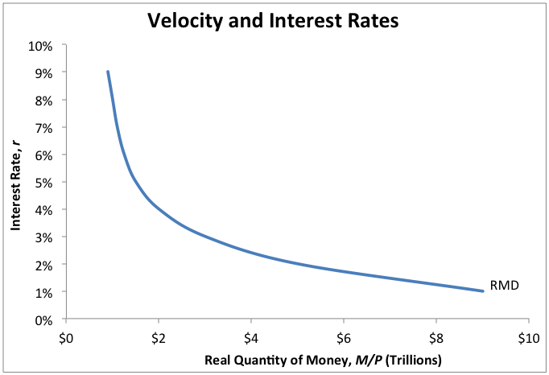
The Velocity of Money
The velocity of money refers to how many times a unit of money is spent during a year. It is another way of illustrating the concept of money demand.
1) The Velocity of Money Equation
M
Y
4
Equation 3
1
3
A) Calculates how many times a unit of money is spent in a year.
=
=
P
V
8
6
?
24
B) Velocity equals GDP divided by quantity of money. V = (P x Y) / M
3) And Velocity Increases
2) Velocity and Interest Rates
1) If Interest Rates Rise
A) Velocity is a special case of real money demand. M/P = Y/V
B) Higher interest rates decrease RMD, causing velocity to rise.
E
2) RMD
Decreases
If output (Y) and prices (P) remain unchanged, then a decrease in the quantity of money (M) must be matched by a proportionate increase in velocity (V).
Notes:
The connections between interest rates, real money demand, and money velocity are quite difficult. The main thing for students to remember is that a change in interest rates will cause velocity to change in the same direction. Increase/Increase and Decrease/Decrease.

Slide 47
The Velocity of Money
The velocity of money refers to how many times a unit of money is spent during a year. It is another way of illustrating the concept of money demand.
1) The Velocity of Money Equation
M
Y
4
Equation 3
8
3
A) Calculates how many times a unit of money is spent in a year.
=
=
P
V
8
6
?
3
B) Velocity equals GDP divided by quantity of money. V = (P x Y) / M
3) And Velocity Decreases
2) Velocity and Interest Rates
1) If Interest Rates Fall
A) Velocity is a special case of real money demand. M/P = Y/V
B) Higher interest rates decrease RMD, causing velocity to rise.
E
2) RMD
Increases
C) Lower interest rates increase RMD, causing velocity to fall.
Intuitively, if there is more money, people do not need to spend their dollars as quickly in order to purchase the same amount of goods as before.
Notes:
The connections between interest rates, real money demand, and money velocity are quite difficult. The main thing for students to remember is that a change in interest rates will cause velocity to change in the same direction. Increase/Increase and Decrease/Decrease.

Slide 48
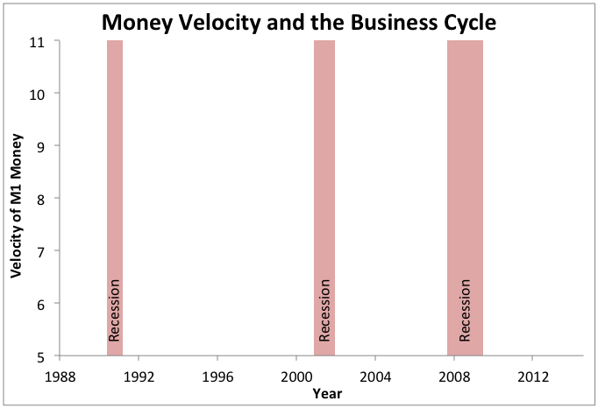
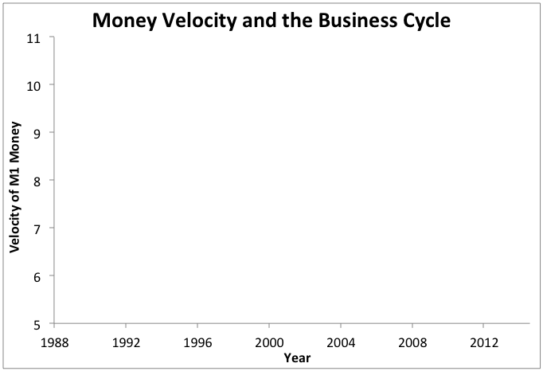
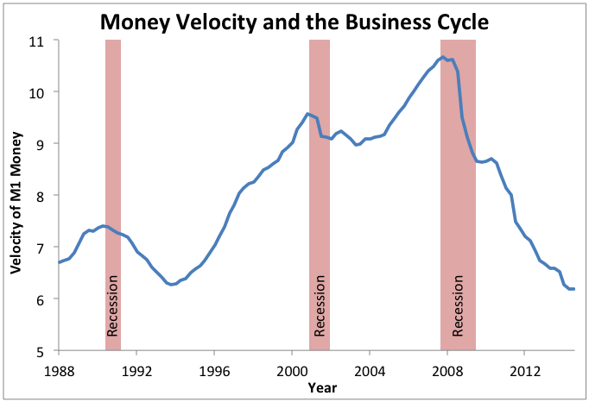
The Velocity of Money
The velocity of money refers to how many times a unit of money is spent during a year. It is another way of illustrating the concept of money demand.
1) The Velocity of Money Equation
A) Calculates how many times a unit of money is spent in a year.
B) Velocity equals GDP divided by quantity of money. V = (P x Y) / M
2) Velocity and Interest Rates
A) Velocity is a special case of real money demand. M/P = Y/V
B) Higher interest rates decrease RMD, causing velocity to rise.
C) Lower interest rates increase RMD, causing velocity to fall.
3) Velocity and the Business Cycle
When an economy is unhealthy, like in 2009, people are hesitant to spend their money. This contributes to slow growth and reduced inflation, or even deflation.
A) Velocity falls in a recession.
Notes:
Notice that most of the major decreases in money velocity began at the beginning of a recession.

Slide 49
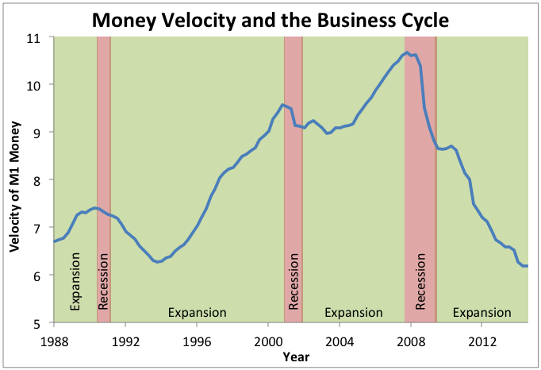
The Velocity of Money
The velocity of money refers to how many times a unit of money is spent during a year. It is another way of illustrating the concept of money demand.
1) The Velocity of Money Equation
A) Calculates how many times a unit of money is spent in a year.
B) Velocity equals GDP divided by quantity of money. V = (P x Y) / M
2) Velocity and Interest Rates
A) Velocity is a special case of real money demand. M/P = Y/V
B) Higher interest rates decrease RMD, causing velocity to rise.
C) Lower interest rates increase RMD, causing velocity to fall.
3) Velocity and the Business Cycle
When an economy is healthy, like in the 1990s, people spend money rather quickly. This contributes to both economic growth and inflation.
A) Velocity falls in a recession.
B) Velocity rises in an expansion.
Notes:
Notice that money velocity may take a little while to begin to increase again once a recession is over. Nevertheless, the principle that velocity increases during expansions is generally true.

Slide 50
Equilibrium in the Money Market
The money market is formally known as the liquidity preference model. It shows how the Fed affects a very important interest rate: the federal funds rate.

Slide 51
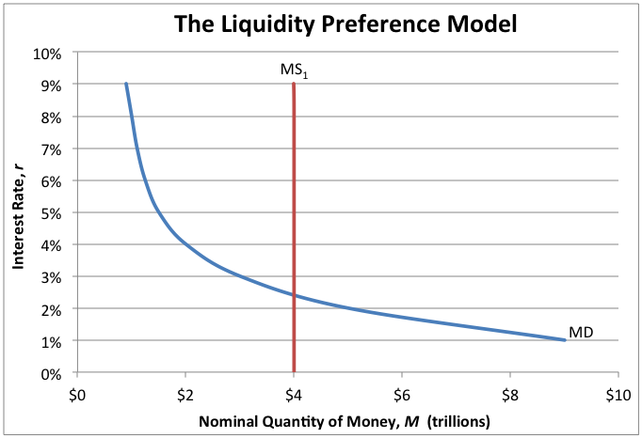
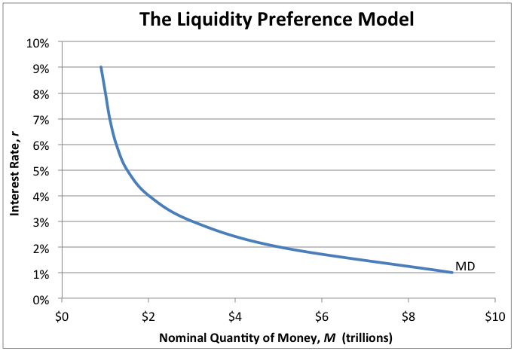
Equilibrium in the Money Market
The money market is formally known as the liquidity preference model. It shows how the Fed affects a very important interest rate: the federal funds rate.
1) The Liquidity Preference Model
A) Supply and demand for money determines the interest rate.
Equilibrium
The money market is in equilibrium where money supply equals money demand. This point determines the quantity of money and the interest rate.

Slide 52
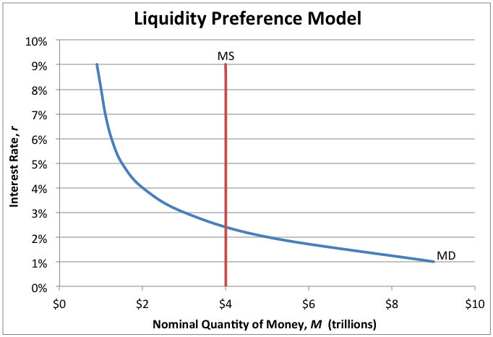
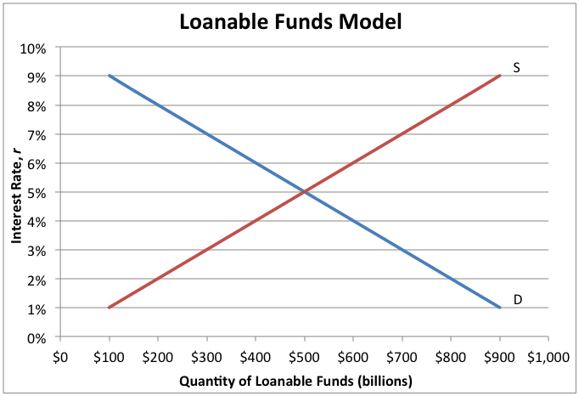
Equilibrium in the Money Market
The money market is formally known as the liquidity preference model. It shows how the Fed affects a very important interest rate: the federal funds rate.
1) The Liquidity Preference Model
A) Supply and demand for money determines the interest rate.
B) Both this model and the loanable funds model are correct.
In the loanable funds model, the supply and demand for funds between lenders and borrowers determines the interest rate. Let’s set this model aside for now.

Slide 53
Equilibrium in the Money Market
The money market is formally known as the liquidity preference model. It shows how the Fed affects a very important interest rate: the federal funds rate.
1) The Liquidity Preference Model
The Fed Lowers Its
Target Interest Rate
The Fed Raises Its
Target Interest Rate
A) Supply and demand for money determines the interest rate.
B) Both this model and the loanable funds model are correct.
The Fed
Buys T-Bills
The Fed
Sells T-Bills
C) It shows how monetary policy can affect the interest rate.
Money Supply
Increases
Money Supply
Decreases
Federal Funds Rate
Decreases
Federal Funds Rate
Increases
All Short-Term Interest
Rates Decrease
All Short-Term Interest
Rates Increase
The Fed uses open-market operations to affect a very important interest rate: the federal funds rate. This is the basis for all other interest rates in the economy.
Notes:
These two flow charts are depicted graphically and explained in greater detail in the next three slides.

Slide 54
Equilibrium in the Money Market
The money market is formally known as the liquidity preference model. It shows how the Fed affects a very important interest rate: the federal funds rate.
1) The Liquidity Preference Model
A) Supply and demand for money determines the interest rate.
B) Both this model and the loanable funds model are correct.
C) It shows how monetary policy can affect the interest rate.
2) Setting the Federal Funds Rate
Target
A) The target federal funds rate determines the money supply.
The liquidity preference model represents all short-term interest rates. In this instance, we can think of the interest rate being just the federal funds rate.

Slide 55
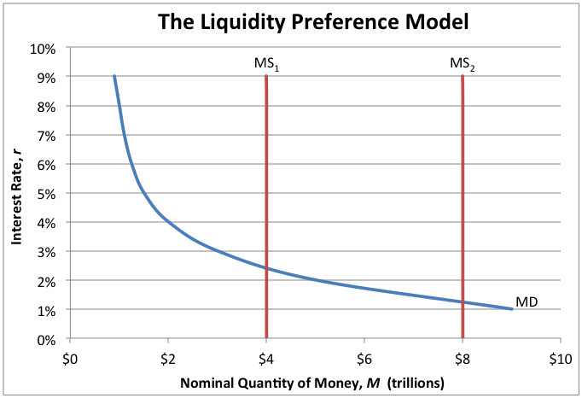
Equilibrium in the Money Market
The money market is formally known as the liquidity preference model. It shows how the Fed affects a very important interest rate: the federal funds rate.
1) The Liquidity Preference Model
A) Supply and demand for money determines the interest rate.
B) Both this model and the loanable funds model are correct.
C) It shows how monetary policy can affect the interest rate.
...then MS increases
2) Setting the Federal Funds Rate
A) The target federal funds rate determines the money supply.
If the target decreases...
B) If the target is lowered, the Fed will increase the money supply.
To increase the money supply, the Federal Reserve Bank of New York buys T-bills from banks until the target federal funds rate is achieved.

Slide 56
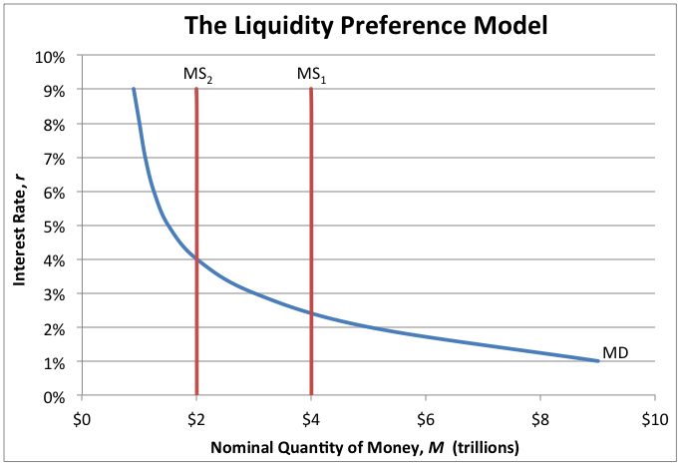
Equilibrium in the Money Market
The money market is formally known as the liquidity preference model. It shows how the Fed affects a very important interest rate: the federal funds rate.
1) The Liquidity Preference Model
A) Supply and demand for money determines the interest rate.
B) Both this model and the loanable funds model are correct.
If the target increases...
C) It shows how monetary policy can affect the interest rate.
...then MS decreases
2) Setting the Federal Funds Rate
A) The target federal funds rate determines the money supply.
B) If the target is lowered, the Fed will increase the money supply.
To decrease the money supply, the Federal Reserve Bank of New York sells T-bills to banks until the target federal funds rate is achieved.
C) If the target is raised, the Fed will decrease the money supply.

Slide 57
The Different Interest Rates
The Fed has a lot of power because it determines the federal funds rate. This interest rate influences all other short-term interest rates in the economy.

Slide 58
The Different Interest Rates
The Fed has a lot of power because it determines the federal funds rate. This interest rate influences all other short-term interest rates in the economy.
1) Federal Funds Rate
A) Interest rate banks charge each other for overnight loans.
It is called the federal funds rate because these funds are maintained at the Federal Reserve. It is only applicable to the most credit-worthy institutions.

Slide 59
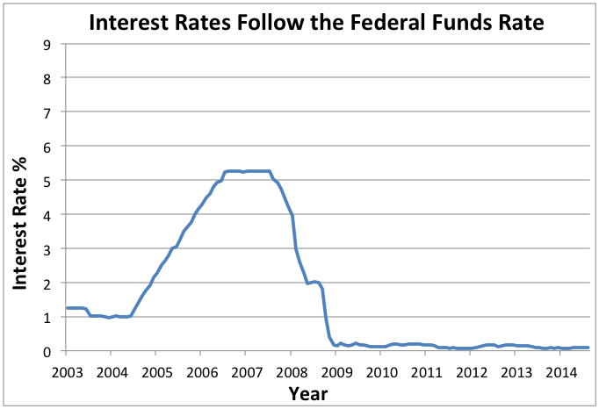
The Different Interest Rates
The Fed has a lot of power because it determines the federal funds rate. This interest rate influences all other short-term interest rates in the economy.
1) Federal Funds Rate
A) Interest rate banks charge each other for overnight loans.
Federal Funds Rate
B) Influences all other interest rates.
The federal funds rate is the most influential interest rate in the U.S. economy. Any increase or decrease in it will be matched by all other interest rates.

Slide 60
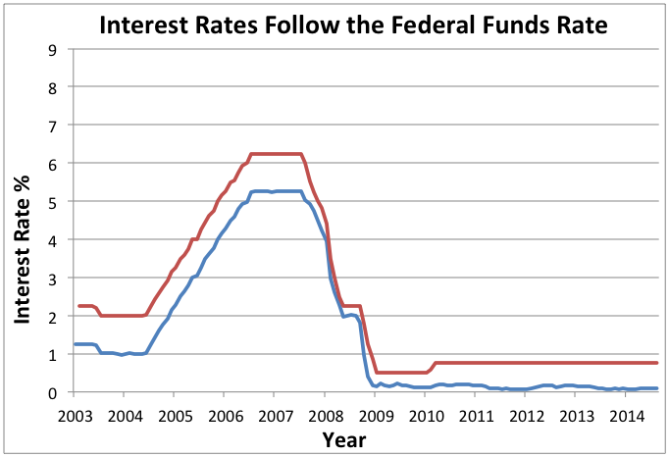
The Different Interest Rates
The Fed has a lot of power because it determines the federal funds rate. This interest rate influences all other short-term interest rates in the economy.
1) Federal Funds Rate
A) Interest rate banks charge each other for overnight loans.
Federal Funds Rate
Discount Rate
B) Influences all other interest rates.
2) Discount Rate
Interest rate the Fed charges banks.
To discourage banks from borrowing from the Fed, the discount rate is usually kept slightly higher than the federal funds rate.

Slide 61
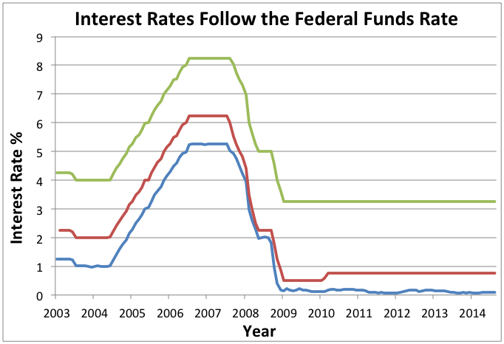
The Different Interest Rates
The Fed has a lot of power because it determines the federal funds rate. This interest rate influences all other short-term interest rates in the economy.
1) Federal Funds Rate
A) Interest rate banks charge each other for overnight loans.
Federal Funds Rate
Discount Rate
Prime Rate
B) Influences all other interest rates.
2) Discount Rate
Interest rate the Fed charges banks.
3) Prime Rate
Interest rate banks charge their best customers, mainly corporations.
The prime rate strongly influences the interest rate individuals pay for mortgages and personal loans, but it is itself determined by the federal funds rate.

Slide 62
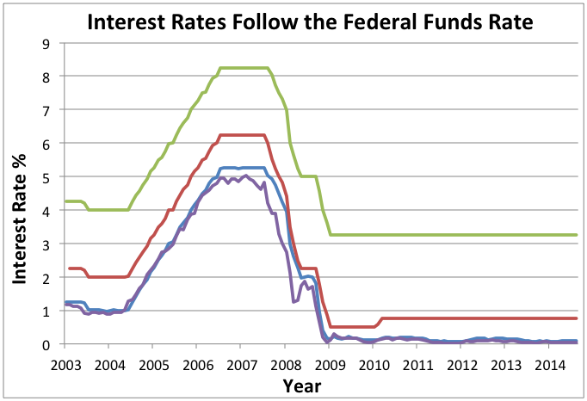
The Different Interest Rates
The Fed has a lot of power because it determines the federal funds rate. This interest rate influences all other short-term interest rates in the economy.
1) Federal Funds Rate
A) Interest rate banks charge each other for overnight loans.
Federal Funds Rate
Discount Rate
3-Month T-Bills
Prime Rate
B) Influences all other interest rates.
2) Discount Rate
Interest rate the Fed charges banks.
3) Prime Rate
Interest rate banks charge their best customers, mainly corporations.
4) Short-Term Interest Rates
Interest rate on financial assets that mature in six months or less.
There are several types of short-term interest rates, but they all tend to move together. This is because they are competing for the same business.

Slide 63
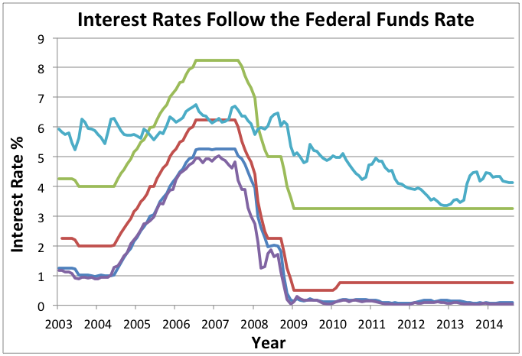
The Different Interest Rates
The Fed has a lot of power because it determines the federal funds rate. This interest rate influences all other short-term interest rates in the economy.
1) Federal Funds Rate
A) Interest rate banks charge each other for overnight loans.
Federal Funds Rate
Discount Rate
3-Month T-Bills
Prime Rate
30-Year Mortgage
B) Influences all other interest rates.
2) Discount Rate
Interest rate the Fed charges banks.
3) Prime Rate
Interest rate banks charge their best customers, mainly corporations.
4) Short-Term Interest Rates
Interest rate on financial assets that mature in six months or less.
5) Long-Term Interest Rates
Long-term interest rates are affected by changes in short-term interest rates, but only by a little bit. They are usually higher than short-term interest rates.
Interest rate on financial assets that mature in several years.

Slide 64
The Money Market
Class Activity
EQUILIBRIUM IN THE MONEY MARKET
If the money market is currently operating at the “Equilibrium” point in the graph below, how will the following headlines affect equilibrium? First, determine if demand, supply, the interest rate, and quantity “Increase,” “Decrease,” or exhibit “No Change.” Then, write in the letter of the new equilibrium point.
REAL MONEY DEMAND
These are the factors that cause real money demand to change. For each headline, circle whether there is an “Increase” or a “Decrease” in demand, and indicate which “Factor” caused demand to change.
SETTING THE FEDERAL FUNDS RATE
Two actual statements released by the Federal Reserve are listed below. Under each one, there is a money market graph in equilibrium prior to the release date. Use the graphs to illustrate how the money market will change based on each statement, and then answer the questions.
Equilibrium in the
Money Market
Real
Money Demand
Setting the
Federal Funds Rate
Notes:
This is the Class Activity included in the download, entitled “The Money Market.” Assign students one of the three versions. Difficulty increases from (a) to (b) to (c), allowing for differentiation, if desired. Students may either self-identify which difficulty to complete, or the teacher can decide.

Slide 65
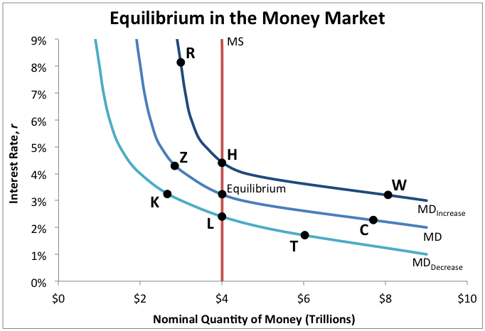
The Money Market
EQUILIBRIUM IN THE MONEY MARKET
1) Inflation Hits the Economy
Demand:
Supply:
Interest Rate:
Quantity:
New Equilibrium Point:
3) Interest Rate Target Lowered
Demand:
Supply:
Interest Rate:
Quantity:
New Equilibrium Point:
2) Recession Shakes Consumer Confidence
Demand:
Supply:
Interest Rate:
Quantity:
New Equilibrium Point:
4) Federal Reserve Sells T-Bills
Demand:
Supply:
Interest Rate:
Quantity:
New Equilibrium Point:
Show Answers
Real
Money Demand
Setting the
Federal Funds Rate

Slide 66
The Money Market
EQUILIBRIUM IN THE MONEY MARKET
1) Inflation Hits the Economy
Demand:
Supply:
Interest Rate:
Quantity:
New Equilibrium Point:
1) Inflation Hits the Economy
Demand: Increase
Supply: No Change
Interest Rate: Increase
Quantity: No Change
New Equilibrium Point: H
3) Interest Rate Target Lowered
Demand:
Supply:
Interest Rate:
Quantity:
New Equilibrium Point:
3) Interest Rate Target Lowered
Demand: No Change
Supply: Increase
Interest Rate: Decrease
Quantity: Increase
New Equilibrium Point: C
2) Recession Shakes Consumer Confidence
Demand:
Supply:
Interest Rate:
Quantity:
New Equilibrium Point:
2) Recession Shakes Consumer Confidence
Demand: Decrease
Supply: No Change
Interest Rate: Decrease
Quantity: No Change
New Equilibrium Point: L
4) Federal Reserve Sells T-Bills
Demand:
Supply:
Interest Rate:
Quantity:
New Equilibrium Point:
4) Federal Reserve Sells T-Bills
Demand: No Change
Supply: Decrease
Interest Rate: Increase
Quantity: Decrease
New Equilibrium Point: Z
Equilibrium in the
Money Market
Real
Money Demand
Setting the
Federal Funds Rate

Slide 67
The Money Market
REAL MONEY DEMAND
A | B | C | D | E
Consumer Spending | Technology | Financial Innovation | Precautionary Motives | International Factors
5) Foreigners Seek More U.S. Dollars
Demand:
Factor:
7) Officials Say a Recession Is Coming Soon
Demand:
Factor:
9) Online Stores Now Accept Credit Cards
Demand:
Factor:
6) Withdrawal Limits for ATMs Removed
Demand:
Factor:
8) Black Friday Holiday Shopping Causes Lots of Spending
Demand:
Factor:
10) New Government Budget Bigger Than Ever
Demand:
Factor:
Equilibrium in the
Money Market
Show Answers
Setting the
Federal Funds Rate

Slide 68
The Money Market
REAL MONEY DEMAND
A | B | C | D | E
Consumer Spending | Technology | Financial Innovation | Precautionary Motives | International Factors
5) Foreigners Seek More U.S. Dollars
Demand:
Factor:
5) Foreigners Seek More U.S. Dollars
Demand: Increase
Factor: E
7) Officials Say a Recession Is Coming Soon
Demand:
Factor:
7) Officials Say a Recession Is Coming Soon
Demand: Decrease
Factor: D
9) Online Stores Now Accept Credit Cards
Demand:
Factor:
9) Online Stores Now Accept Credit Cards
Demand: Decrease
Factor: B or C
10) New Government Budget Bigger Than Ever
Demand:
Factor:
6) Withdrawal Limits for ATMs Removed
Demand:
Factor:
10) New Government Budget Bigger Than Ever
Demand: Increase
Factor: A
6) Withdrawal Limits for ATMs Removed
Demand: Increase
Factor: C
8) Black Friday Holiday Shopping Causes Lots of Spending
Demand:
Factor:
8) Black Friday Holiday Shopping Causes Lots of Spending
Demand: Increase
Factor: A or D
Equilibrium in the
Money Market
Real
Money Demand
Setting the
Federal Funds Rate

Slide 69
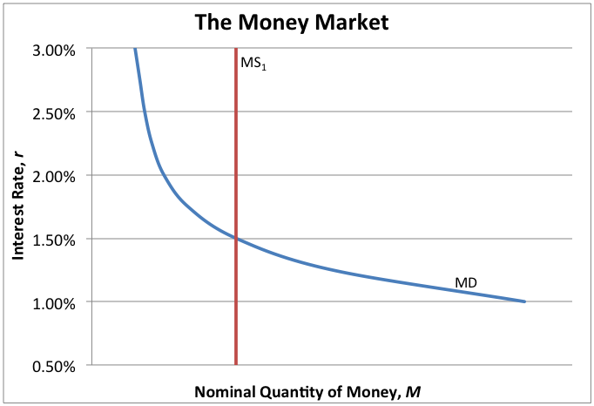
The Money Market
SETTING THE FEDERAL FUNDS RATE
Release Date: September 21, 2004
The Federal Open Market Committee decided today to raise its target for the federal funds rate by 25 basis points, from 1.50 to 1.75 percent.
11) Draw the graph.
12) Which open-market operation should the Fed use?
13) How will the interest rate and quantity change?
14) What relationship exists between the federal funds rate and all other short-term interest rates?
Release Date: October 29, 2008
The Federal Open Market Committee decided today to lower its target for the federal funds rate by 50 basis points, from 1.50 to 1.00 percent.
15) Draw the graph.
16) Which open-market operation should the Fed use?
17) How will the interest rate and quantity change?
18) Do you think a lowering of the target federal funds rate signifies the economy is in an expansion, or a recession?
Equilibrium in the
Money Market
Real
Money Demand
Show Answers

Slide 70
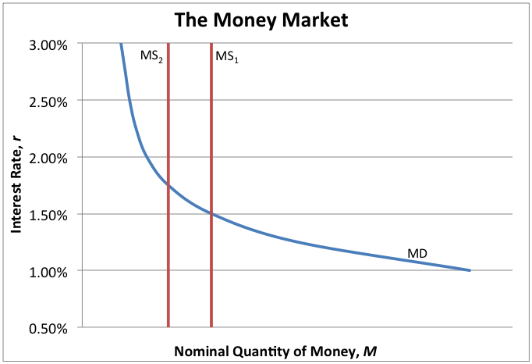
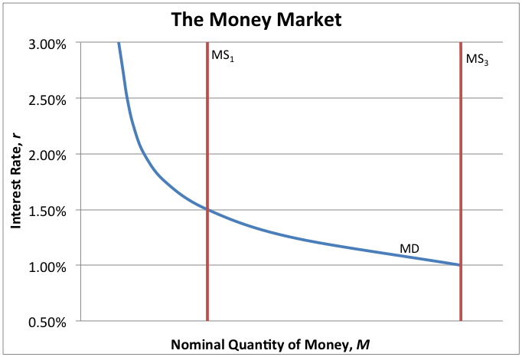
The Money Market
SETTING THE FEDERAL FUNDS RATE
Release Date: September 21, 2004
The Federal Open Market Committee decided today to raise its target for the federal funds rate by 25 basis points, from 1.50 to 1.75 percent.
11) Draw the graph.
12) Which open-market operation should the Fed use?
13) How will the interest rate and quantity change?
14) What relationship exists between the federal funds rate and all other short-term interest rates?
Release Date: September 21, 2004
The Federal Open Market Committee decided today to raise its target for the federal funds rate by 25 basis points, from 1.50 to 1.75 percent.
11) Money supply decreases
12) Sell T-Bills
13) Interest rate increases, quantity decreases
14) The federal funds rate gets set first, then all short-term interest rates change in a similar way.
Release Date: October 29, 2008
The Federal Open Market Committee decided today to lower its target for the federal funds rate by 50 basis points, from 1.50 to 1.00 percent.
15) Draw the graph.
16) Which open-market operation should the Fed use?
17) How will the interest rate and quantity change?
18) Do you think a lowering of the target federal funds rate signifies the economy is in an expansion, or a recession?
Release Date: October 29, 2008
The Federal Open Market Committee decided today to lower its target for the federal funds rate by 50 basis points, from 1.50 to 1.00 percent.
15) Money supply increases
16) Buy T-Bills
17) Interest rate decreases, quantity increases
18) Recession. By increasing the money supply, the Fed encourages people to engage in economic activities.
Equilibrium in the
Money Market
Real
Money Demand
Setting the
Federal Funds Rate

Slide 71
Learning Targets
Knowledge
None
Reasoning
Explain how the supply and demand of money determine the equilibrium interest rate.
Explain how the Federal Reserve uses open-market operations to achieve a target federal funds rate.
Skill
Calculate data using the velocity approach to money demand.
Essential Questions
How do interest rates get determined?
Why is the Federal Reserve considered such an important part of the United States economy?
Notes:
Help students make connections between the learning targets and the activities from today. If desired, see if students can answer the Essential Questions.

Slide 72
Quiz
This quiz covers topics from today’s lesson and is divided into three sections.
Section 1
MATCHING
Match the correct letter from each definition with each vocabulary word.
Or
VOCABULARY
Write the definition of each vocabulary word in your own words.
Section 2
MULTIPLE CHOICE
Select the best answer for each question or incomplete statement.
Or
SHORT RESPONSE
Write in the answer for each question or incomplete statement.
Section 3
CALCULATIONS
Calculate each problem correctly.
Matching /
Vocabulary
Multiple Choice /
Short Response
Calculations
Notes:
A short quiz has been included, which can be utilized in different ways. Each student can complete the quiz silently, the teacher can read the questions aloud and call on students for informal answers, or it can be given at the beginning of tomorrow’s class. There are three versions, allowing for differentiation. Difficulty increases from (a) to (b) to (c).

Slide 73
Quiz
MATCHING / VOCABULARY
1) Discount Rate
3) Federal Funds Rate
2) Prime Rate
4) Short-Term Interest Rate
Show Answers
Multiple Choice /
Short Response
Calculations

Slide 74
Quiz
MATCHING / VOCABULARY
1) Discount Rate
1) Discount Rate
a) Interest rate charged to commercial banks by the Federal Reserve.
3) Federal Funds Rate
3) Federal Funds Rate
c) Interest rate banks charge each other for overnight loans kept at the Federal Reserve.
2) Prime Rate
2) Prime Rate
d) Interest rate banks charge their best customers, usually large corporations.
4) Short-Term Interest Rate
4) Short-Term Interest Rate
b) Interest rate for assets that mature in roughly six months or less.
Matching /
Vocabulary
Multiple Choice /
Short Response
Calculations

Slide 75
Quiz
MULTIPLE CHOICE / SHORT RESPONSE
5) The opportunity cost of holding onto M1 money, such as cash and checking account deposits, is the
7) During a recession, it is very likely that money velocity will
9) If the nominal demand for money increases, but the money supply stays the same, interest rates
6) If checking accounts can now earn interest, the factor that causes real money demand to shift is
8) If the money supply decreases, but the money demand stays the same, interest rates
10) If the Federal Reserve wants to increase the money supply, it will likely
Matching /
Vocabulary
Show Answers
Calculations

Slide 76
Quiz
MULTIPLE CHOICE / SHORT RESPONSE
5) The opportunity cost of holding onto M1 money, such as cash and checking account deposits, is the
5) The opportunity cost of holding onto M1 money, such as cash and checking account deposits, is the
b) lost interest it could have earned.
7) During a recession, it is very likely that money velocity will
7) During a recession, it is very likely that money velocity will
c) decrease.
9) If the nominal demand for money increases, but the money supply stays the same, interest rates
9) If the nominal demand for money increases, but the money supply stays the same, interest rates
a) increase, but quantity stays the same.
6) If checking accounts can now earn interest, the factor that causes real money demand to shift is
6) If checking accounts can now earn interest, the factor that causes real money demand to shift is
c) financial innovation.
8) If the money supply decreases, but the money demand stays the same, interest rates
8) If the money supply decreases, but the money demand stays the same, interest rates
a) increase, but quantity decreases.
10) If the Federal Reserve wants to increase the money supply, it will likely
10) If the Federal Reserve wants to increase the money supply, it will likely
b) buy T-bills.
Matching /
Vocabulary
Multiple Choice /
Short Response
Calculations

Slide 77
Quiz
CALCULATIONS
11) Solve for V:
If the money supply is $2 trillion, and nominal GDP is $16 trillion, what is the velocity of money?
12) Solve for (P x Y):
If the money supply is $2.5 trillion, and money velocity is 8, what is nominal GDP?
13) Solve for V:
If the real money demand for money (M / P) is 4, and output (Y) is 20, what is the velocity of money?
Matching /
Vocabulary
Multiple Choice /
Short Response
Show Answers

Slide 78
Quiz
CALCULATIONS
11) Solve for V:
If the money supply is $2 trillion, and nominal GDP is $16 trillion, what is the velocity of money?
11) Solve for V:
If the money supply is $2 trillion, and nominal GDP is $16 trillion, what is the velocity of money?
V = (P x Y) / M
V = ($16 trillion) / $2 trillion
V = 8
12) Solve for (P x Y):
If the money supply is $2.5 trillion, and money velocity is 8, what is nominal GDP?
12) Solve for (P x Y):
If the money supply is $2.5 trillion, and money velocity is 8, what is nominal GDP?
M x V = P x Y
$2.5 trillion x 8 = P x Y
P x Y = $20 trillion
13) Solve for V:
If the real money demand for money (M / P) is 4, and output (Y) is 20, what is the velocity of money?
13) Solve for V:
If the real money demand for money (M / P) is 4, and output (Y) is 20, what is the velocity of money?
M / P = Y / V
4 = 20 / V
4V = 20
V = 5
Matching /
Vocabulary
Multiple Choice /
Short Response
Calculations

Slide 79
Money Velocity
Homework
1) Velocity of Money Equation
Solve for V using the following equation:
V = (P x Y) / M
3) Real Money Demand Equation
Solve for V using the following equation:
M / P = Y / V
5) Velocity and Interest Rates
A) Graph “Fed Funds Rate” on the chart.
B) Answer the questions.
2) Quantity Equation
Solve for (P x Y) using the following equation:
M x V = P x Y
4) Money Velocity in the United States
A) Complete the table.
B) Graph “M1 Velocity” and “M2 Velocity” on the chart.
6) Velocity and the Business Cycle
A) Graph “% Change in Real GDP” on the chart.
B) Answer the questions.
1) Velocity of
Money Equation
2) Quantity
Equation
3) Real Money
Demand Equation
4) Money Velocity
In the U.S.
5) Velocity and
Interest Rates
6) Velocity and the
Business Cycle
Notes:
These are the directions for the Homework that is included in the download, entitled “Money Velocity.” Assign students one of the three versions. Difficulty increases from (a) to (b) to (c), allowing for differentiation, if desired. Students may either self-identify which difficulty to complete, or the teacher can decide.

Slide 80
Money Velocity
1) VELOCITY OF MONEY EQUATION
A
P x Y = $800
M = $500
B
If the price level is $300, output is 60, and the money supply is $200, what is velocity?
C
Suppose a very small economy has a money supply of $500. In one year, the following transactions occurred. What is the velocity of money?
Show Answers
2) Quantity
Equation
3) Real Money
Demand Equation
4) Money Velocity
In the U.S.
5) Velocity and
Interest Rates
6) Velocity and the
Business Cycle

Slide 81
Money Velocity
1) VELOCITY OF MONEY EQUATION
A
P x Y = $800
M = $500
A
P x Y = $800
M = $500
V = (P x Y) / M
V = $800 / $500
V = 1.6
B
If the price level is $300, output is 60, and the money supply is $200, what is velocity?
B
If the price level is $300, output is 60, and the money supply is $200, what is velocity?
V = ($300 + 60) / $200
V = ($360) / $200
V = 1.8
C
Suppose a very small economy has a money supply of $500. In one year, the following transactions occurred. What is the velocity of money?
C
Suppose a very small economy has a money supply of $500. In one year, the following transactions occurred. What is the velocity of money?
V=(300+200+450+250)/500
V = ($1,200) / $500
V = 2.4
1) Velocity of
Money Equation
2) Quantity
Equation
3) Real Money
Demand Equation
4) Money Velocity
In the U.S.
5) Velocity and
Interest Rates
6) Velocity and the
Business Cycle

Slide 82
Money Velocity
2) QUANTITY EQUATION
A
M = $2.3 Trillion
V = 1.6
B
The Fed has put $4.2 trillion worth of money into the economy, and they have calculated that velocity will hold at 3.9. What is nominal GDP?
C
The Fed has collected the following data. Has nominal GDP increased or decreased? By how much?
1) Velocity of
Money Equation
Show Answers
3) Real Money
Demand Equation
4) Money Velocity
In the U.S.
5) Velocity and
Interest Rates
6) Velocity and the
Business Cycle

Slide 83
Money Velocity
2) QUANTITY EQUATION
A
M = $2.3 Trillion
V = 1.6
A
M = $2.3 Trillion
V = 1.6
M x V = P x Y
$2.3 Trillion x 1.6 = P x Y
P x Y = $3.68 Trillion
B
The Fed has put $4.2 trillion worth of money into the economy, and they have calculated that velocity will hold at 3.9. What is nominal GDP?
B
The Fed has put $4.2 trillion worth of money into the economy, and they have calculated that velocity will hold at 3.9. What is nominal GDP?
$4.2 Trillion x 3.9 = P x Y
P x Y = $16.38 Trillion
C
The Fed has collected the following data. Has nominal GDP increased or decreased? By how much?
C
The Fed has collected the following data. Has nominal GDP increased or decreased? By how much?
$2.4 x 10.2 = P x Y
P x Y = $24.48
$2.4 x 8.5 = P x Y
P x Y = $20.4
$24.48 - $20.4 = $4.08
Decreased by $4.08
1) Velocity of
Money Equation
2) Quantity
Equation
3) Real Money
Demand Equation
4) Money Velocity
In the U.S.
5) Velocity and
Interest Rates
6) Velocity and the
Business Cycle

Slide 84
Money Velocity
3) REAL MONEY DEMAND EQUATION
A
M / P = 0.25
Y = 2
B
The Fed knows the price level is $8 and the output level is 1.2. If the Fed sets the money supply at $3, what is the velocity of money?
C
The Fed has collected the following data. Has velocity increased or decreased? By how much?
1) Velocity of
Money Equation
2) Quantity
Equation
Show Answers
4) Money Velocity
In the U.S.
5) Velocity and
Interest Rates
6) Velocity and the
Business Cycle

Slide 85
Money Velocity
3) REAL MONEY DEMAND EQUATION
A
M / P = 0.25
Y = 2
A
M / P = 0.25
Y = 2
M / P = Y / V
0.25 = 2 / V
0.25 x V = 2
V = 8
B
The Fed knows the price level is $8 and the output level is 1.2. If the Fed sets the money supply at $3, what is the velocity of money?
B
The Fed knows the price level is $8 and the output level is 1.2. If the Fed sets the money supply at $3, what is the velocity of money?
$3 / $8 = 1.2 / V
0.375 x V = 1.2
V = 3.2
C
The Fed has collected the following data. Has velocity increased or decreased? By how much?
C
The Fed has collected the following data. Has velocity increased or decreased? By how much?
$4 / $12 = 4 / V
1/3 x V = 4
V = 12
$6 / $12 = 4 / V
1/2 x V = 4
V = 8
Decreased by 4
1) Velocity of
Money Equation
2) Quantity
Equation
3) Real Money
Demand Equation
4) Money Velocity
In the U.S.
5) Velocity and
Interest Rates
6) Velocity and the
Business Cycle

Slide 86
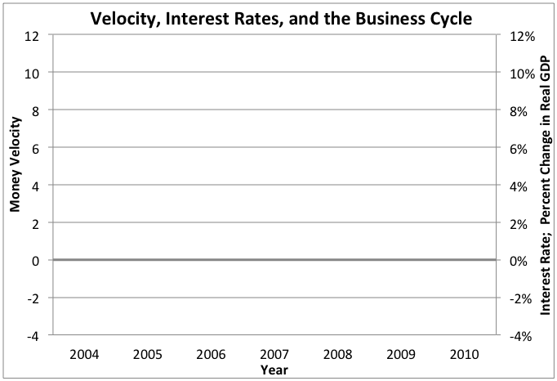
Money Velocity
4) MONEY VELOCITY IN THE UNITED STATES
Year | Nominal GDP | M1 | M2 | M1 Velocity | M2 Velocity
2004 | $12,275 | $1,344 | $6,236
2005 | $13,094 | $1,372 | $6,505
2006 | $13,856 | $1,375 | $6,847
2007 | $14,478 | $1,373 | $7,269
2008 | $14,719 | $1,435 | $7,766
2009 | $14,419 | $1,638 | $8,393
2010 | $14,964 | $1,742 | $8,602
A) Complete the table by calculating “M1 Velocity” and “M2 Velocity.”
V = (Nominal GDP) / M
B) Graph “M1 Velocity” and “M2 Velocity” on the chart.
1) Velocity of
Money Equation
2) Quantity
Equation
3) Real Money
Demand Equation
Show Answers
5) Velocity and
Interest Rates
6) Velocity and the
Business Cycle

Slide 87
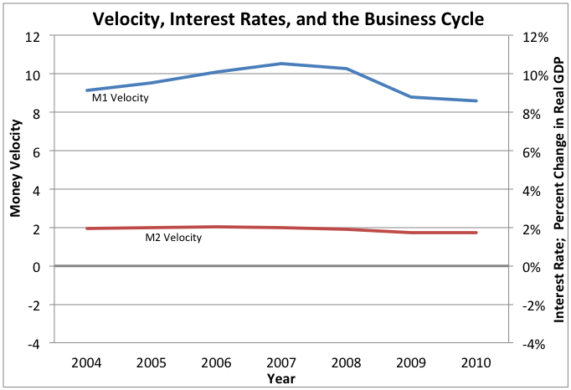
Money Velocity
4) MONEY VELOCITY IN THE UNITED STATES
Year | Nominal GDP | M1 | M2 | M1 Velocity | M2 Velocity
2004 | $12,275 | $1,344 | $6,236
2005 | $13,094 | $1,372 | $6,505
2006 | $13,856 | $1,375 | $6,847
2007 | $14,478 | $1,373 | $7,269
2008 | $14,719 | $1,435 | $7,766
2009 | $14,419 | $1,638 | $8,393
2010 | $14,964 | $1,742 | $8,602
Year | Nominal GDP | M1 | M2 | M1 Velocity | M2 Velocity
2004 | $12,275 | $1,344 | $6,236 | 9.1 | 2.0
2005 | $13,094 | $1,372 | $6,505 | 9.5 | 2.0
2006 | $13,856 | $1,375 | $6,847 | 10.1 | 2.0
2007 | $14,478 | $1,373 | $7,269 | 10.5 | 2.0
2008 | $14,719 | $1,435 | $7,766 | 10.3 | 1.9
2009 | $14,419 | $1,638 | $8,393 | 8.8 | 1.7
2010 | $14,964 | $1,742 | $8,602 | 8.6 | 1.7
A) Complete the table by calculating “M1 Velocity” and “M2 Velocity.”
V = (Nominal GDP) / M
B) Graph “M1 Velocity” and “M2 Velocity” on the chart.
1) Velocity of
Money Equation
2) Quantity
Equation
3) Real Money
Demand Equation
4) Money Velocity
In the U.S.
5) Velocity and
Interest Rates
6) Velocity and the
Business Cycle

Slide 88
Money Velocity
5) VELOCITY AND INTEREST RATES
A) Graph “Fed Funds Rate” on the chart.
B) What relationship exists between changes in interest rates and changes in velocity?
C) Why does this relationship exist?
1) Velocity of
Money Equation
2) Quantity
Equation
3) Real Money
Demand Equation
4) Money Velocity
In the U.S.
Show Answers
6) Velocity and the
Business Cycle

Slide 89
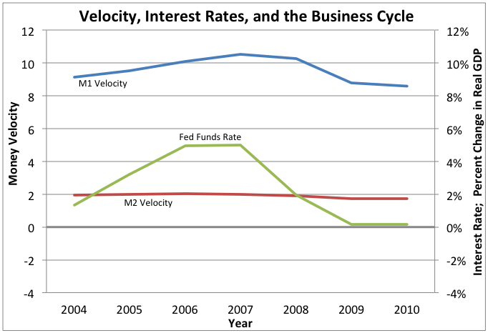
Money Velocity
5) VELOCITY AND INTEREST RATES
A) Graph “Fed Funds Rate” on the chart.
B) What relationship exists between changes in interest rates and changes in velocity?
C) Why does this relationship exist?
A) Graph “Fed Funds Rate” on the chart.
B) What relationship exists between changes in interest rates and changes in velocity?
They tend to move in the same direction (increase/increase or decrease/decrease).
C) Why does this relationship exist?
If interest rates rise, the opportunity cost of holding money also rises. This reduces the quantity of money demanded. Less money is used but nominal GDP will be the same as before, so velocity must also rise. (The reverse is also true.)
1) Velocity of
Money Equation
2) Quantity
Equation
3) Real Money
Demand Equation
4) Money Velocity
In the U.S.
5) Velocity and
Interest Rates
6) Velocity and the
Business Cycle

Slide 90
Money Velocity
6) VELOCITY AND THE BUSINESS CYCLE
A) Graph “% Change in Real GDP” on the chart.
B) What relationship exists between changes in real GDP and changes in velocity?
C) Why does this relationship exist?
1) Velocity of
Money Equation
2) Quantity
Equation
3) Real Money
Demand Equation
4) Money Velocity
In the U.S.
5) Velocity and
Interest Rates
Show Answers

Slide 91
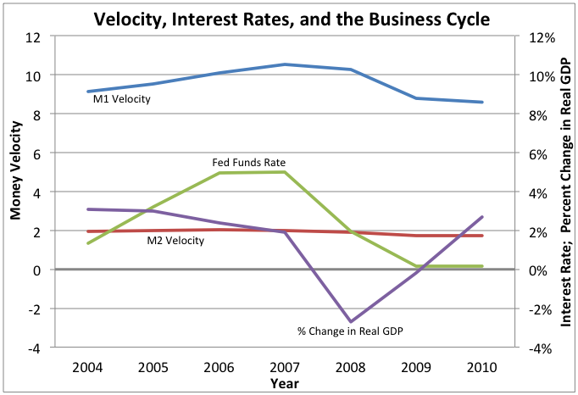
Money Velocity
6) VELOCITY AND THE BUSINESS CYCLE
A) Graph “% Change in Real GDP” on the chart.
B) What relationship exists between changes in real GDP and changes in velocity?
C) Why does this relationship exist?
A) Graph “% Change in Real GDP” on the chart.
B) What relationship exists between changes in real GDP and changes in velocity?
They tend to move in the same direction (increase/increase or decrease/decrease).
C) Why does this relationship exist?
During expansions, consumer confidence is usually high. This leads to more spending and an increase in velocity. During recessions, consumer confidence is usually low. This leads to less spending and a decrease in velocity.
1) Velocity of
Money Equation
2) Quantity
Equation
3) Real Money
Demand Equation
4) Money Velocity
In the U.S.
5) Velocity and
Interest Rates
6) Velocity and the
Business Cycle

Slide 92
Resources
Warm Up Activity
https://openclipart.org/detail/635/independence-hall-by-johnny_automatic - Independence Hall
Slideshow
http://economics.about.com/cs/money/a/money_demand_2.htm - Factors that cause real money demand to change
http://commons.wikimedia.org/wiki/File:Cash-in_machine_(CDM)_of_ABA_Bank.jpg - Image of ATM
http://commons.wikimedia.org/wiki/File:CanadianChequeSample.png - Image of a sample check
http://en.wikipedia.org/wiki/Leeds_city_centre#mediaviewer/File:King-edward-street-leeds.jpg - Image of Christmas shopping
http://commons.wikimedia.org/wiki/File:Exchange_rates_display.jpg - Image of exchange rates
https://openclipart.org/detail/386/man-face-cartoon-by-gerald_g - Image of cartoon man
https://openclipart.org/detail/9151/fast-food-drinks-soda-fountain-by-gerald_g - Image of soda
http://research.stlouisfed.org/fred2/series/M1V# - Data on historical United States M1 money velocity
http://www.nber.org/cycles/cyclesmain.html - Data on dates of United States recessions and expansions
Class Activity
http://www.federalreserve.gov/boarddocs/press/monetary/2004/20040921/default.htm - Federal Reserve press release September 21, 2004
http://www.federalreserve.gov/newsevents/press/monetary/20081029a.htm - Federal Reserve press release October, 29, 2008
Homework
http://research.stlouisfed.org/fred2/ - Data for percent change in real GDP, M1, M2, M1 Velocity, M2 Velocity, and Fed Funds Rate

