Slide 1

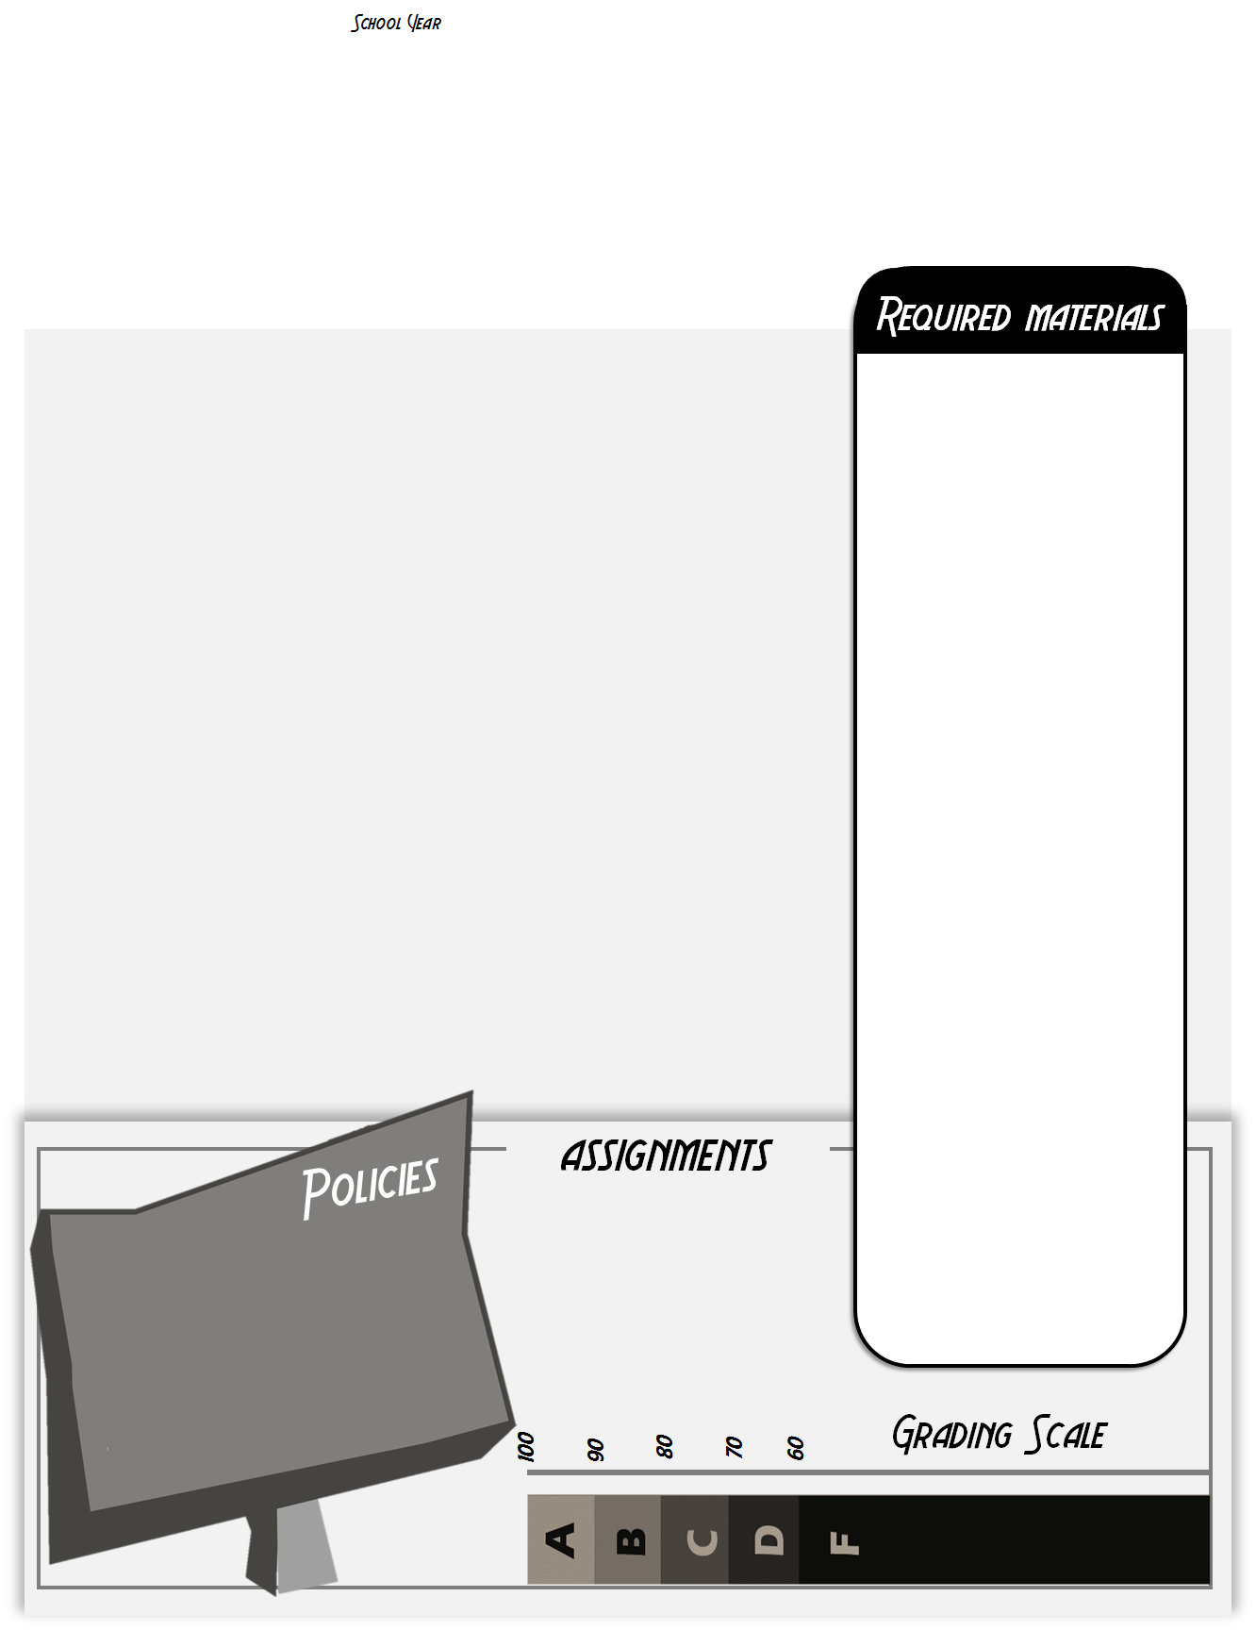

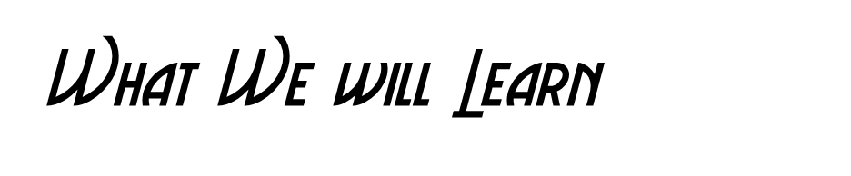
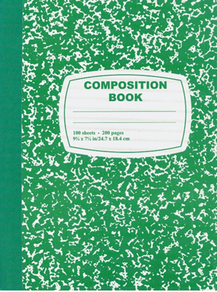
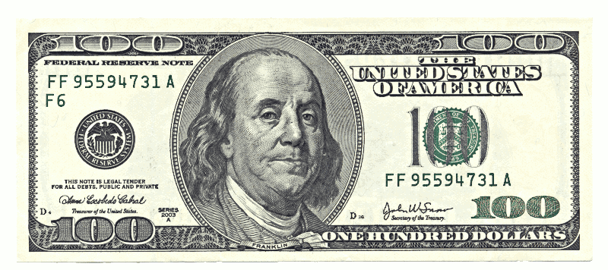

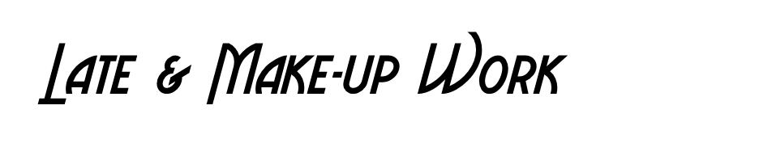

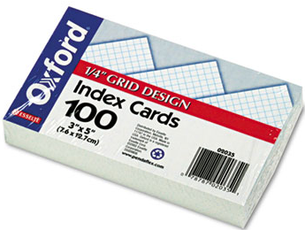

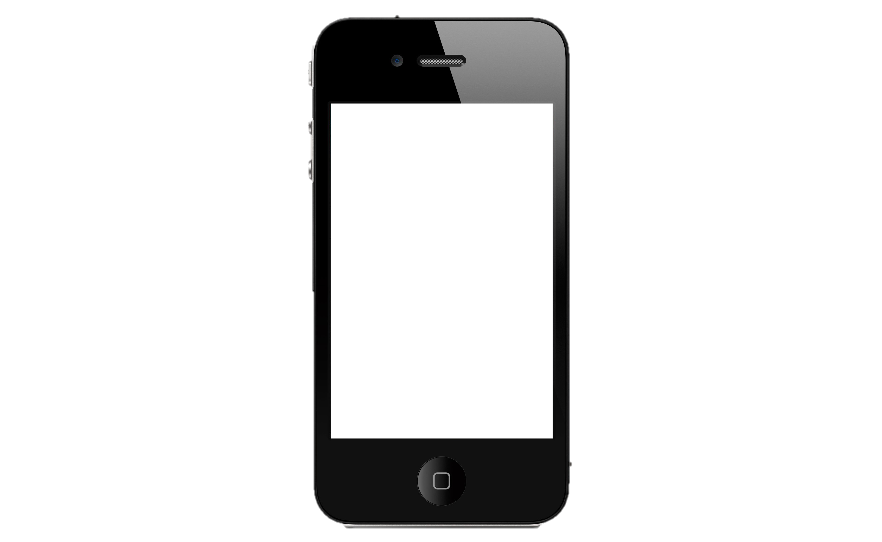
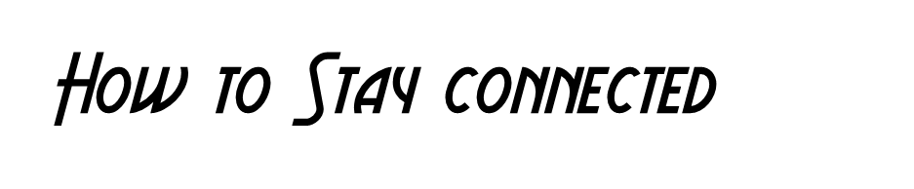


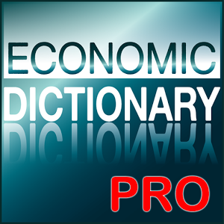

School Year 2016-2017
Mrs. Nelson
Website: www.nelsonecon.weebly.com email: crystal.nelson@polk-fl.net
This course will provide a greater understanding of economics ranging from the viewpoint of the individual consumer or small business owner to the global economy. The course will study the law of supply and demand, forms of business, labor unions, government finances and influence on the economy, money and prices, inflation and deflation cycles. The course relates history and politics to the study of economics.
A Composition Notebook for bellwork.
A folder of your choice to store all classwork and homework.
I reserves the right to deal with specific late work and make-up work issues on a case by case basis. The general rules that will apply are as follows:
If you are absent, it is YOUR responsibility to get your make-up work & bellwork you missed which can be found on my teacher webpage (www.nelsonecon.weebly.com) and in the make-up work folder.
You have 2 days to make up the work or else it will be considered late.
Late assignments will be deducted 50%
Late work will be accepted until the end of each quarter.
1 pack of index cards.
MY PLEDGE TO YOU
I will trust you until you give me reason to do otherwise.
I will respect you and work with you to solve problems.
I will promptly correct and offer feedback on your work.
I will work with you to meet learning goals.
I will offer extra help and alternative assessments should you require them.
Internet access will be a must for certain classwork assignments. A charged smartphone &/or iPad is also strong recommended to bring to class.
Email, crystal.nelson@polk-fl.net
Classroom website, here students can find all the assignments and PowerPoints.
You can also message me using SnapChat. @bhsnelson
Before and After School.
If you have a smartphone please download these free apps
No phones during lecture
No cheating
Be on task
Respect everyone
50
40
There will be more apps that you will need to download later

